Slide 1
Machine Learning crash course
(Part-3)
Ahmed Hammad
Ensemble learning, decision tree, random
forest and boosted decision trees

Slide 2
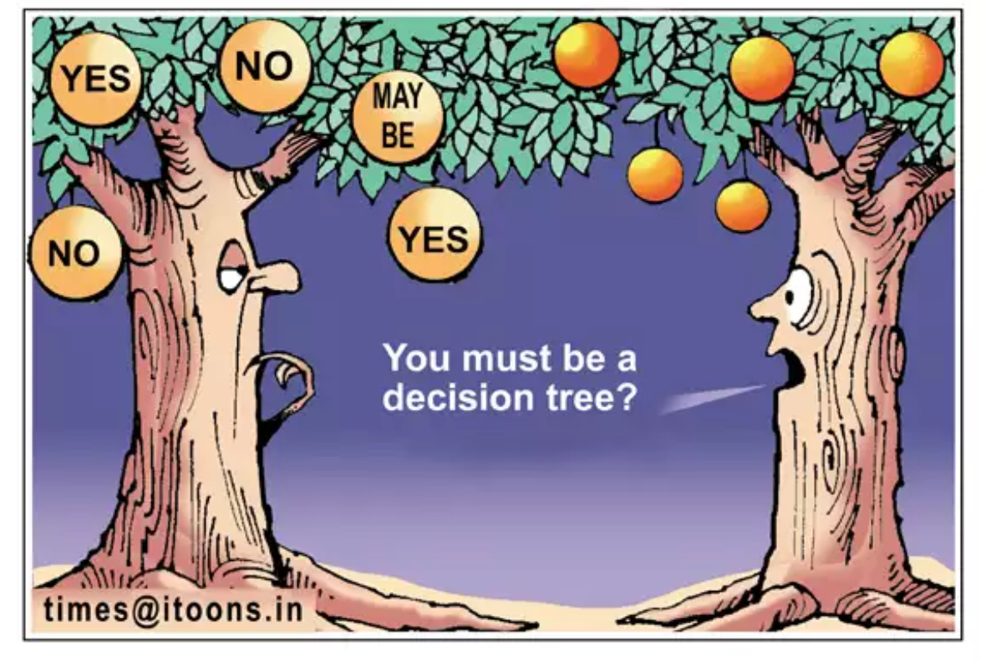
Decision Tree
Why do we need the decision tree over the normal one?

Slide 3
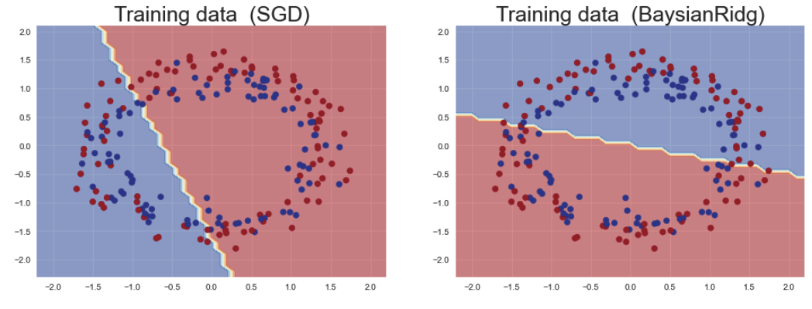
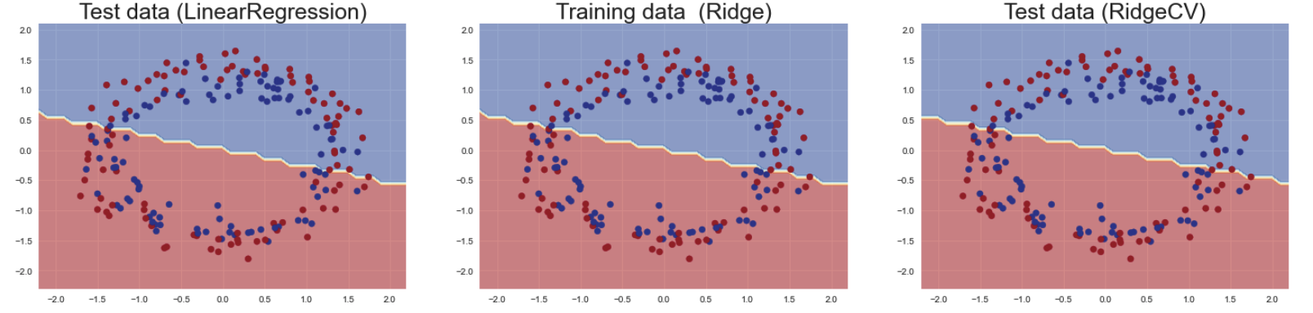
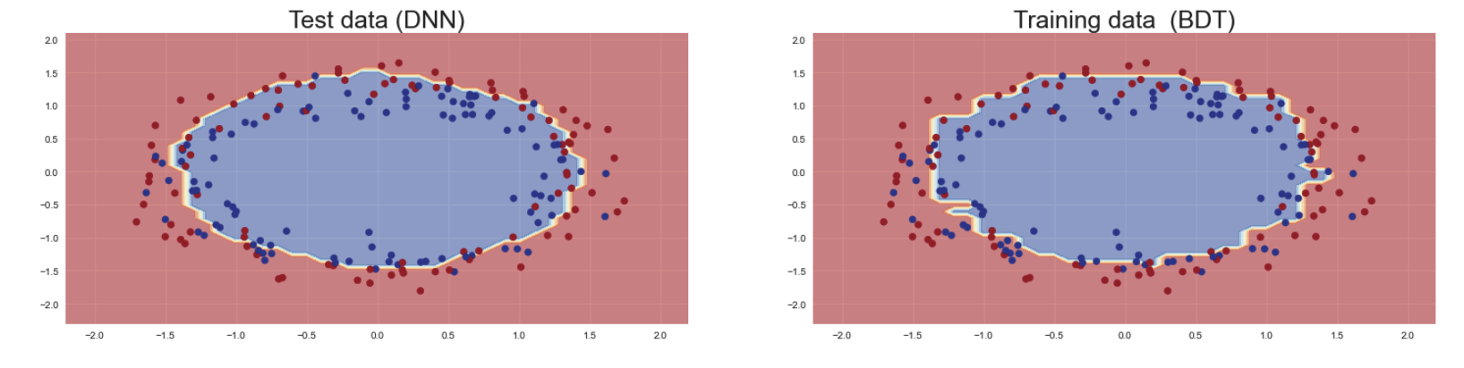
Decision Tree
For non-linear data, more complex machine learning model is needed

Slide 4
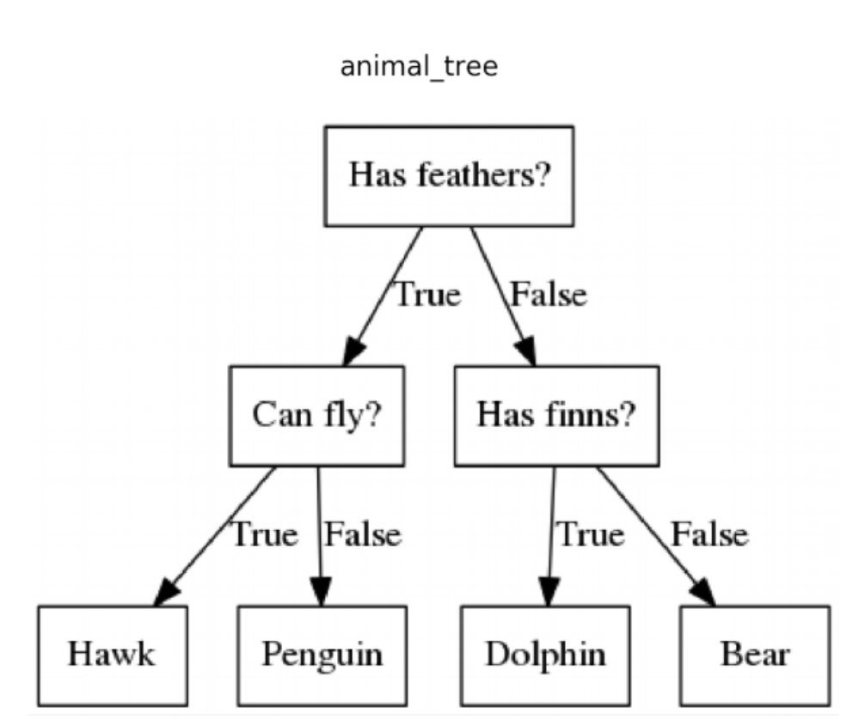
Decision Tree

Slide 5
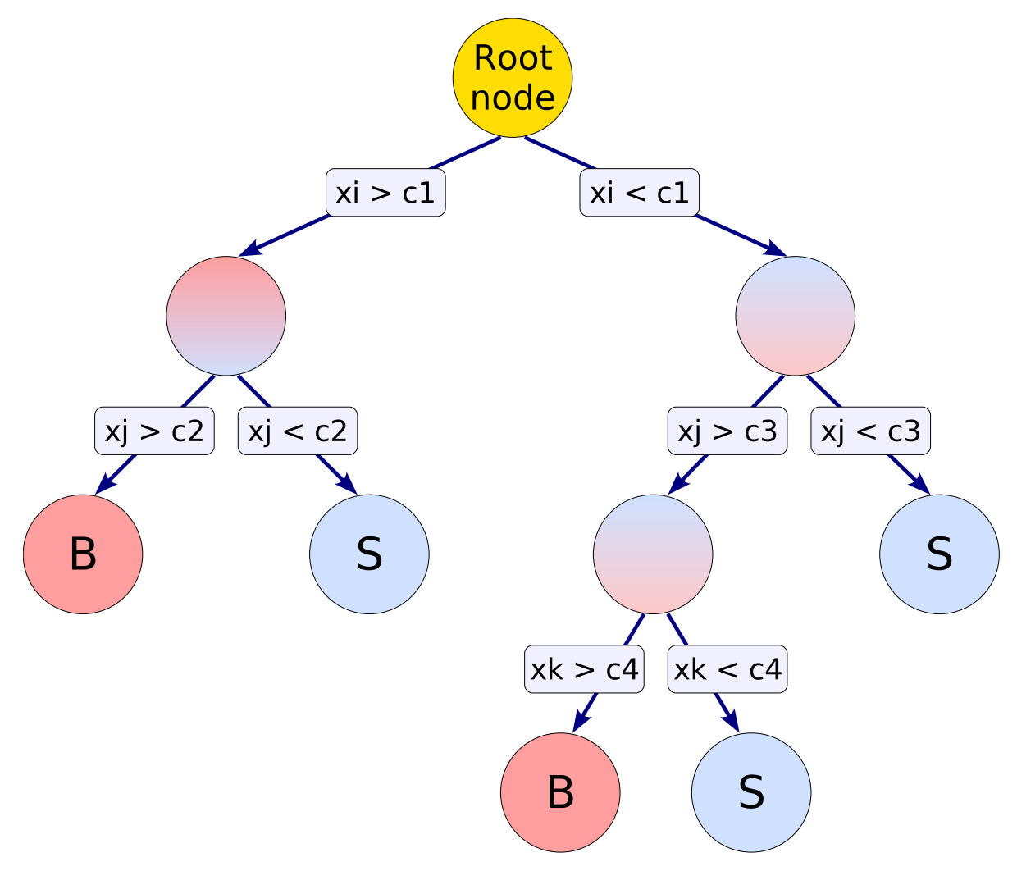
Decision Tree
Constructing a decision (Regression) Tree as :
1- A root node is created from the sample events
2- The algorithm finds the optimal threshold that gives the
best separation between signal and background by calculating the
Loss function
3- Once the threshold has been found, the node split into two branches
4- For the branches that are not mostly signal or background (impure)
the algorithm consider them as new nodes and splits them again.
5- Continue splitting the impure branches until we hit leafs with minimum impurity

Slide 6
Decision Tree
Two questions we need to ask:
1- When do we have to split the node
2- when do we have to stop the splitting

Slide 7
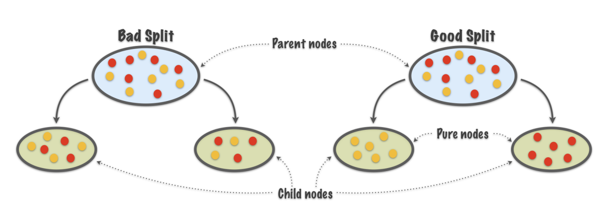
Splitting criteria
Purity (P) = S / (S+B)
P != 0/1
P=0
P=1
Split the tree nodes to maximize the purity in each node
over the splitter node

Slide 8

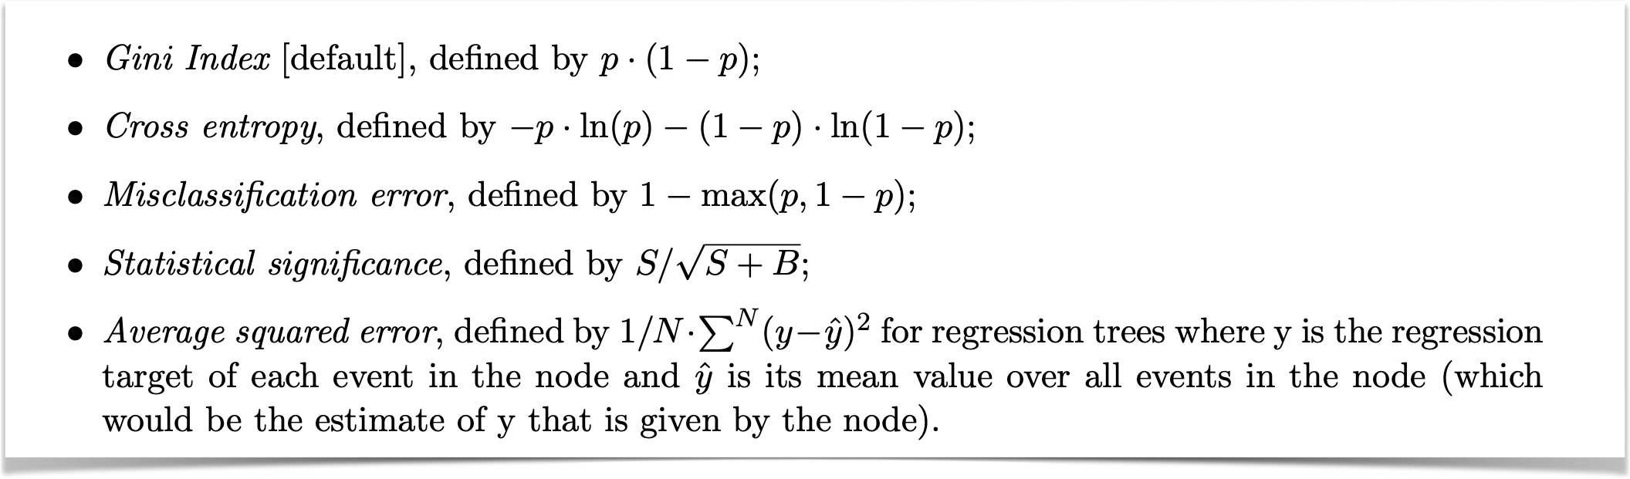
Splitting criteria
Q1: what is the criteria to split the impure nodes ??
Minimize the Loss function and maximize purity

Slide 9
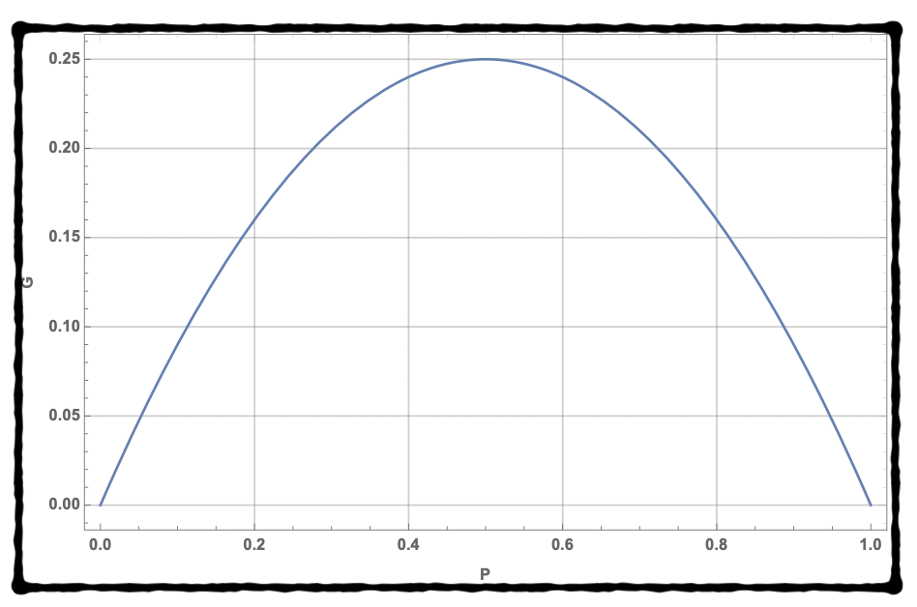


Splitting criteria
Minimize the Gini index with purity > 0.5 or < 0.5
leads two branch with mostly signal like events or background like events

Slide 10
Splitting criteria
Q2: what is the criteria to stop split the impure nodes ??
Well, in principle we can continue splitting our impure nodes till all events are classified into pure leafs

Slide 11

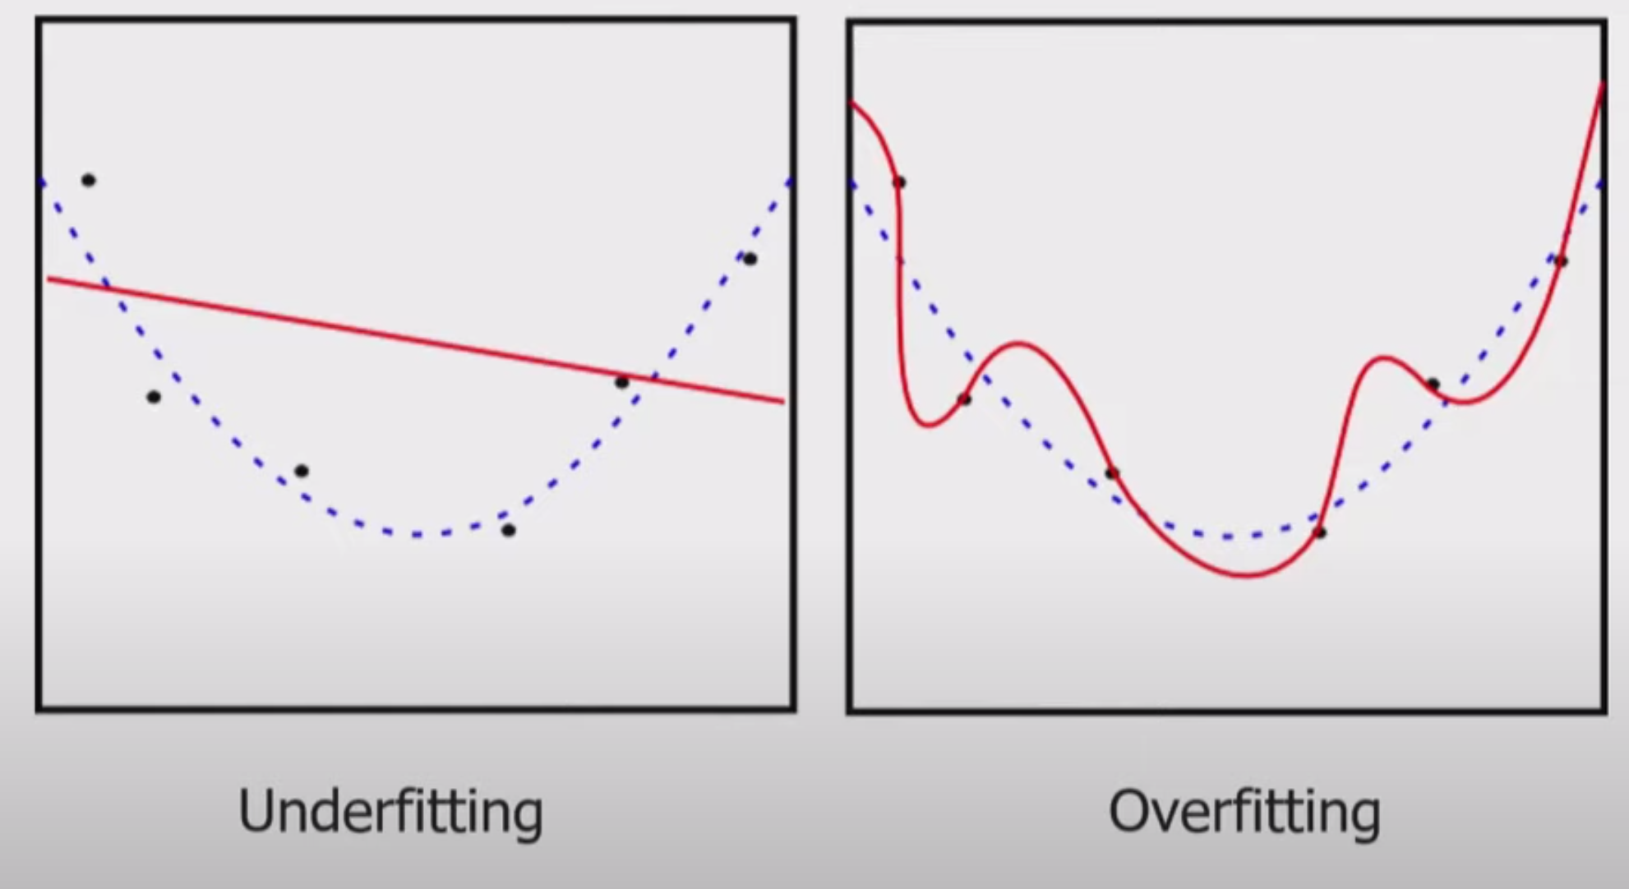

Splitting criteria
Q2: what is the criteria to stop split the impure nodes ??
Well, in principle we can continue splitting our impure nodes till all events are classified into pure leafs
Over fitting:
When you over train your model it starts to learn about the noise into the data. Accordingly when you apply it test unknown data it gives wrong answers

Slide 12
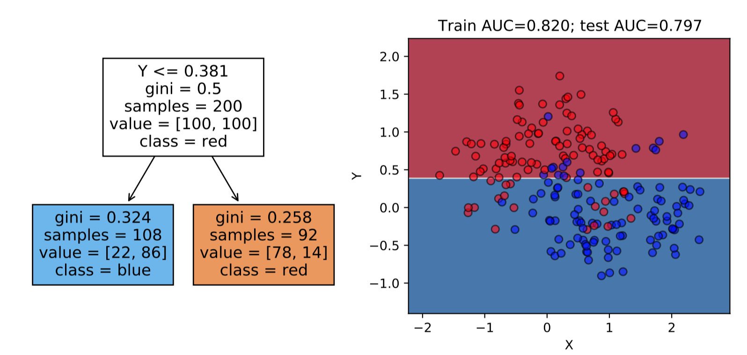
Example

Slide 13
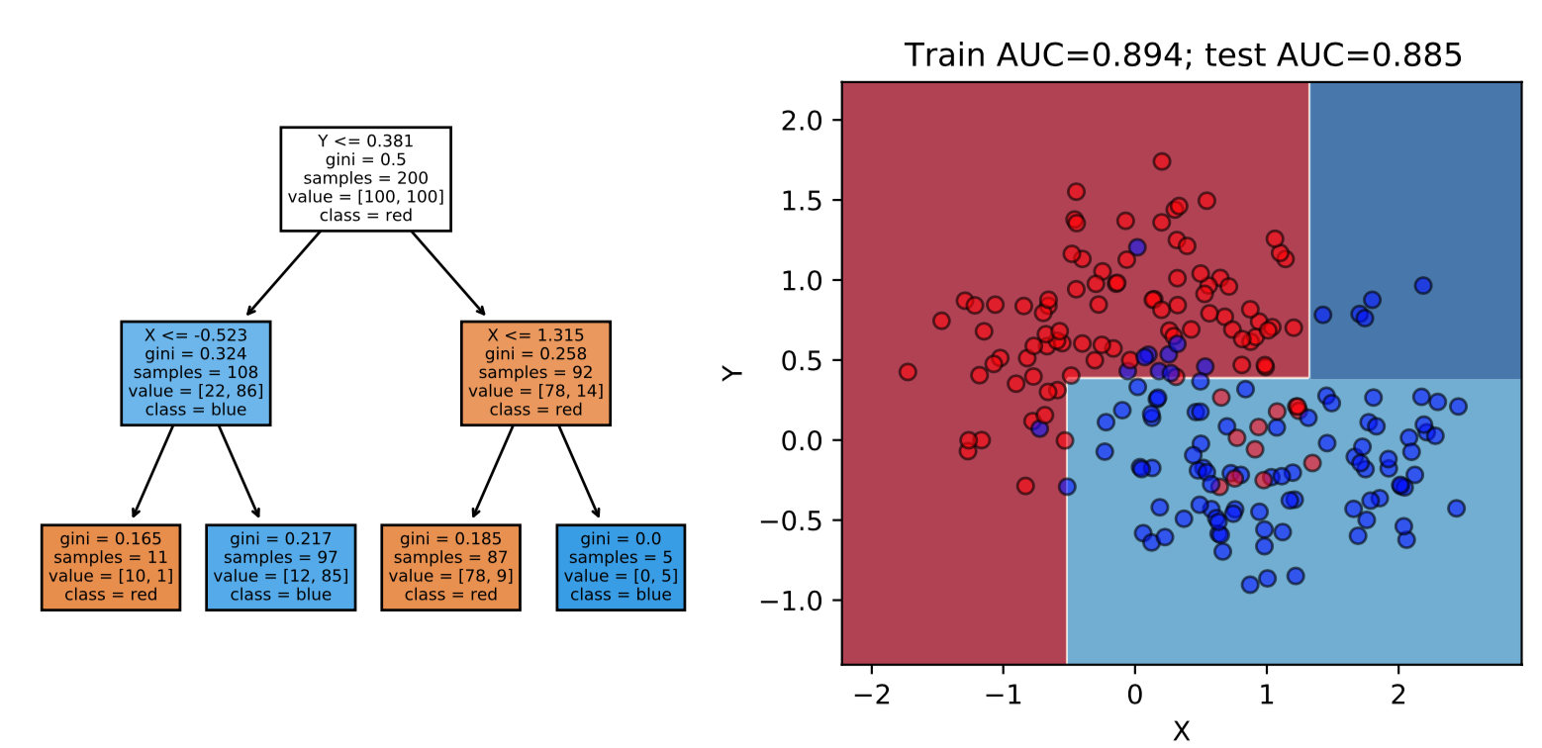
Example

Slide 14
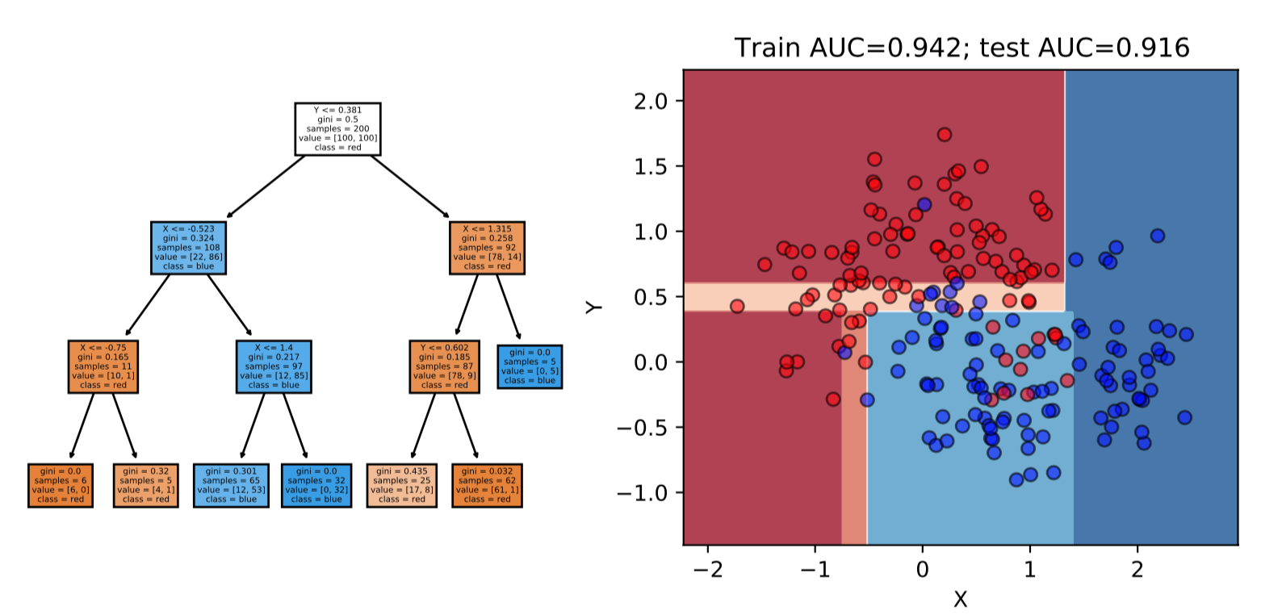
Example

Slide 15
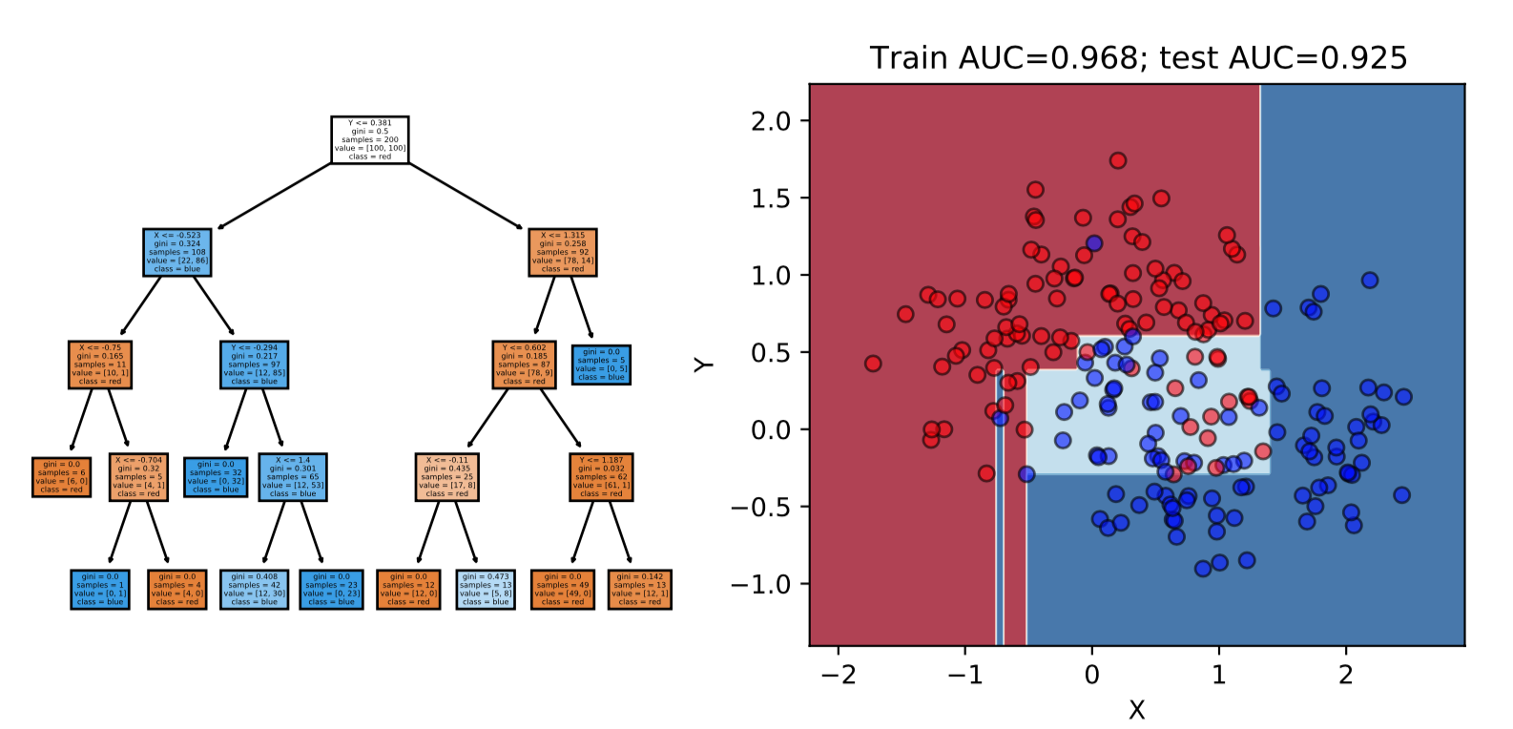
Example

Slide 16
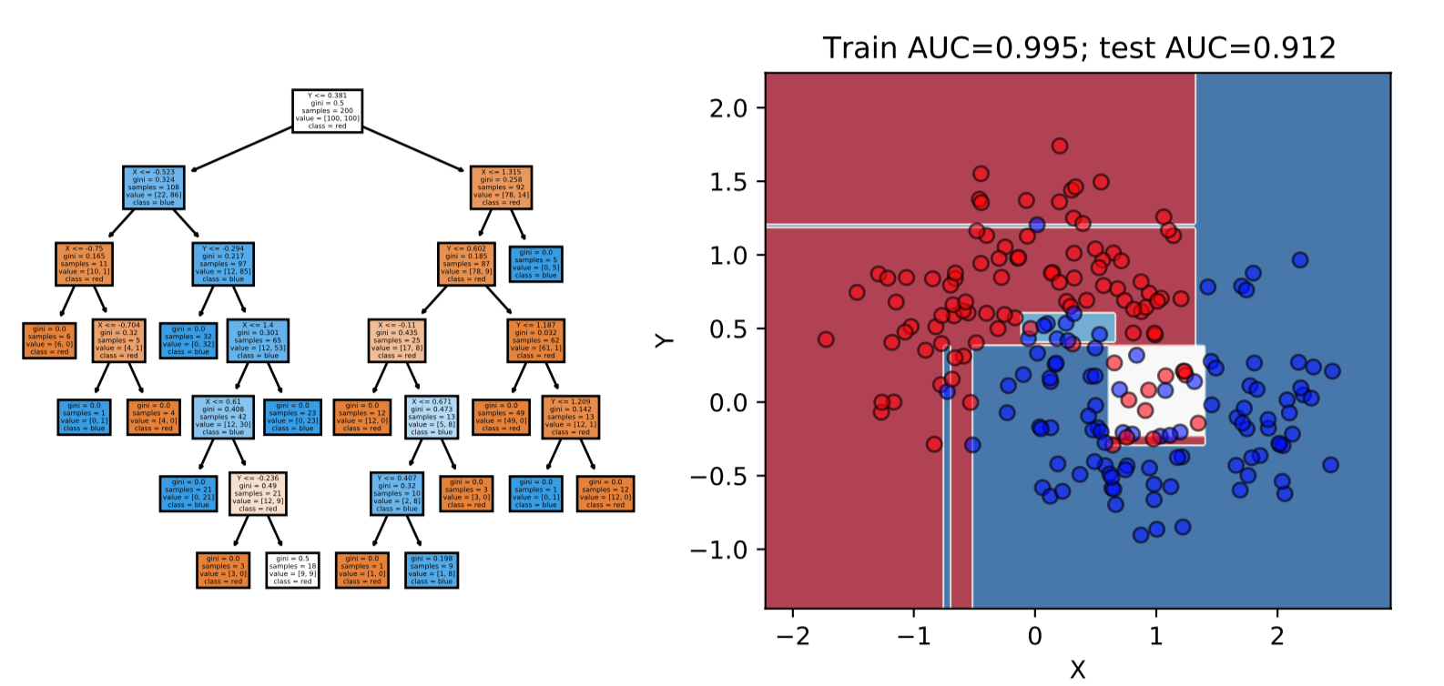
Example

Slide 17
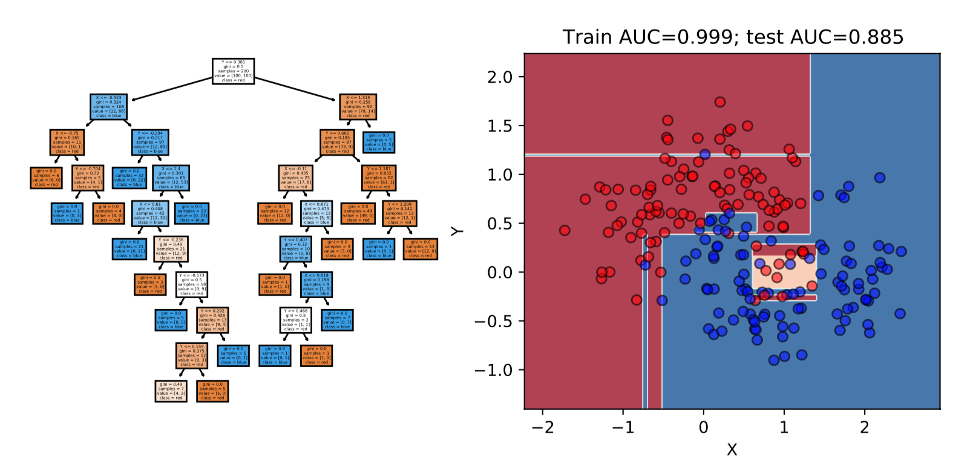
Example

Slide 18
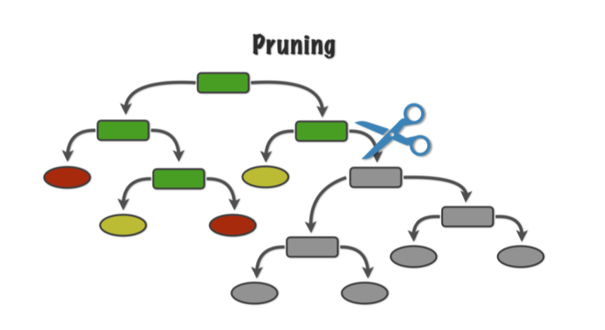
Decision Tree
Two ways to control the Decision tree depth :
1- Pruning the statistically insignificant nodes
2- Optimize the tree depth as a hyper-parameter
Decision tree can always reach a 100% accuracy, but with two main problems:
1- Infinite time for very large data
2- Overfitting for high uncertain data

Slide 19
Ensemble Learning
Ensemble learning
Boosted decision Trees &. Random forest

Slide 20
Ensemble learning

Slide 21

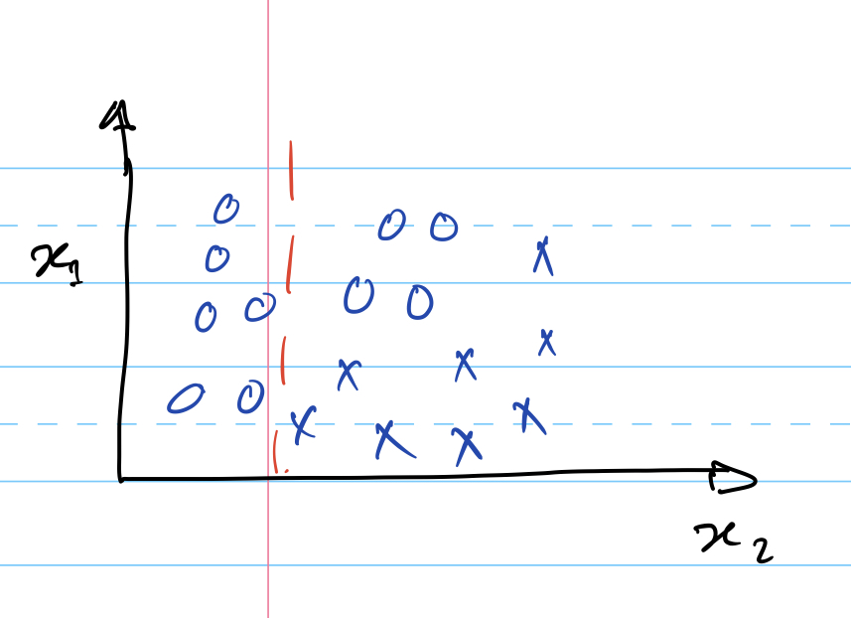
Boosted decision trees
Boosting is a method of combining many weak learners (trees) into a strong classifier.
Start with a decision Tree

Slide 22
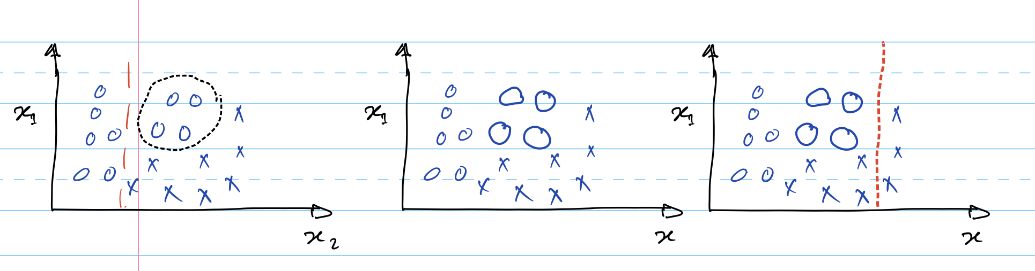
Boosted decision trees
Boosting is a method of combining many weak learners (trees) into a strong classifier.
Start with a decision Tree
Boost the classification boundaries for
first tree

Slide 23

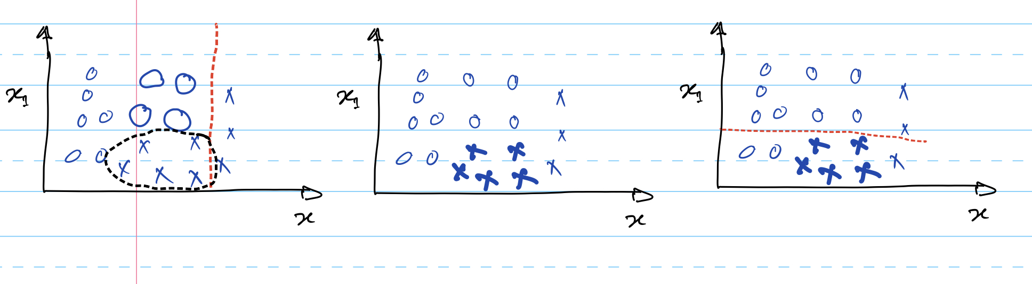
Boosted decision trees
Boost the purity in
trees nodes sequentially
Final classifier is obtained by summing weak learners

Slide 24
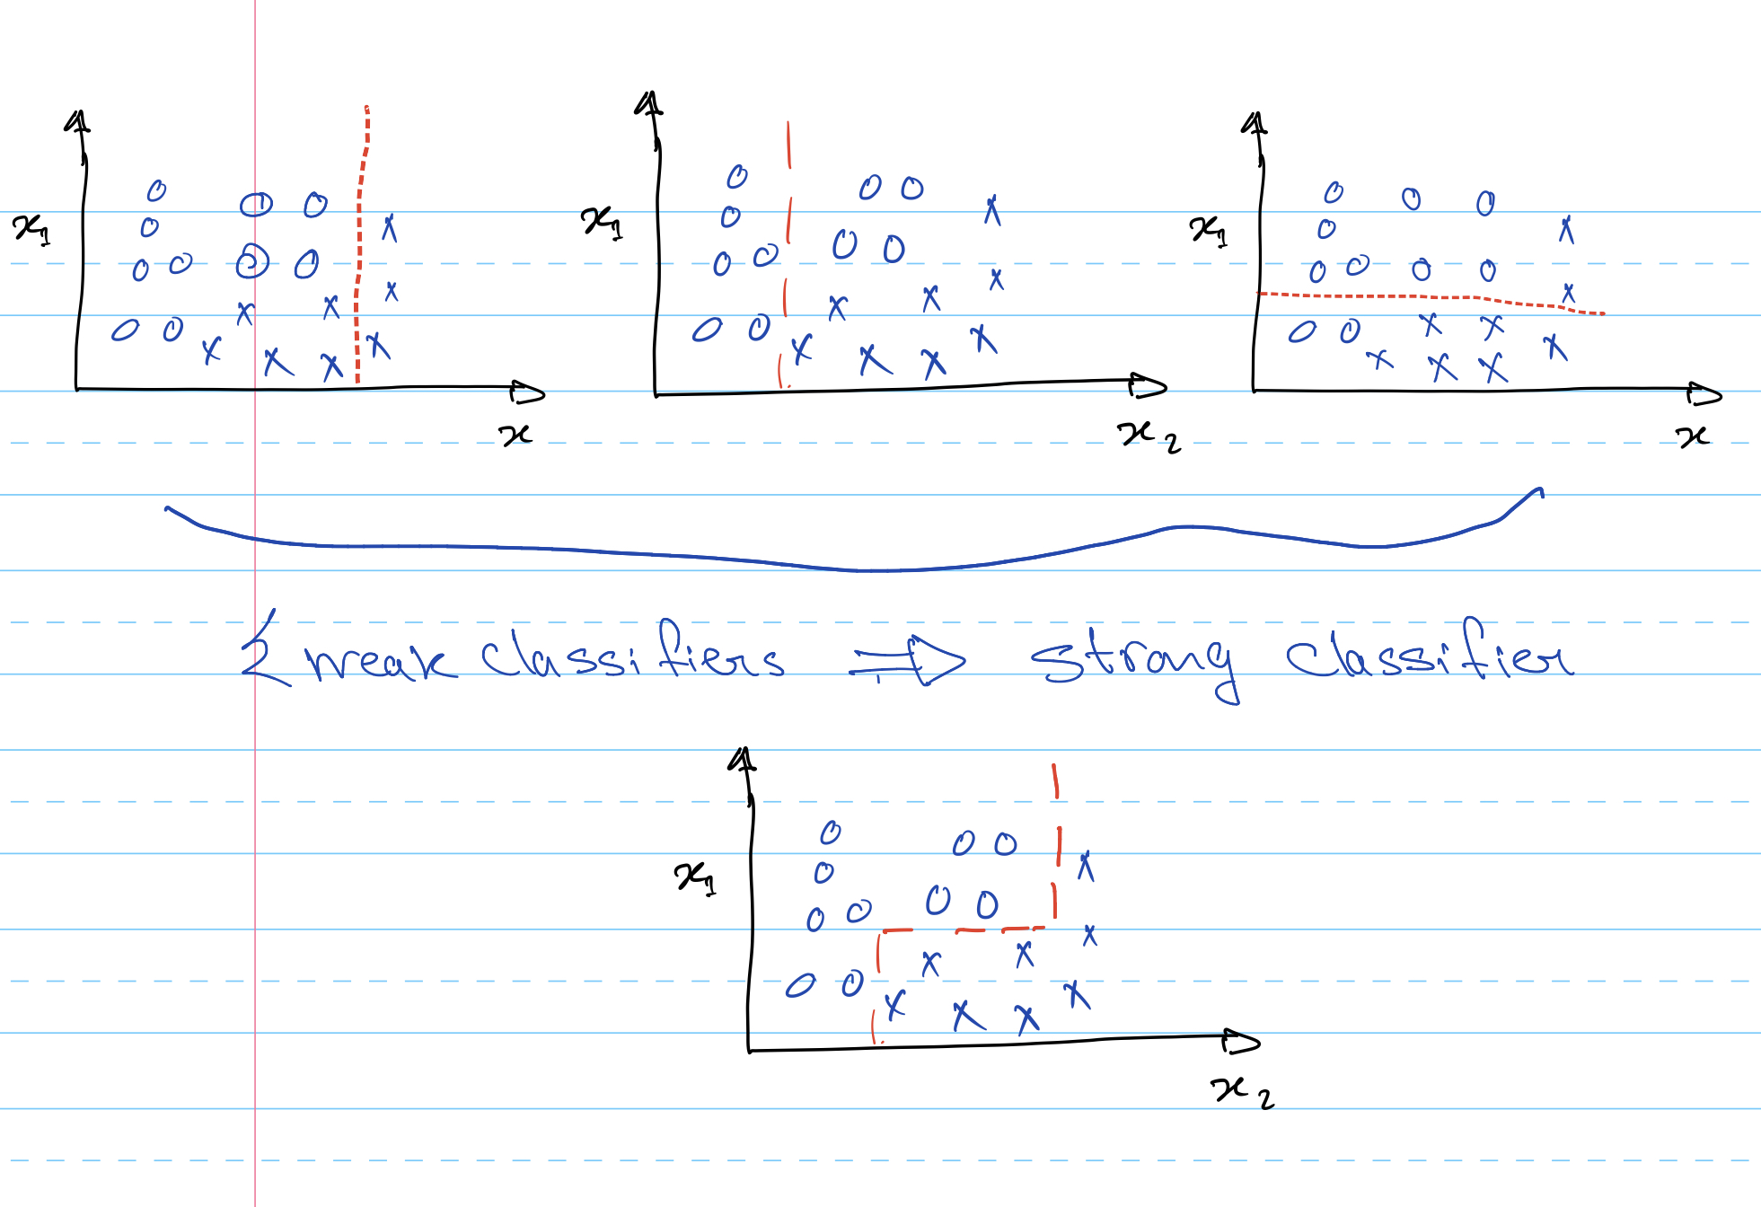
Boosted decision trees

Slide 25
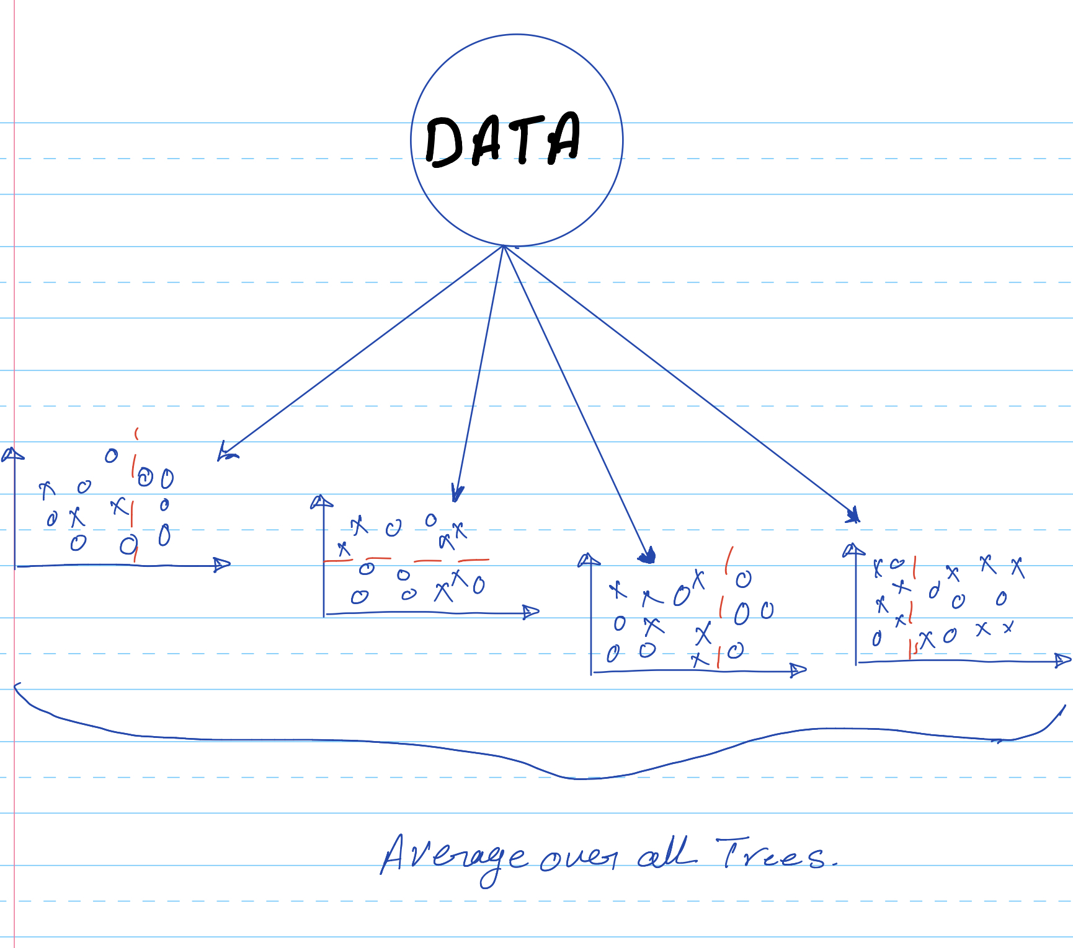
Random forest
Bagging: Bootstrap+aggregation

Slide 26
Random forest

Slide 27
Ensemble learning
http://jimeladu9.leofile.ru.net/jele_463403_gradient-boosted-decision-trees-tutorial.php

Slide 28
Ensemble learning
Boosted decision Trees
Random forest
High classification accuracy
Yes
No
Statistical stability
No
Yes
Easy overfitting
Yes
No
Time consuming
Yes
No

Slide 29
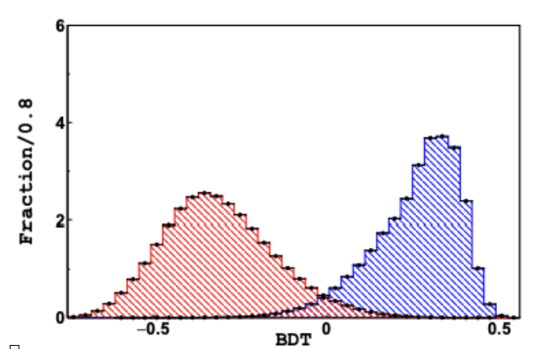

Model evaluation
Model output
Classifier
threshold
Class-B
Class-A
True Negative
True Positive
False Negative
False Positive

Slide 30
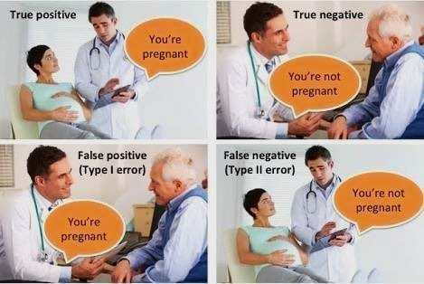
Model evaluation

Slide 31
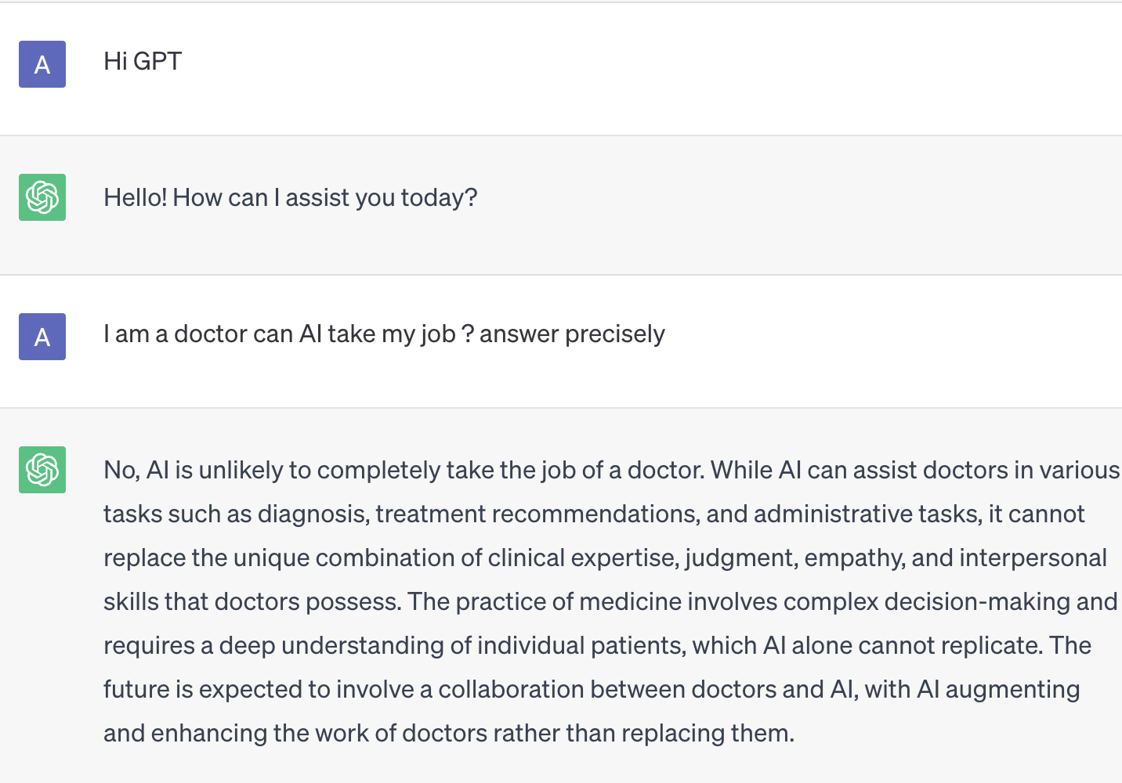
Model evaluation
ChatGPT confirms this will not
be the case in the future

Slide 32

Recursive Operating classifier curve
https://en.wikipedia.org/wiki/Receiver_operating_characteristic#/media/File:Roc_curve.svg
The area under the ROC curve
(AUC) quantifies the model
prediction performance
The larger AUC the larger model
classification accuracy

Slide 33
Evaluation classification metrics
Accuracy:
Quantify the model ability Of making
true prediction from both classes
Precision:
Quantify how good the model is at predicting a specific category
Recall:
Quantify how good the model is at detecting a specific category

Slide 34
Question
Assuming you are a data scientist who is responsible for airport flights analytics.
The airport authority told you that they suspect a terrorist will be on a flight
with 1000 other passengers. You asked to train a ML model to predict the terrorist.
What classification metric you are going to consider ?

Slide 35
To be continued…

