Slide 1
Machine Learning crash course
(Part-2)
Ahmed Hammad
Introduction to machine learning,
linear and non-linear regression models

Slide 2
Introduction to ML
Taken from
https://www.researchgate.net/figure/Relationship-between-artificial-intelligence-machine-learn
ing-neural-network-and-deep_fig3_354124420
Artificial intelligence
A program that can sense, act and adopt with the user
Machine learning
Algorithms whose performance improves as they are
expose to more data over time
Deep learning
A subset of machine learning algorithms in which the
algorithms learns deeply hidden features into the data

Slide 3
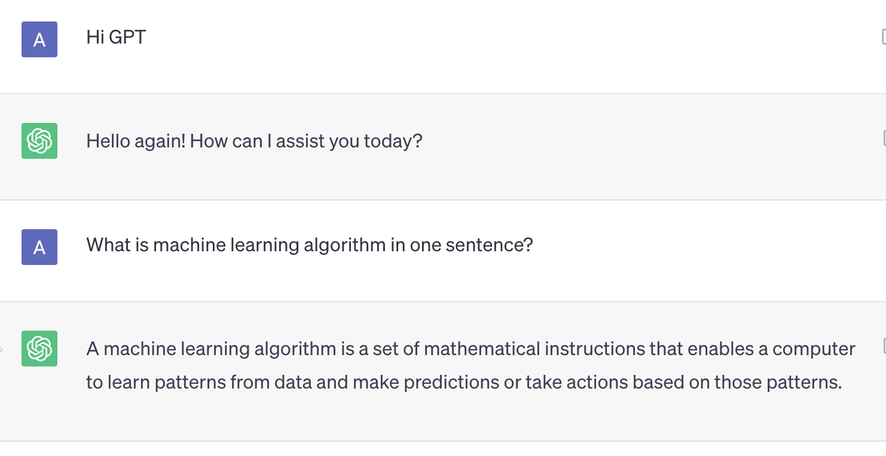
Introduction to ML
What is machine learning ?
Just remind you with ChatGPT answer

Slide 4
Introduction to ML
Machine Learning Algorithms consist of two main parts: Training and Test
Just like a baby in kindergarten
1+1=2
1+2=3
.
.
.
1+9=10
Learning
Test
2+5=?
?
Learning
Test

Slide 5

Introduction to ML
Machine Learning
Supervised Learning
Reinforcement Learning
Particle Physics Model Building with Reinforcemen arXiv:2103.04759
Semi-Supervised Learning
Un-Supervised Learning

Slide 6
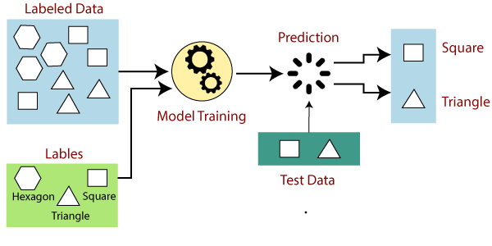
Supervised Learning
Modeling the relationship between measured features of data and some label associated with the data; once this model is determined, it can be used to apply labels to new, unknown data.

Slide 7


Supervised Learning
For the Supervised learning the complexity is how to train your model to find the best classifier for the given data
Modeling the relationship between measured features of data and some label associated with the data; once this model is determined, it can be used to apply labels to new, unknown data.

Slide 8
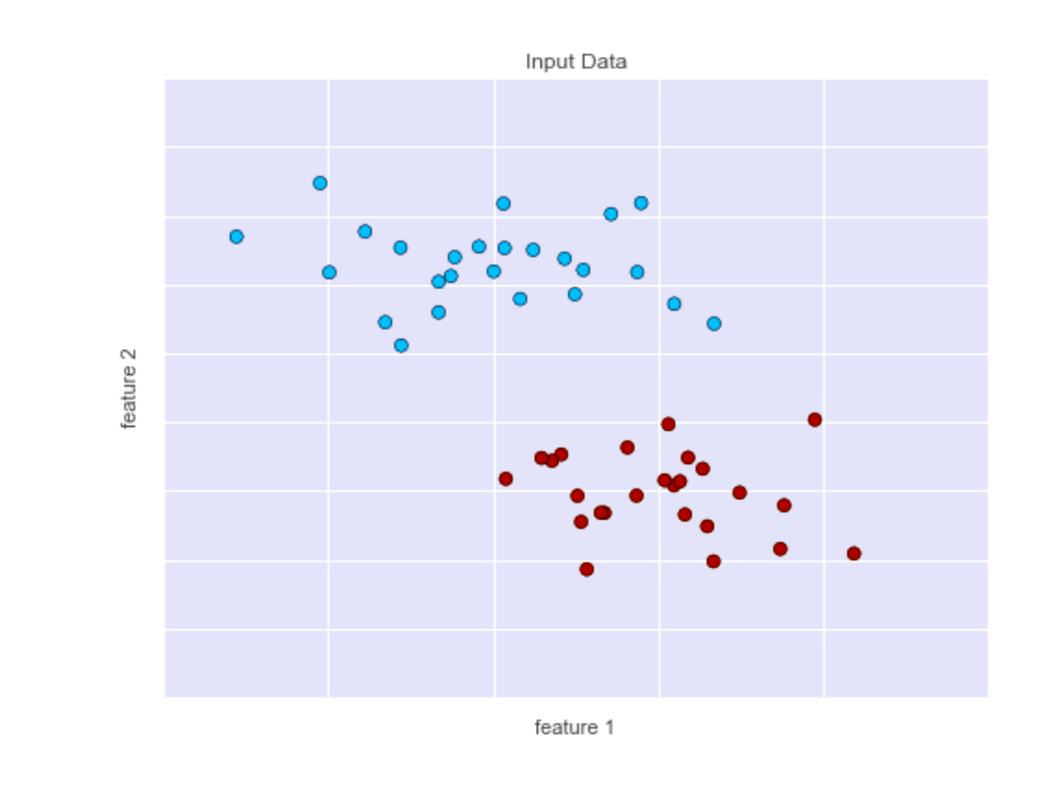
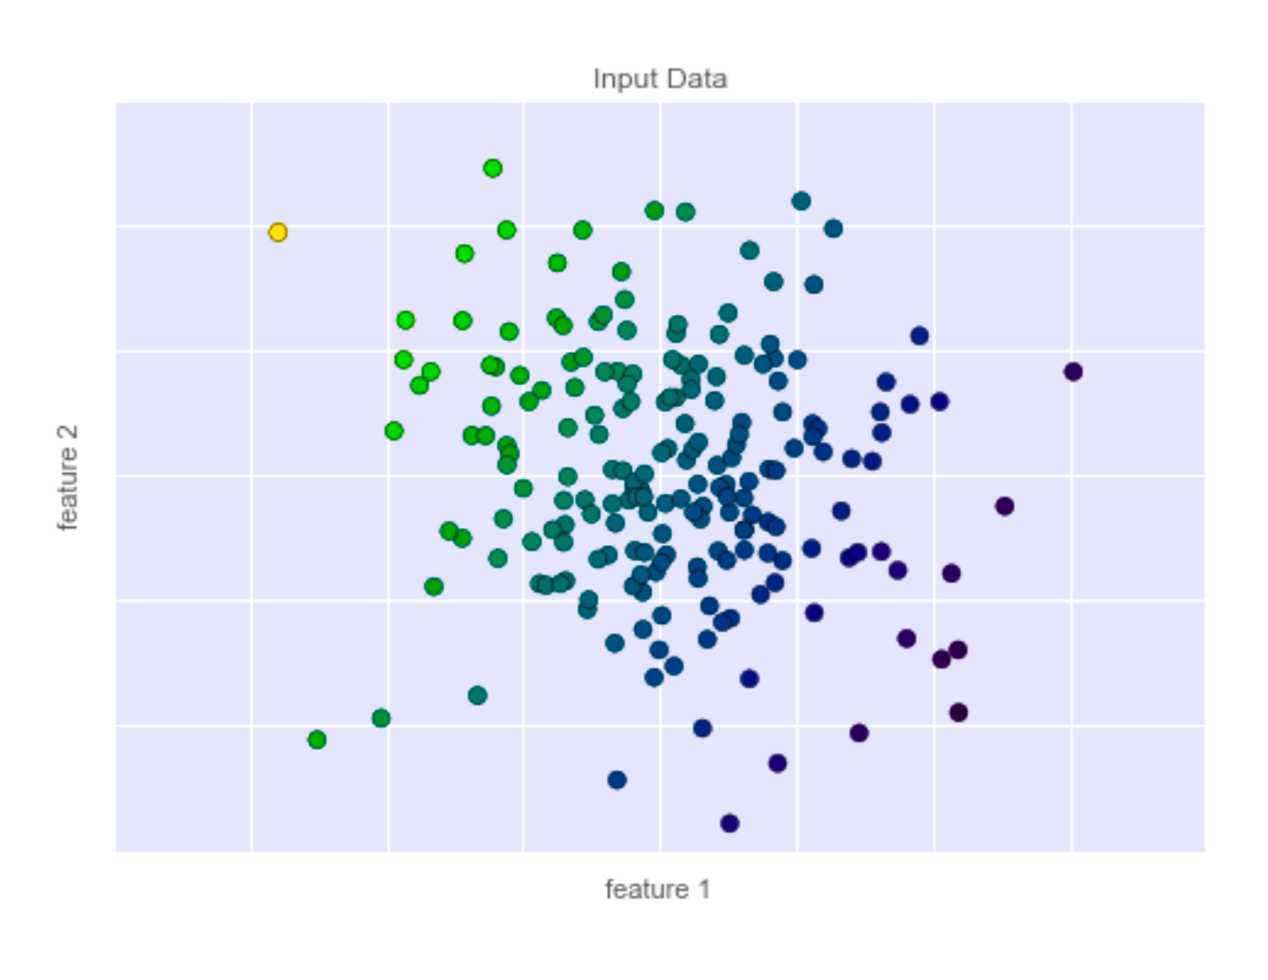
Supervised Learning
Classification : For Binary (colored) data set
Regression : For Continuous (colored) data set

Slide 9
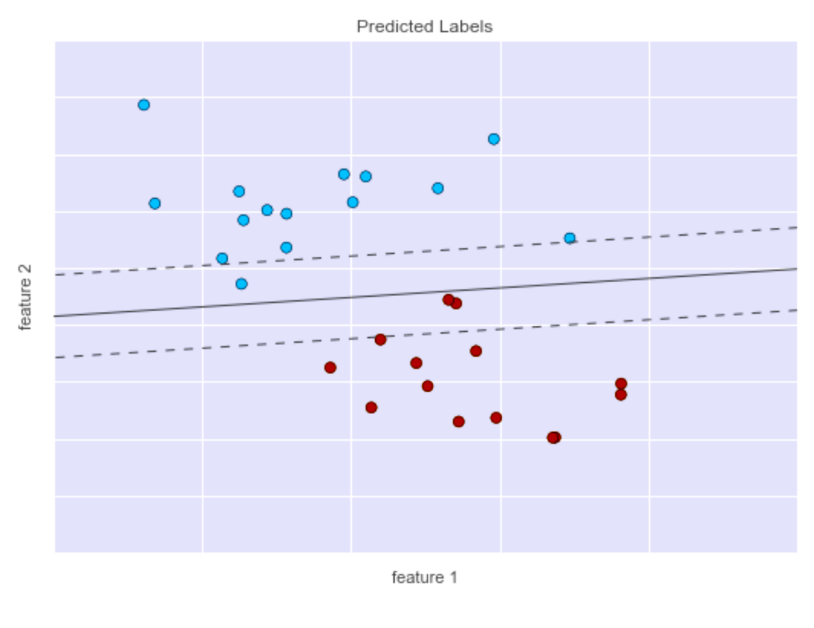
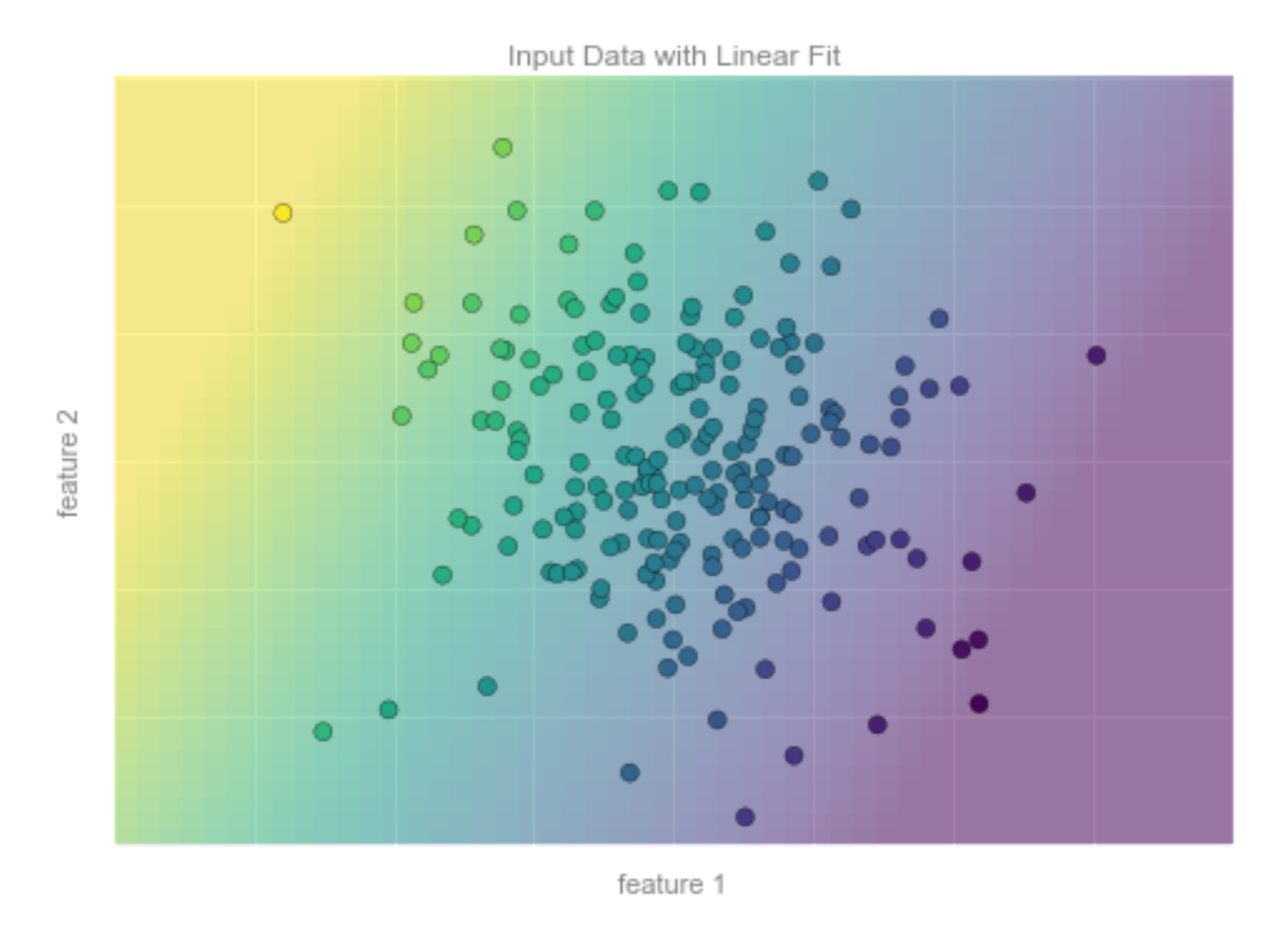
Supervised Learning
Blue points = 0
Linear classification
Red points =1
Classifier: continuous color spectrum

Slide 10
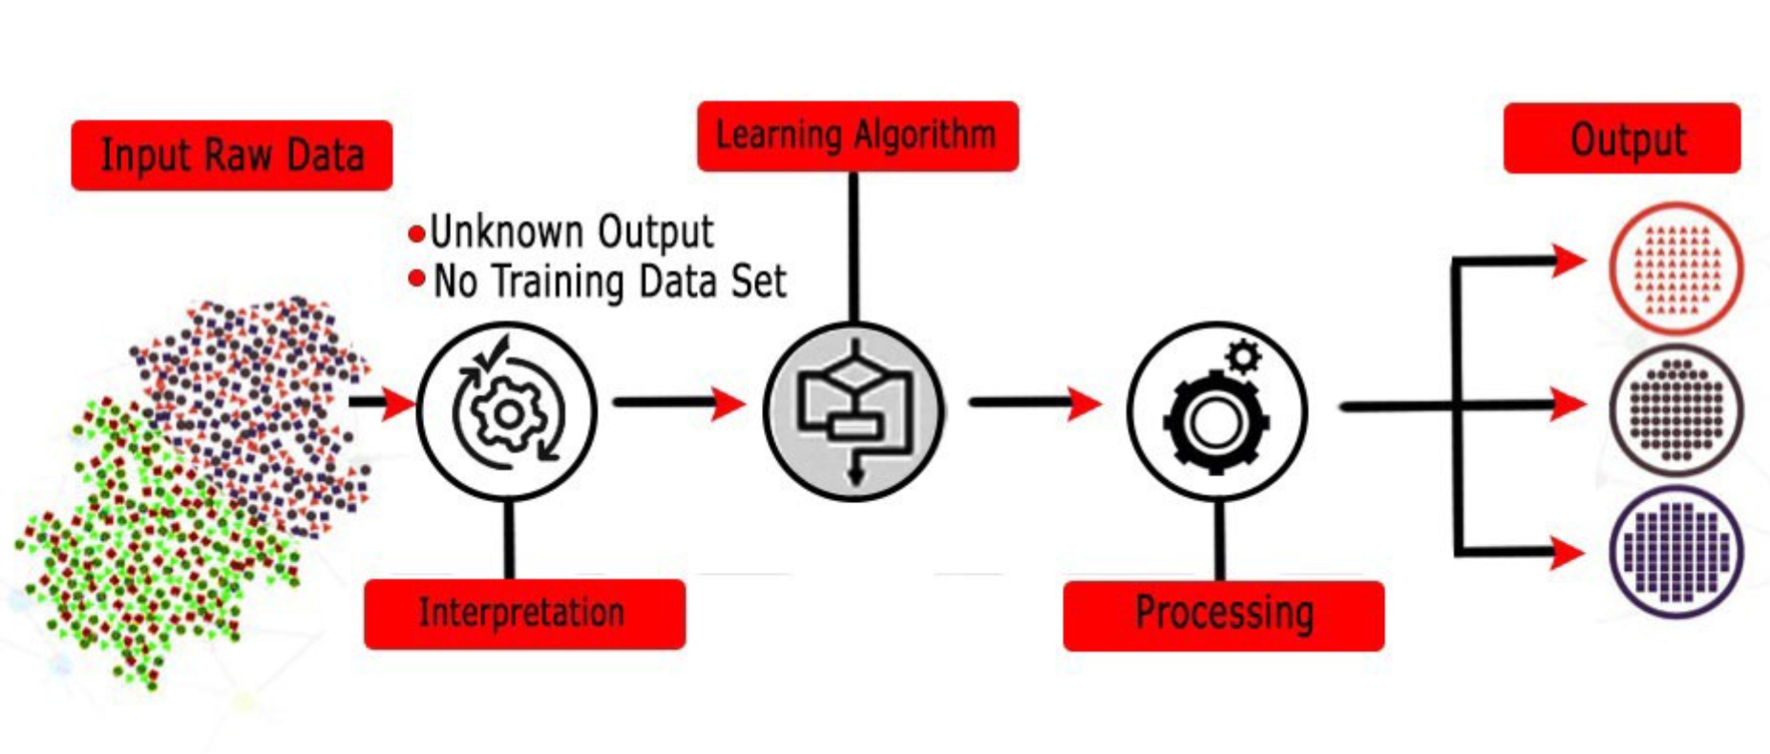
Unsupervised Learning
Modeling the features of a dataset without reference to any label, and is often described as “letting the dataset speaks for itself.”

Slide 11


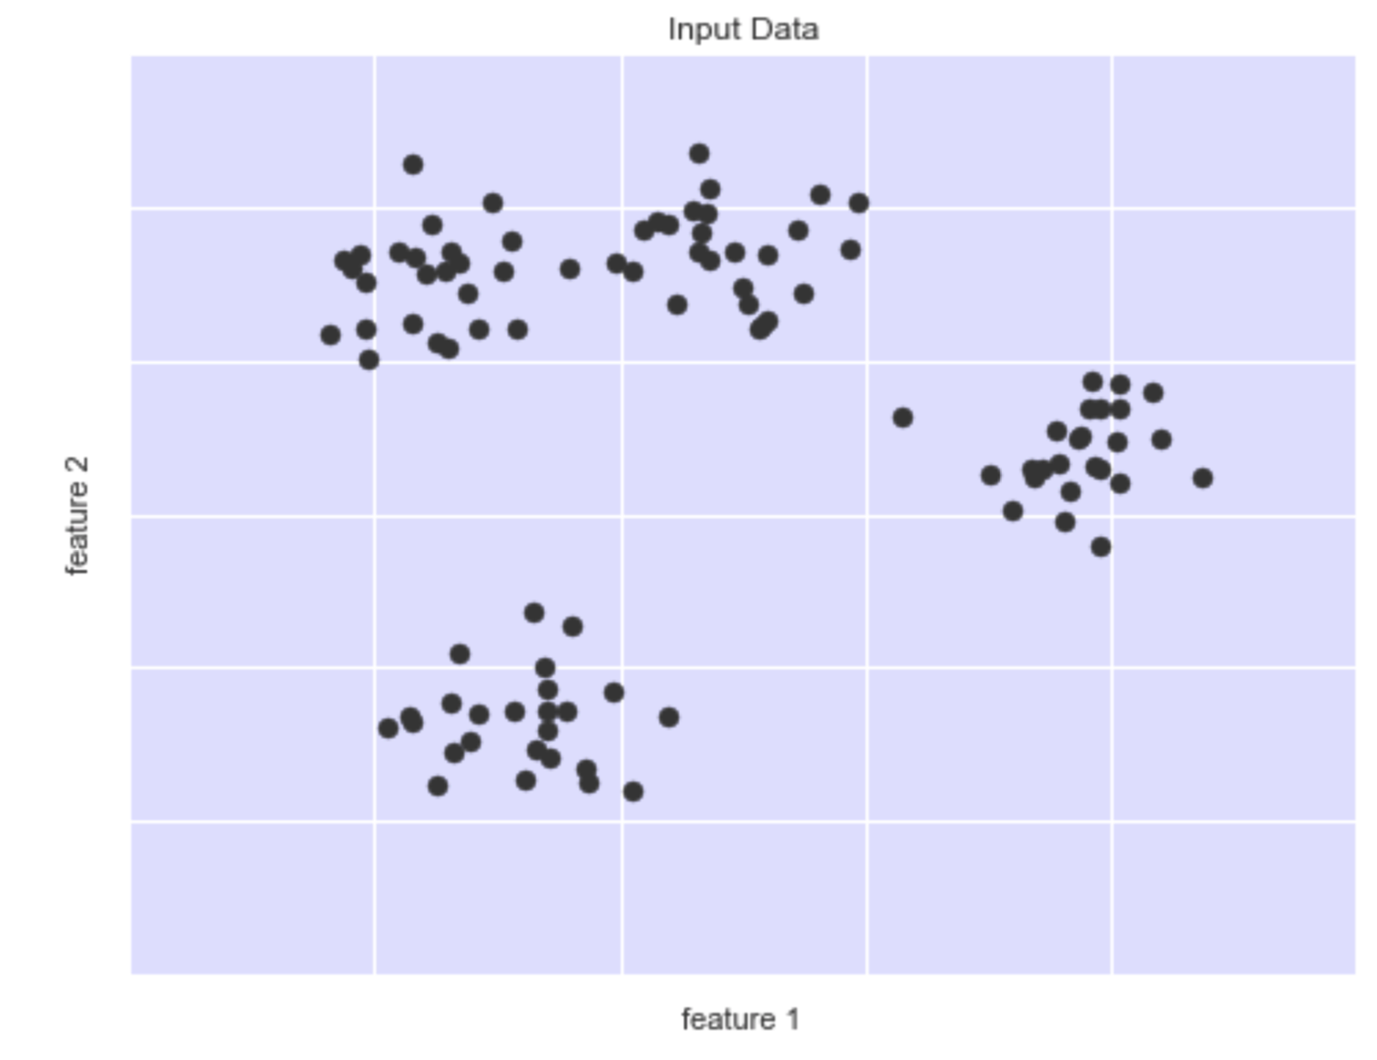
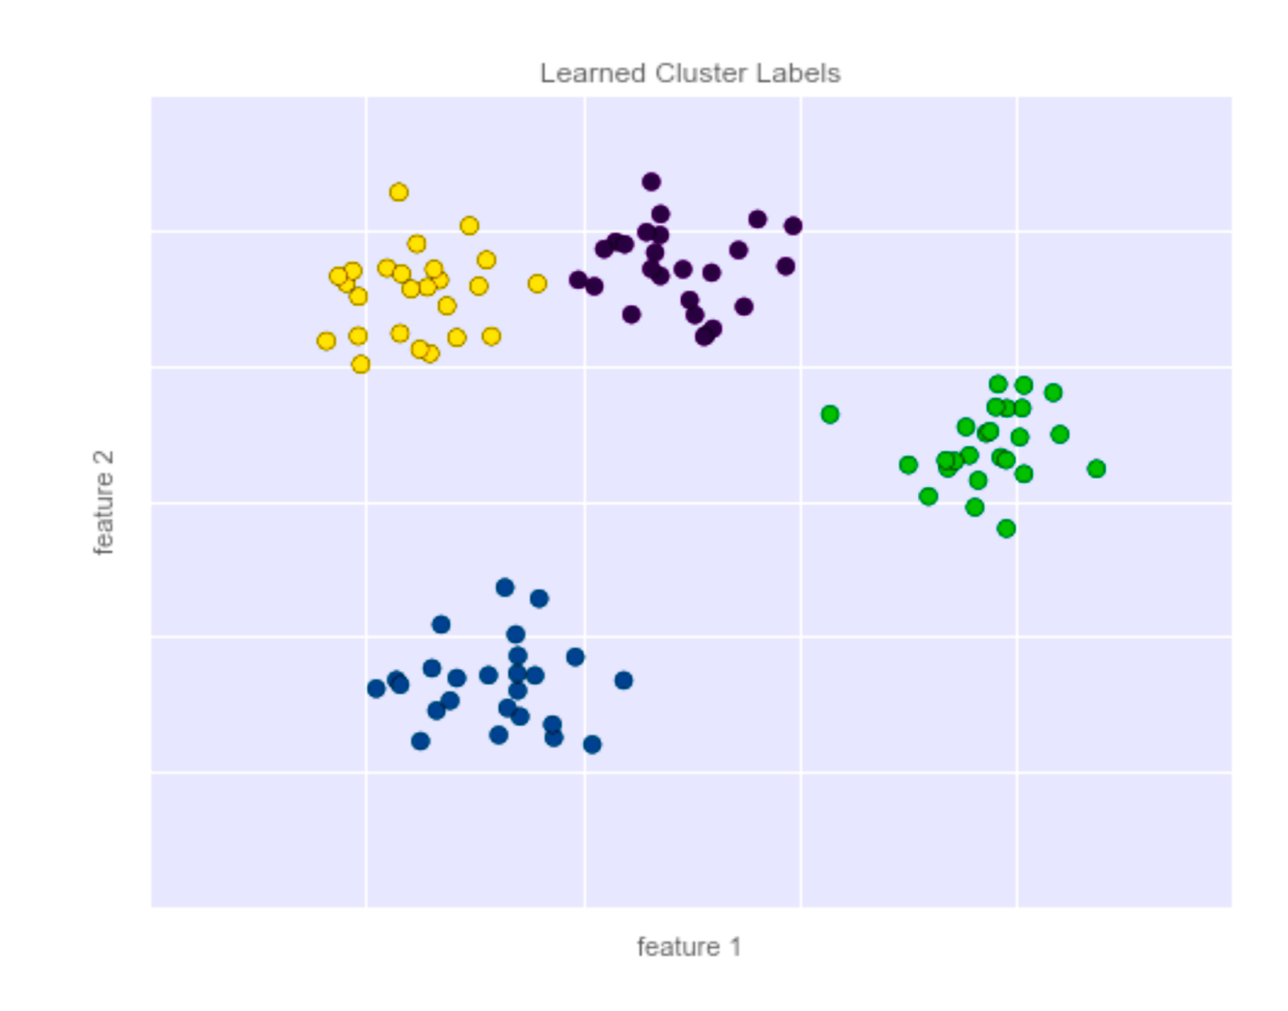
Unsupervised Learning
Unsupervised Learning
No labels
Classification problem
Clustering

Slide 12

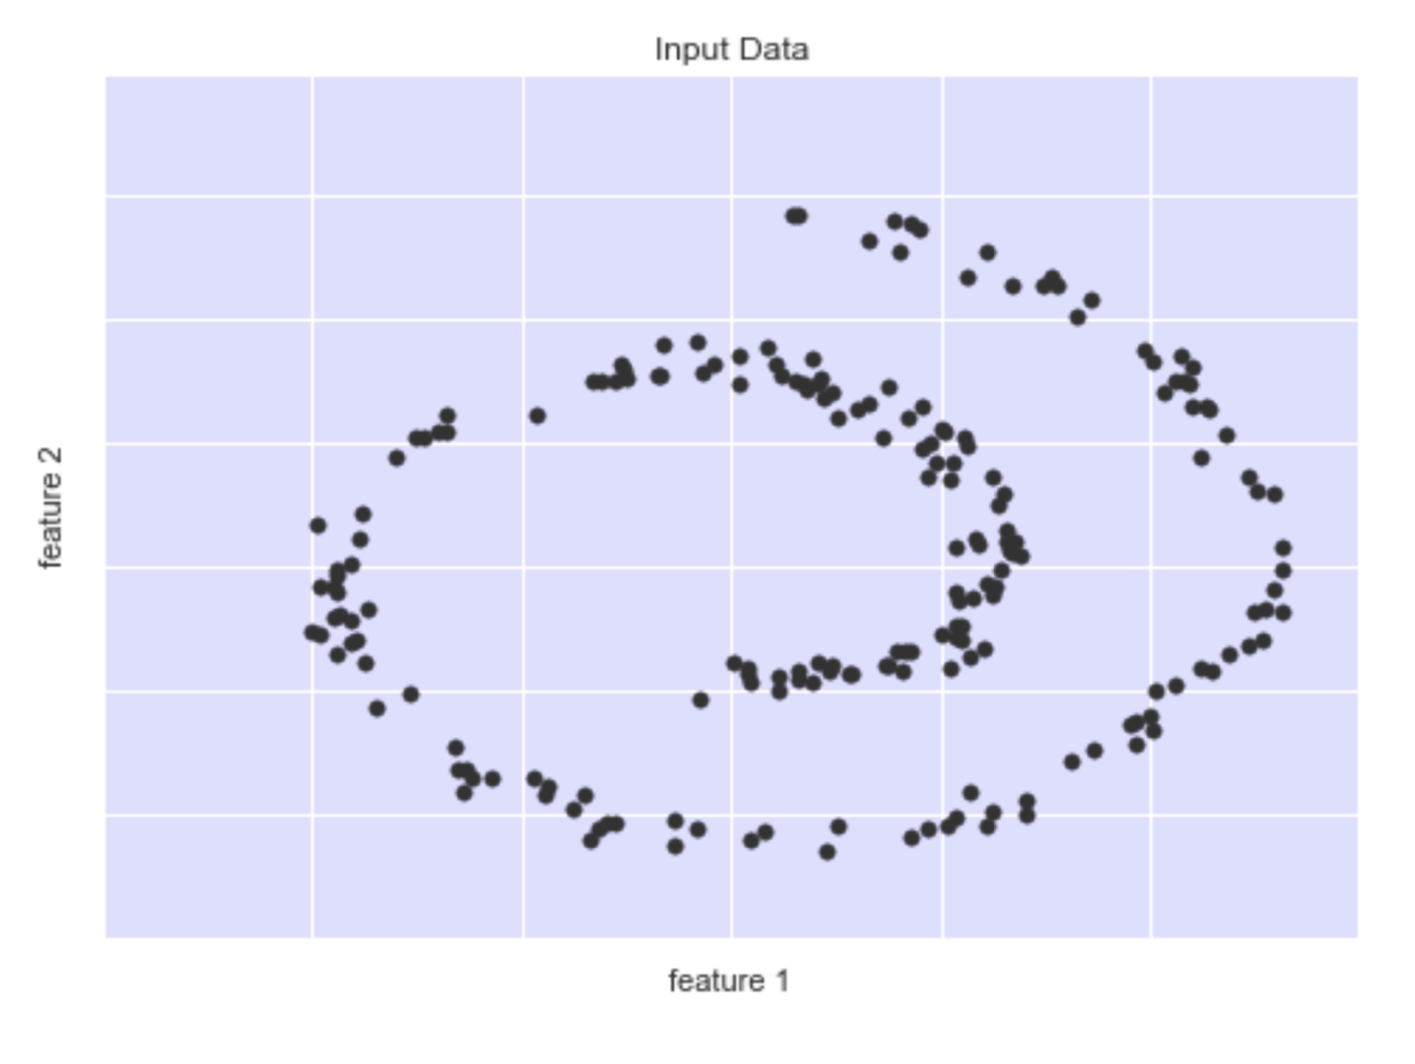
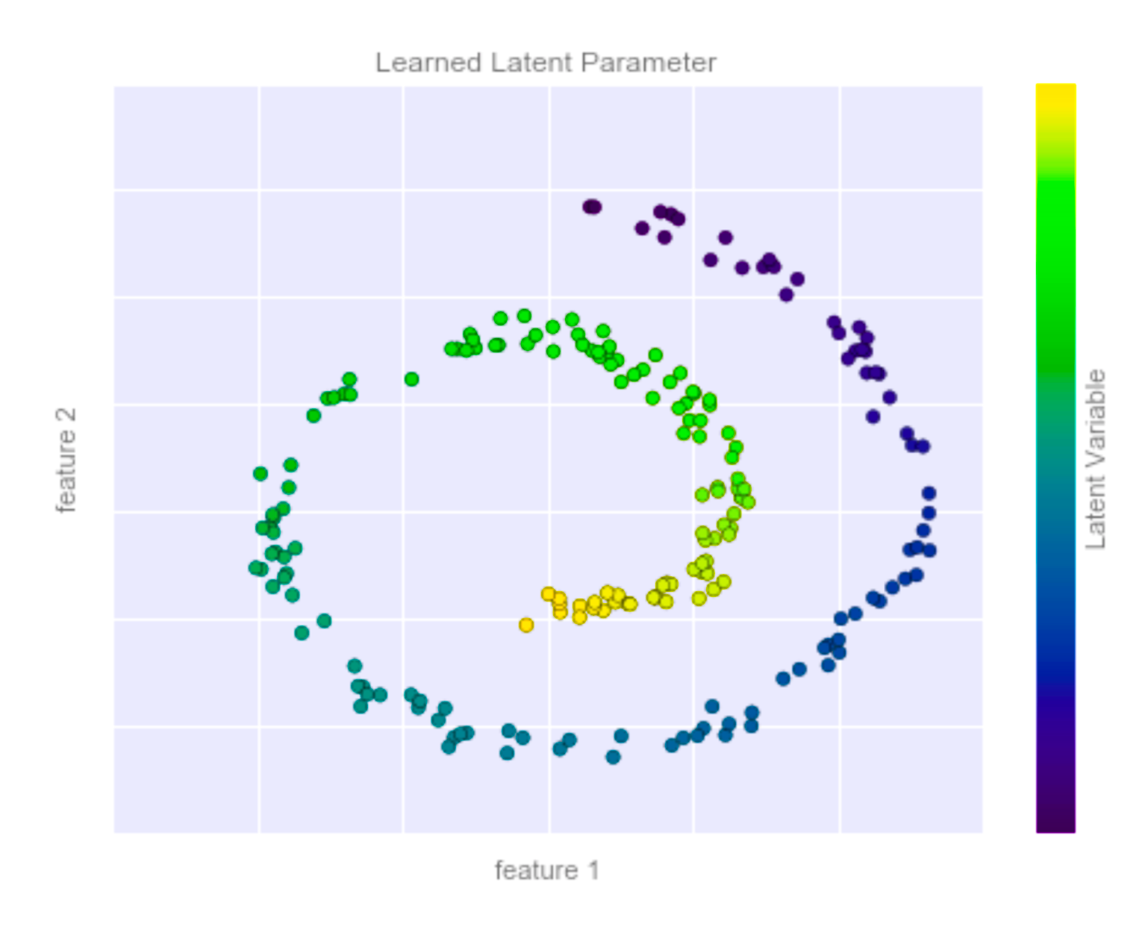
Unsupervised Learning
Unsupervised Learning
No labels
Regression problem
Clustering

Slide 13
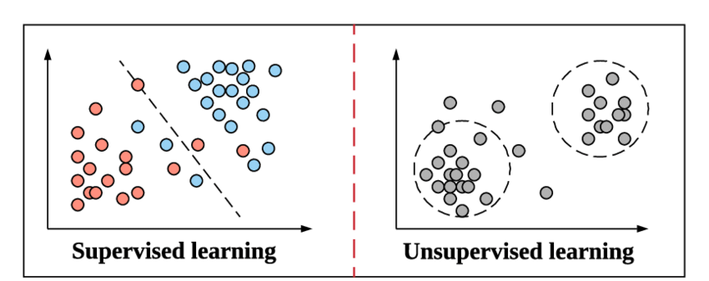
Examples
Supervised Learning
vs
Unsupervised Learning

Slide 14
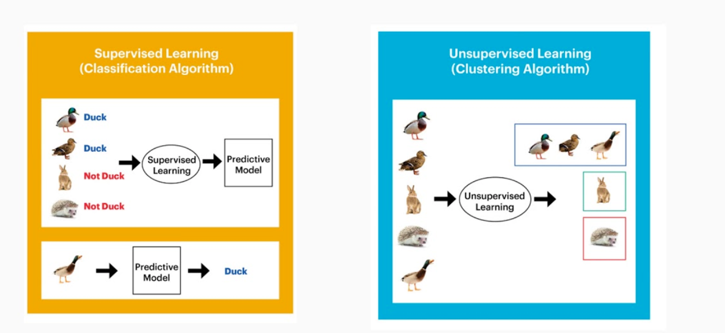
Examples
Supervised Learning
vs
Unsupervised Learning

Slide 15
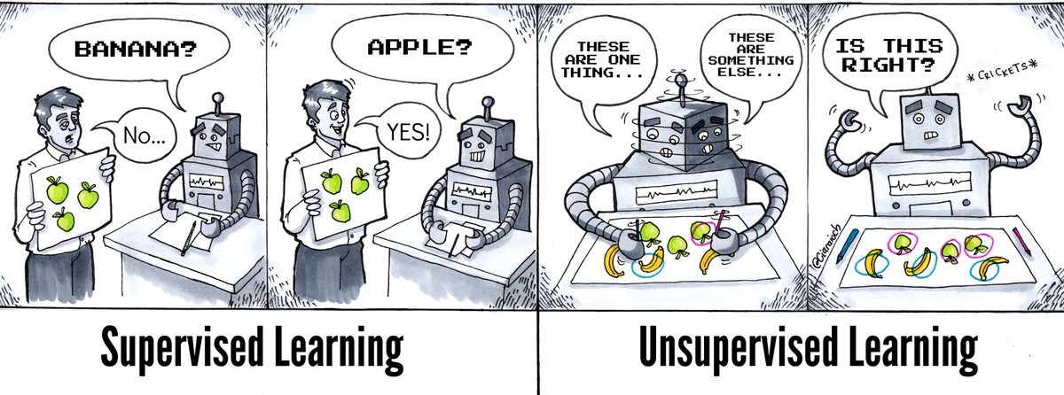
Examples
Supervised Learning
vs
Unsupervised Learning

Slide 16




Supervised learning training
Features (X)
X1
X2
:
Xn
Prediction (Y`)
Most likely Cat
Most likely Dog
:
Most likely Dog
Supervised
Model
Labels (Y)
Cat
Dog
:
Cat

Slide 17




Supervised learning training
2
Features (X)
Prediction (Y`)
Labels (Y)
Most likely Cat
Most likely Dog
:
Most likely Dog
X1
X2
:
Xn
-
Cat
Dog
:
Cat
Supervised
Model
Update the model free parameters
Iteration: Epoch

Slide 18
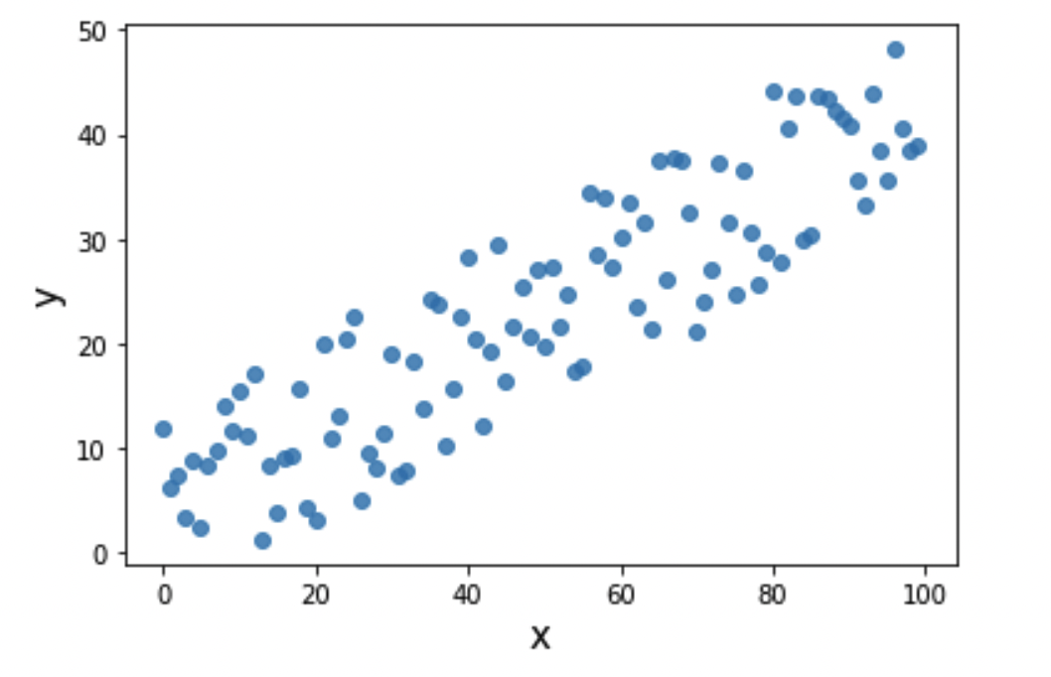
Linear regression
For a continuous data set X
Given new (unseen) x point, can you predict the corresponding Y ?

Slide 19
Linear regression
Once we found the line that best fit the data we can interpret the Y for new x points

Slide 20
Linear regression
How to find the line that fit the given data ?
With given Y and x we try to find B0 and B1 that fit the line to the data

Slide 21
Linear regression
Question:
We can draw infinite number of lines that can fit the data!!
Which line shall we consider ?

Slide 22
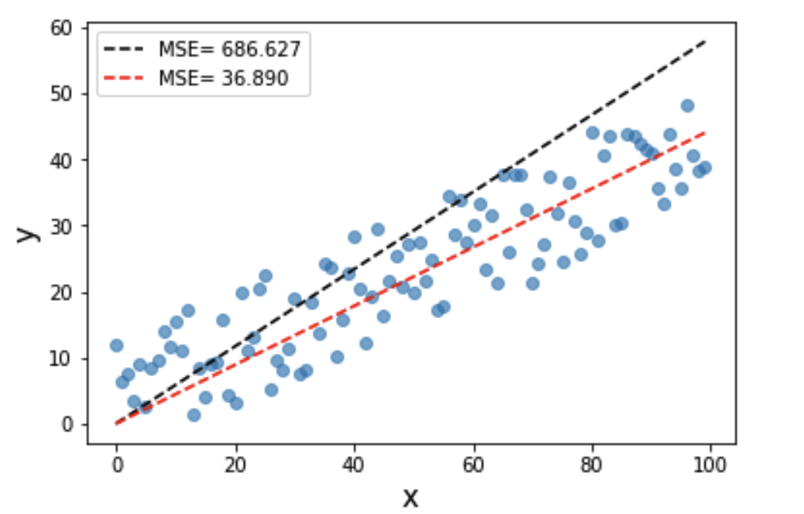
Linear regression
Question:
We can draw infinite number of lines that can fit the data!!
Which line shall we consider ?
We have to consider the line that minimizes the error function

Slide 23
Linear regression-loss function
Loss function:
It mostly quantifies the difference between the model predictions
and the true values

Slide 24
Linear regression-loss function
Types of linear regression loss functions
Absolute mean error:
Mean square error:
Root mean square error:

Slide 25
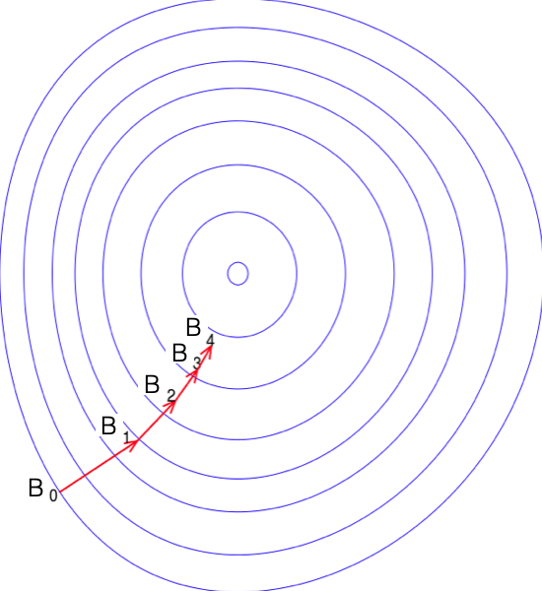
Gradient Descent method
Question:
Well, now we know that to find the best fit line we need to
minimize the loss function, but how ??
Loss function
Find the best fit parameters using
the gradient descent method

Slide 26
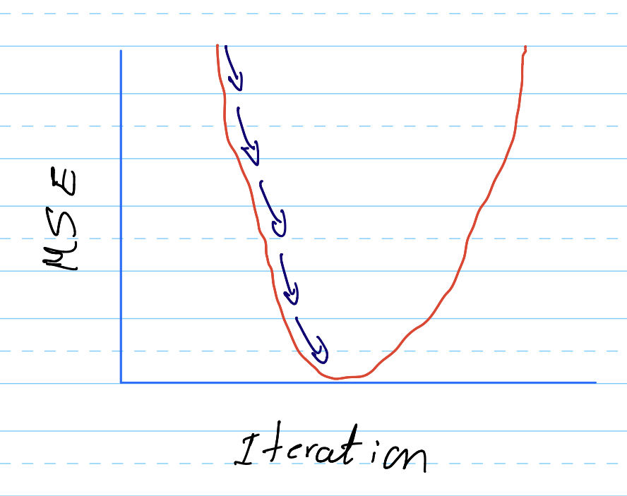
Gradient Descent method
Given a number of iteration, every iteration we update the parameters
and calculate the error function until we hit the global minimum
B

Slide 27
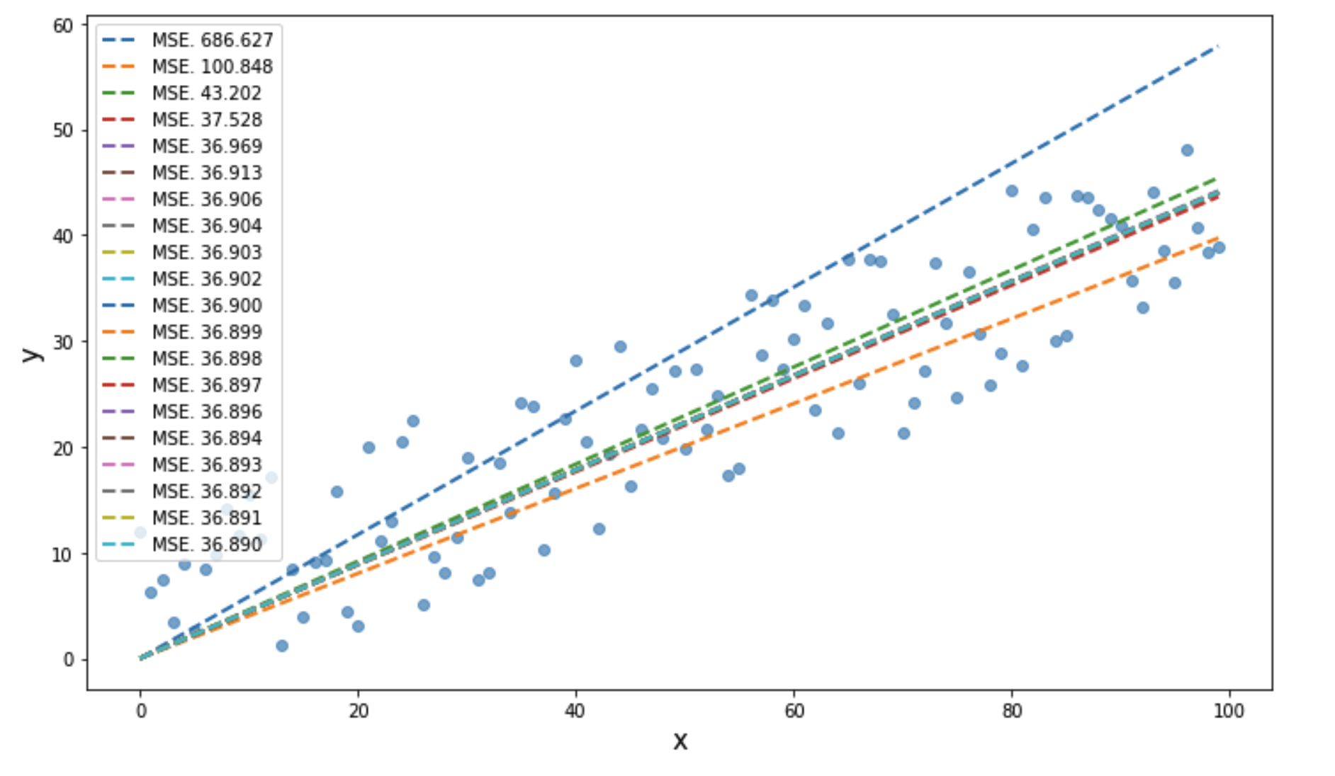
Gradient Descent method
B

Slide 28
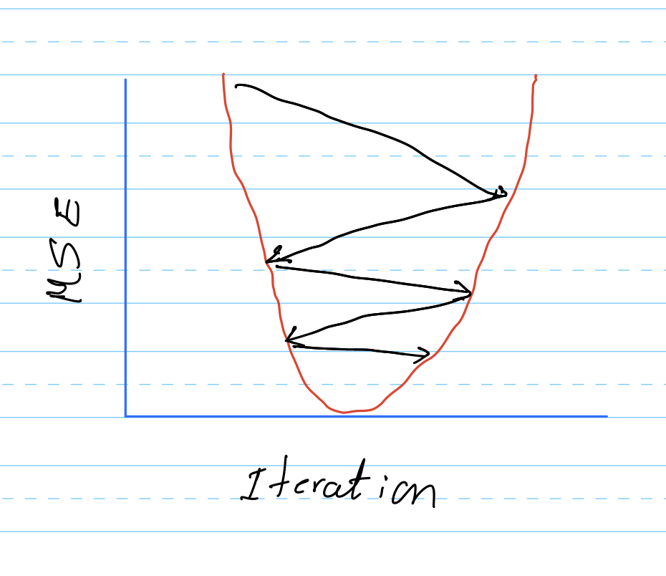
Learning rate
Is called the learning rate which controls the descent rate of the loss function
For large learning rate the function oscillates and we will not able to reach the minimum
B

Slide 29
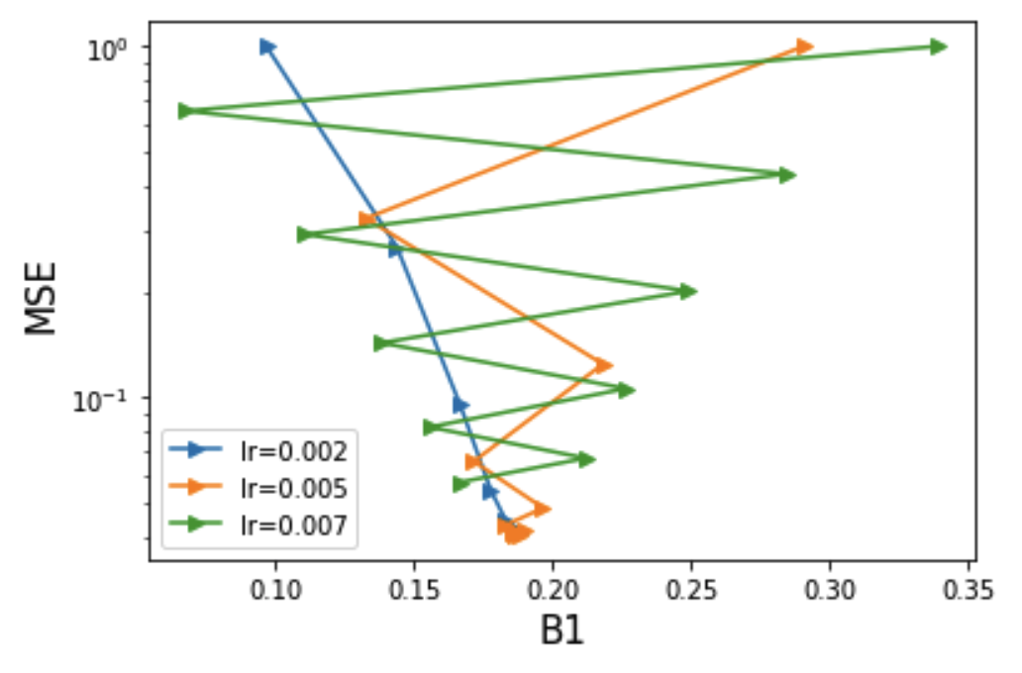
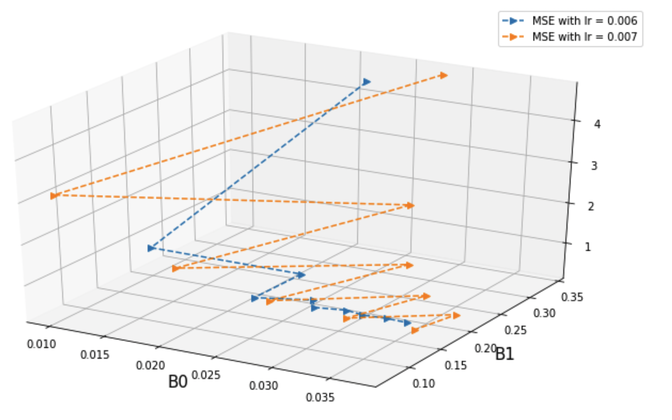
Learning rate
Effect of different learning rates

Slide 30
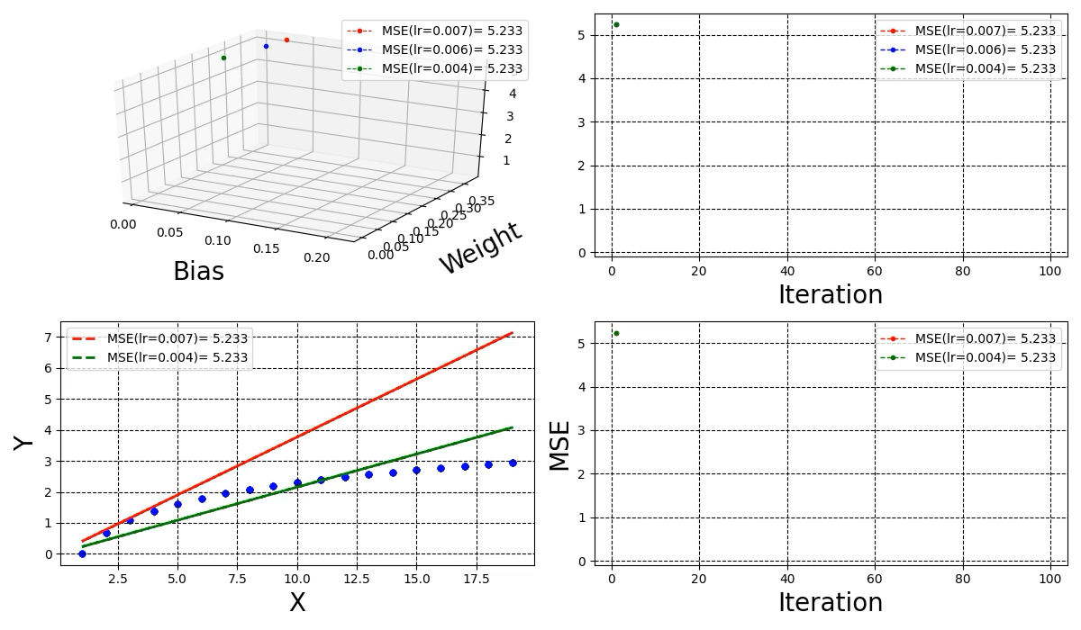
Learning rate

Slide 31
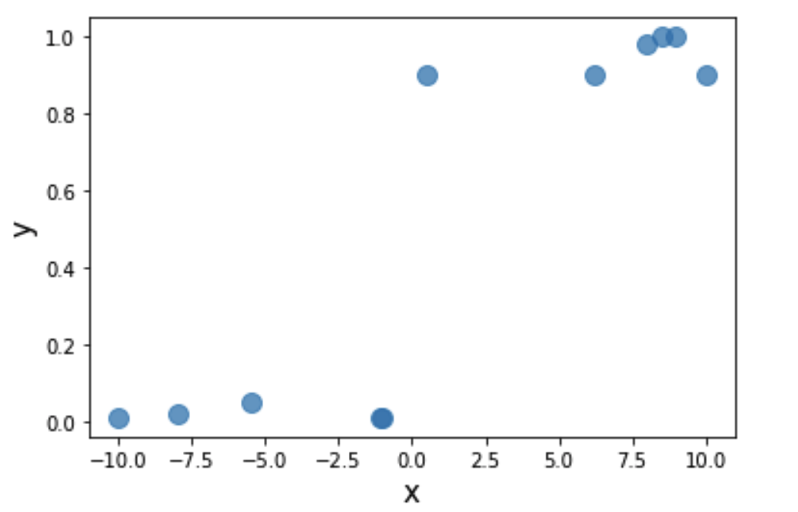
Categorical data
Question:
Can we repeat the previous steps for categorical data ?

Slide 32
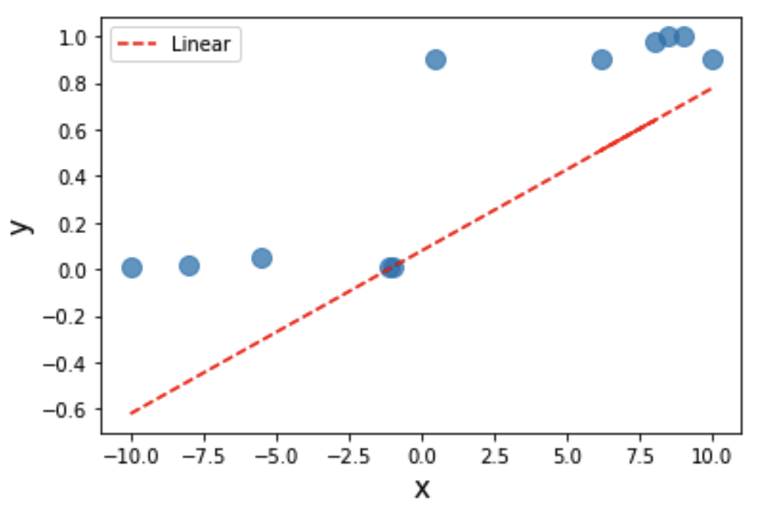
Categorical data
Question:
Can we repeat the previous steps for categorical data ?
It seems not!! But why ?

Slide 33
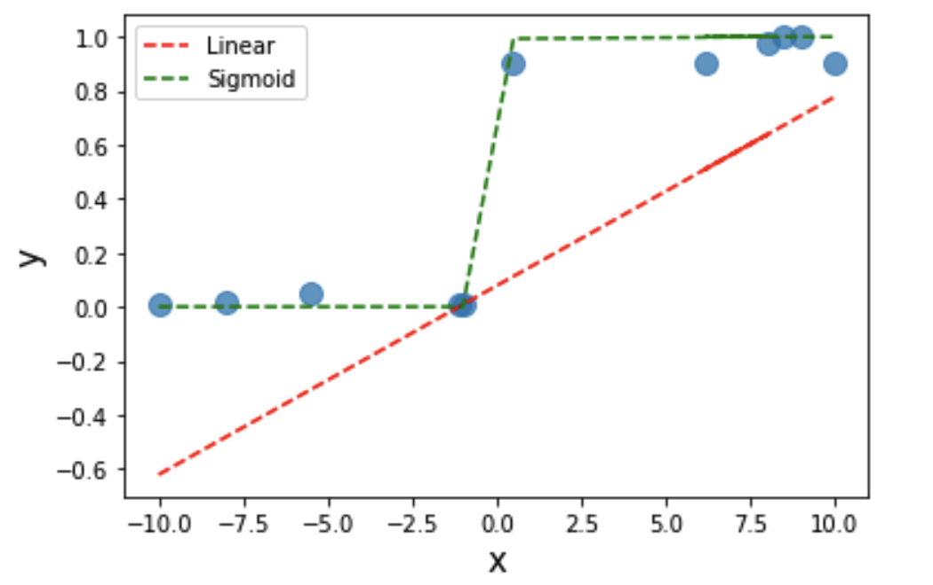
Categorical data
To fit categorical data we need a non linear fitting function

Slide 34
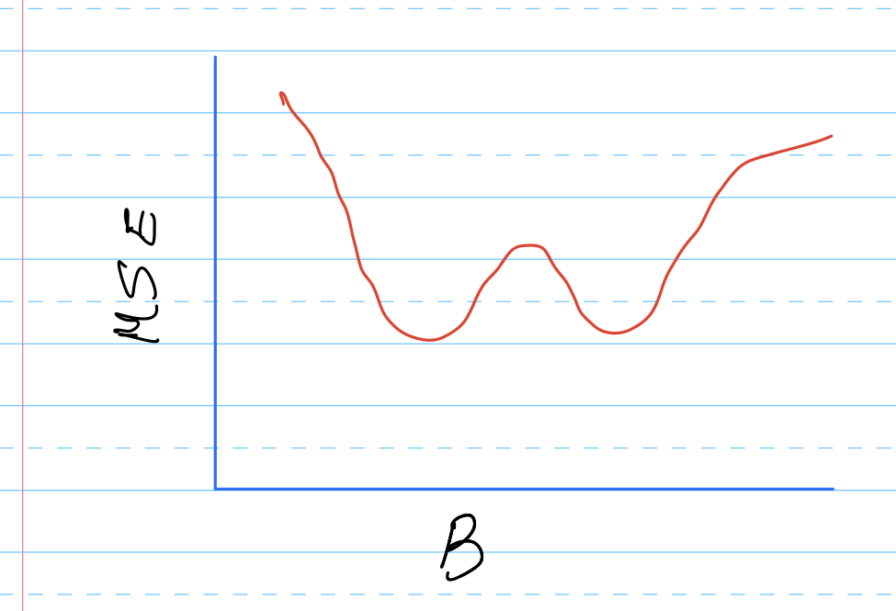
Categorical data
In the case of categorical data the MSE will develop
many local minima and will be hard to converge

Slide 35

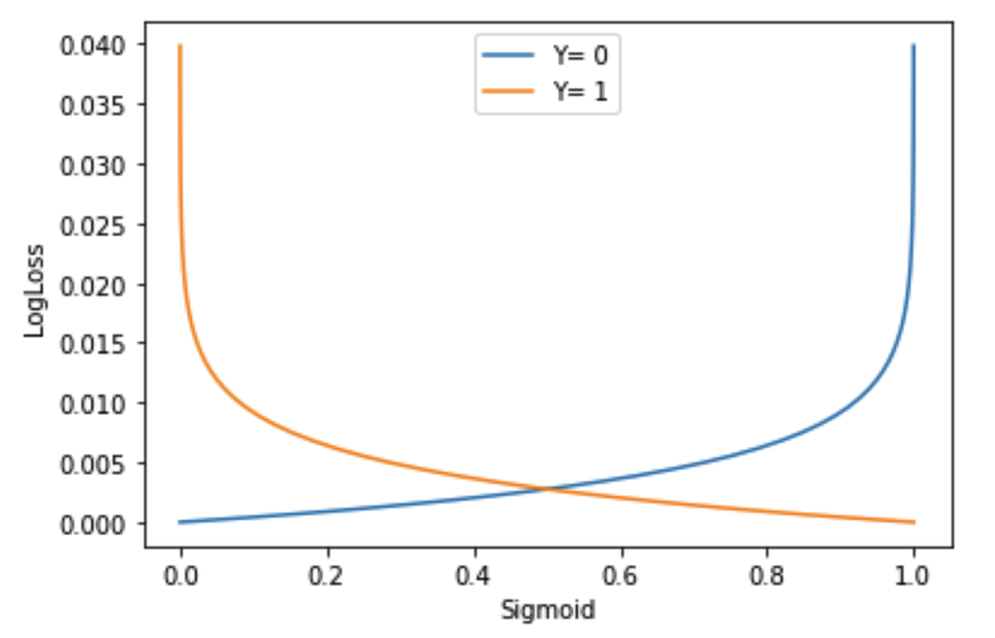
Categorical data-Loss function
Entropy Loss for Categorical data
From Information theory
The model can converge to a global minimum

Slide 36
Loss functions
Continuous data
Mean error functions
Categorical data
Entropy loss functions

Slide 37
Polynomial regression model
We can fit the continuous data with
polynomial model of power 2
Adding more powers to the polynomial model adds more non-linarlity to
The fitted function. How many powers fit the data best?

Slide 38
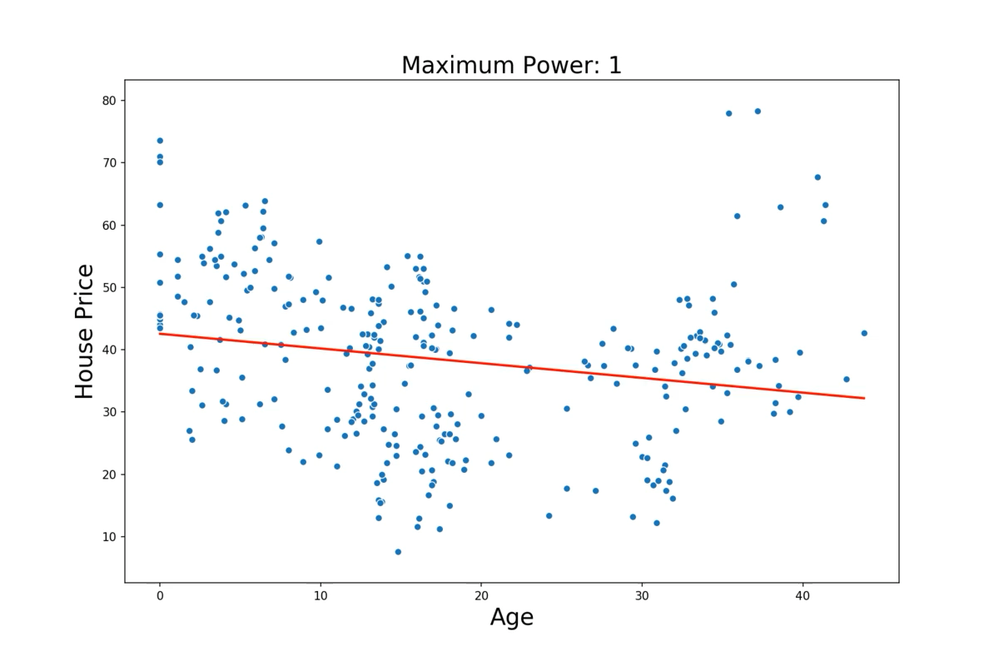
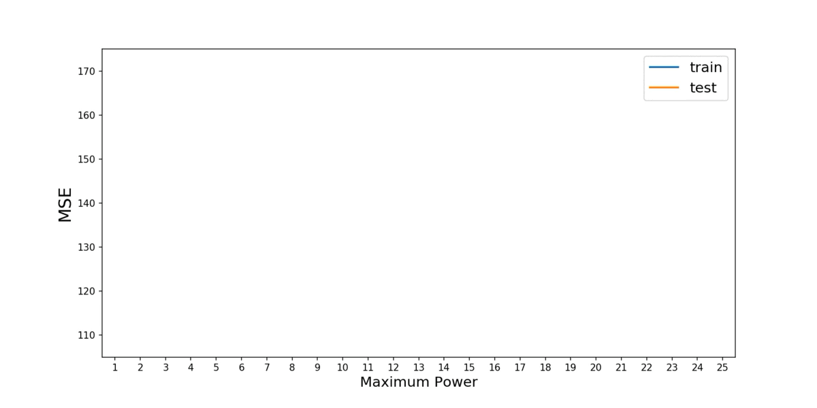
Polynomial regression model
Why the training loss is much better than the test loss function ??

Slide 39
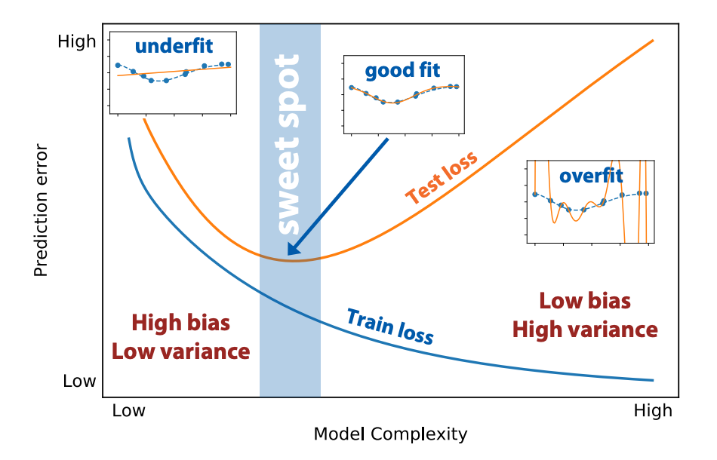
Underfitting & Overfitting
Adding more powers the model has the freedom
to learn not only the pattern into the data but it
learns the noise in the data as well.
To avoid the overfitting problem
we need to regularize the increasing
number of powers

Slide 40
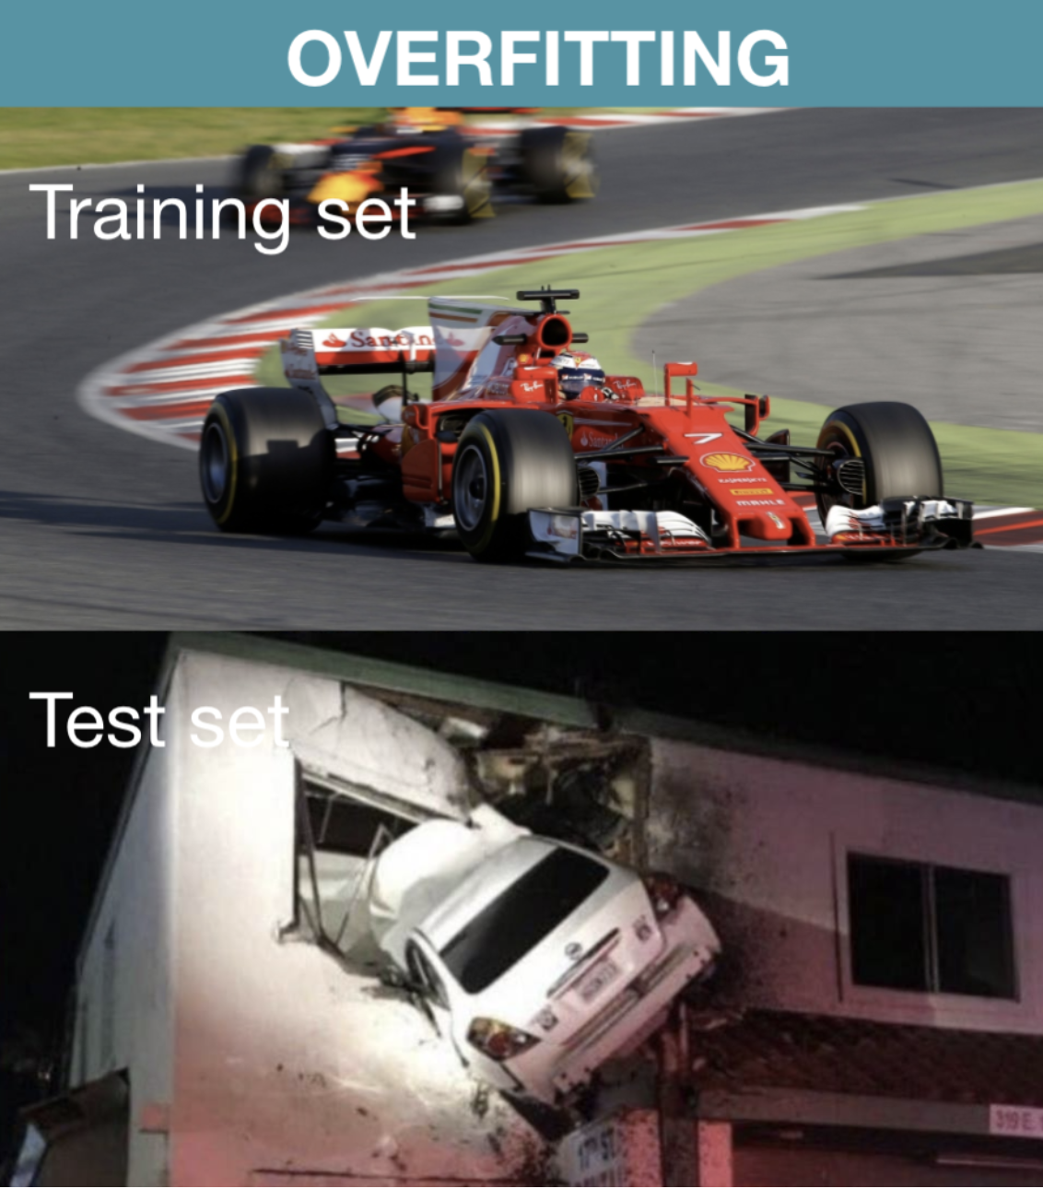
Overfitting danger

Slide 41
Regularized regression
The idea is to reconstruct a loss function that penalize the model
If it contains more degrees of freedom than required
We want to construct a loss function that forces the model
to remove the powers above the best fit value

Slide 42

Regularized regression
Error function with regularization
Lasso Model:
Ridge Model:
Hyper-parameter to be optimized

Slide 43
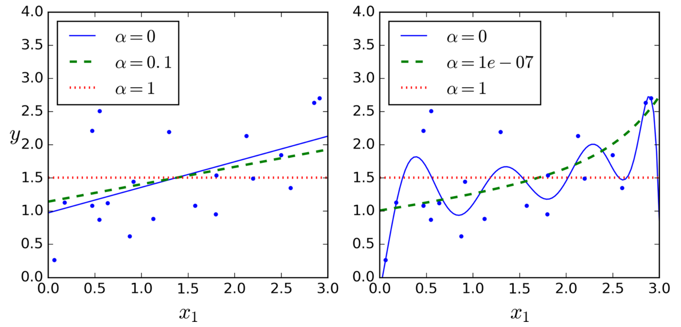
Lasso Model

Slide 44
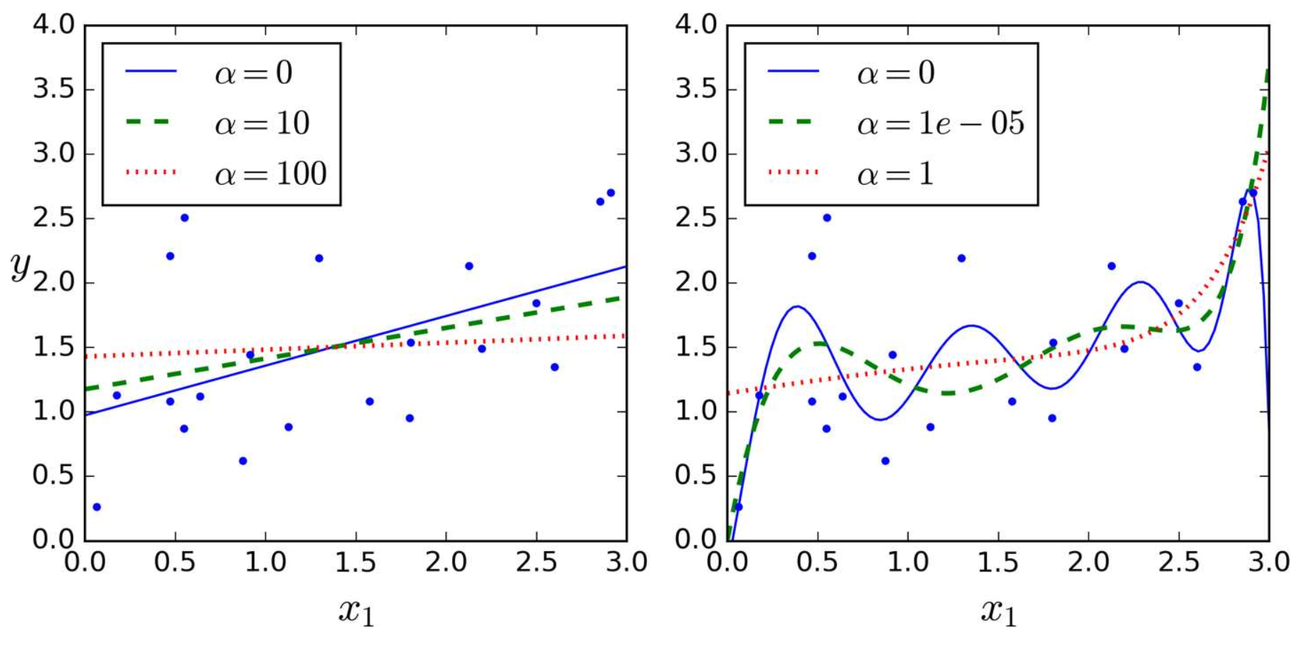
Ridge Model

Slide 45
Question
In which analysis problems we need to use Lasso over Ridge regression ?

Slide 46
To be continued…

