Slide 1
Physical Cosmology and Galaxies II
The Perturbed Universe
Amr El-Zant (CTP, BUE)
Useful refs.
Wayne Hu’s CMB pages: http://background.uchicago.edu/~whu/: Multilevel overview of CMB (nice graphics… used here)
And the very readable short review by Hu, Silk, Sugiyama here https://www.nature.com/articles/386037a0
Also intermediate level review by Hu and Doddleson here https://ned.ipac.caltech.edu/level5/Sept05/Hu/Hu_contents.html
Peacock: Large Scale Surveys and Cosmic Structure (lecture notes on structure form. from Newtonian perspective)
Peacock: Cosmological Physics (covers much ground; intermediate level)
Doddleson: Modern Cosmology (Relatively advanced treatment of structure formation CMB and associated kinetics in GR)
Daniel Baumann Tripos Lectures (now at Amsterdam) Chap 4 & 5
Mo van den Bosch & White: Galaxy Formation and Evolution (a lot of material empirical status of LCDM structure formation)

Slide 2
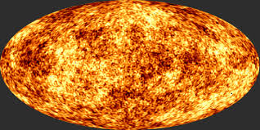
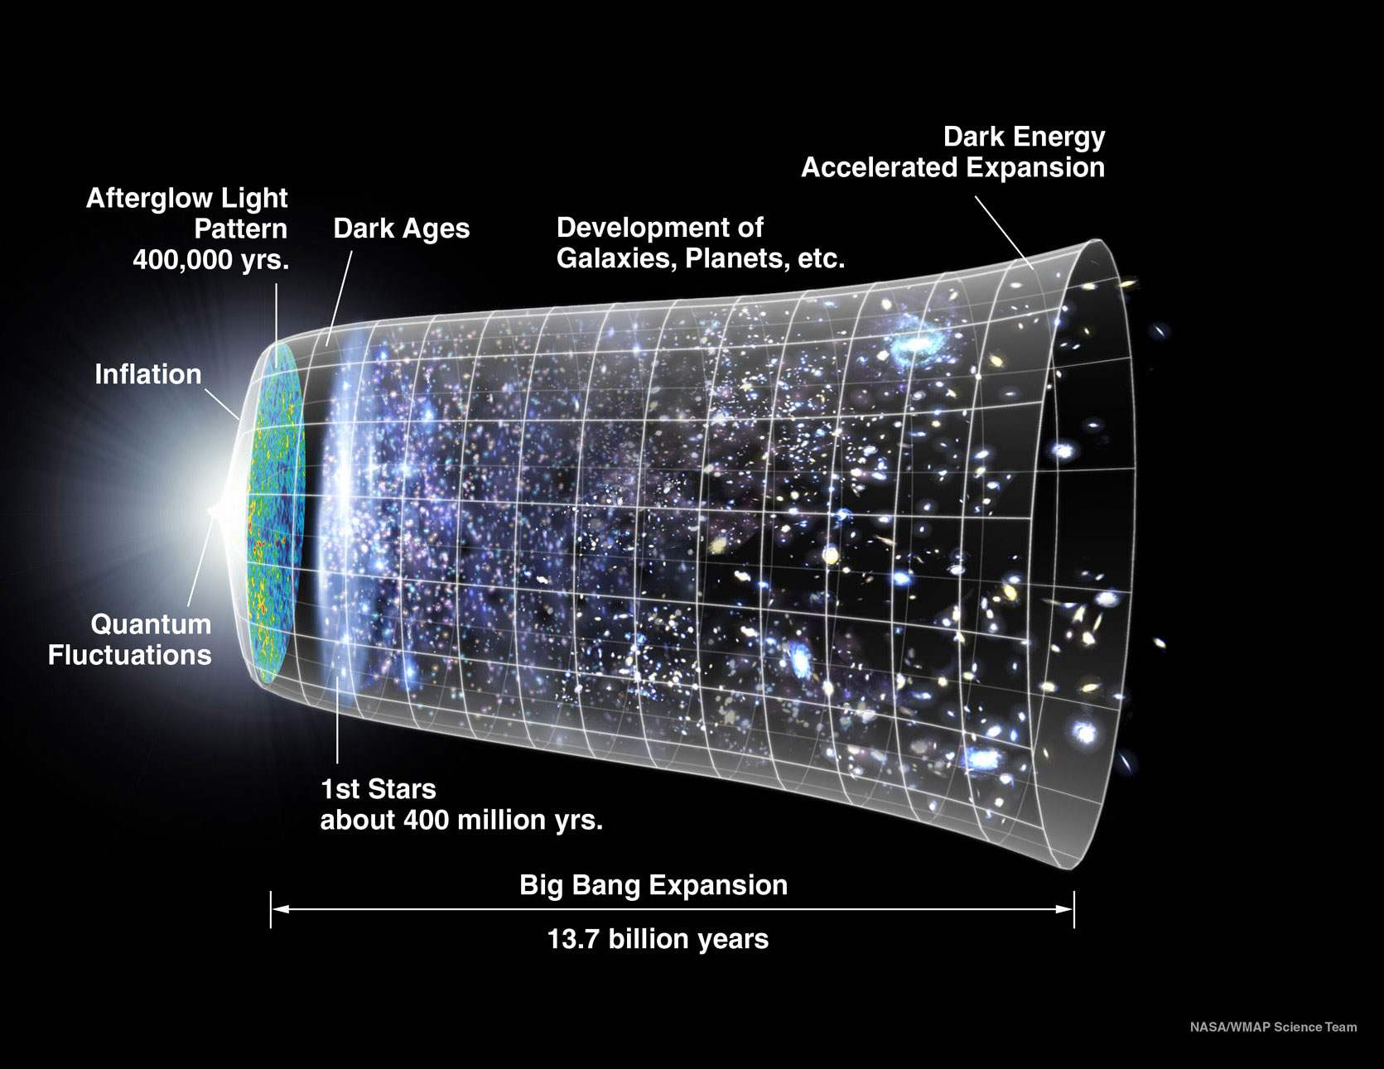
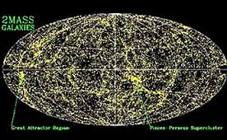
Forming Structure from Fluctuations
** The CMB 400 000 yrs
**Galaxy Distribution (14 Gyr)

Slide 3
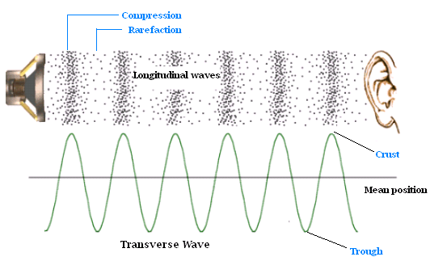
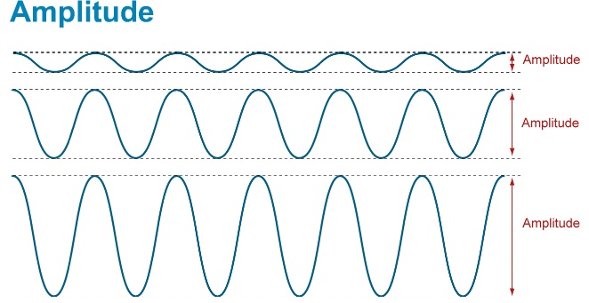
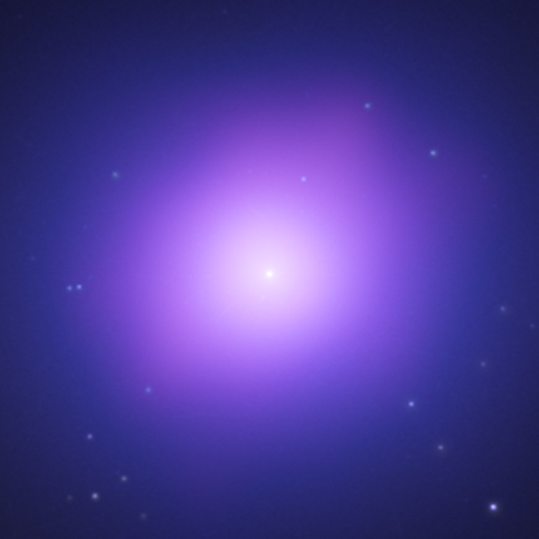
Fundamental Aspect of Gravity : Clustering Instability
Gravity: i) always attractive ii) Long range
I) ‘Normal’ sound wave
Gravity against Pressure
ii) Gravity beats pressure
→ Collapse!

Slide 4
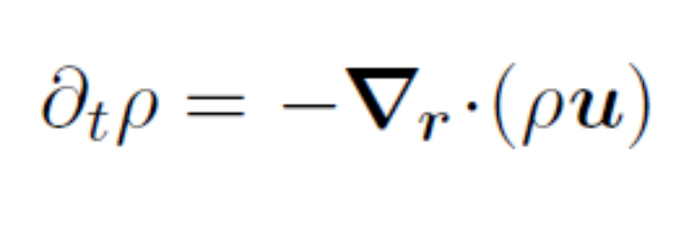
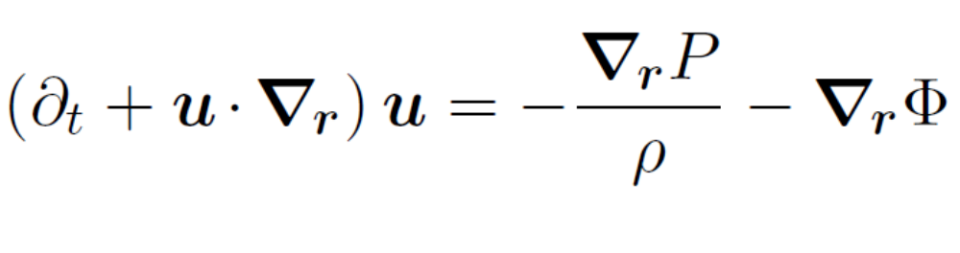

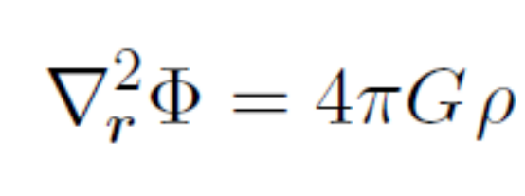
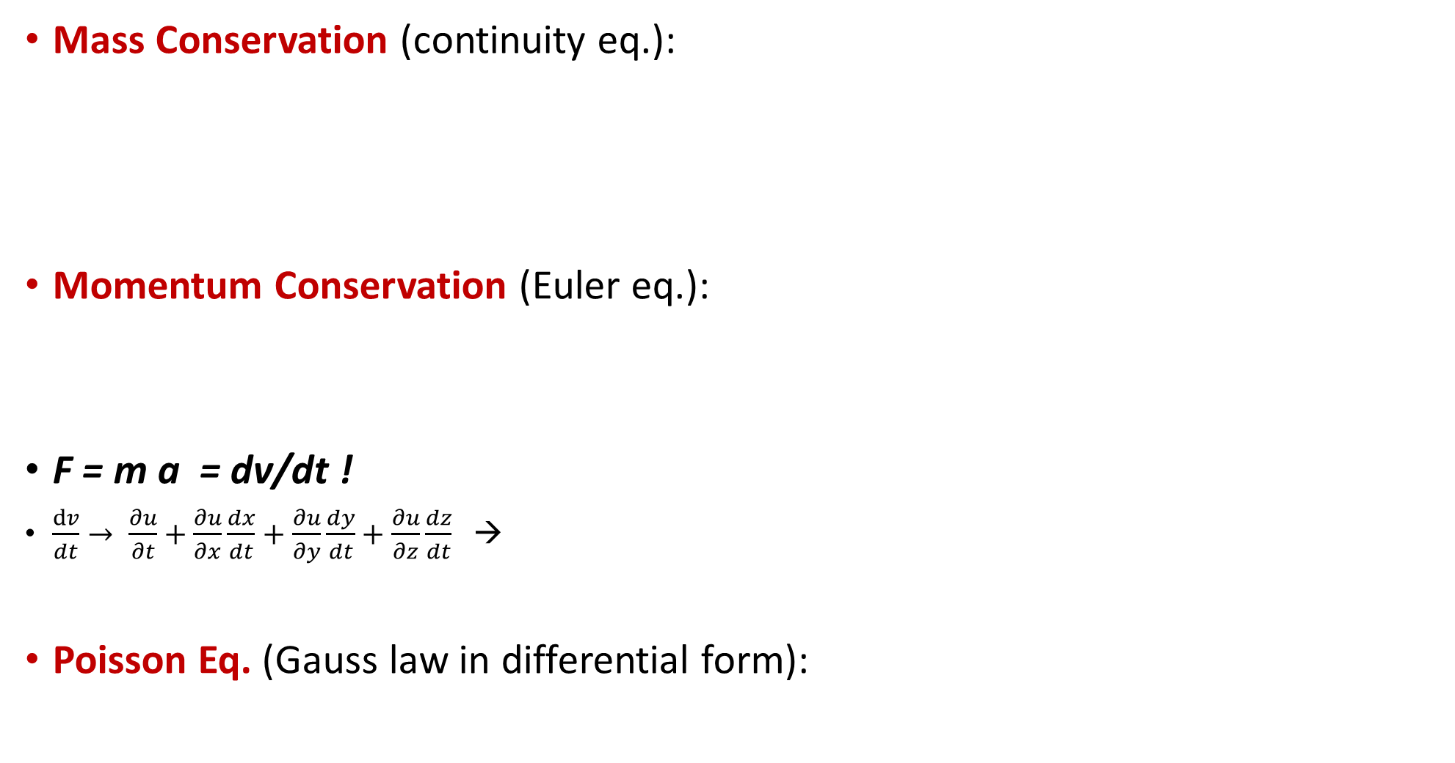
Fluids with Gravity
Mass Conservation (continuity eq.):
Momentum Conservation (Euler eq.):
F = m a = dv/dt !
$\frac{dv}{dt}→ \frac{∂u}{∂t}+\frac{∂u}{∂x}\frac{dx}{dt}+\frac{∂u}{∂y}\frac{dy}{dt}+\frac{∂u}{∂z}\frac{dz}{dt}$ →
Poisson Eq. (Gauss law in differential form):
Mass flux from small unit vol
In fixed ‘Eulerian’ coordinates where vely u = u (x)

Slide 5
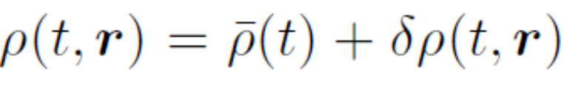
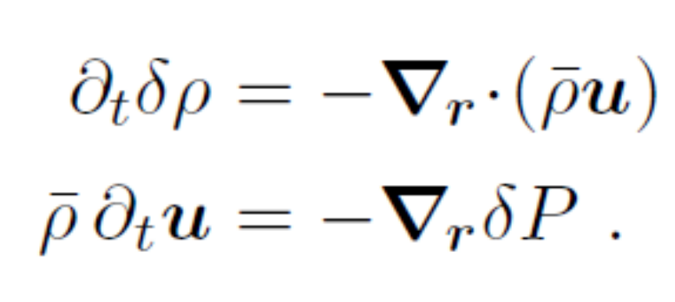
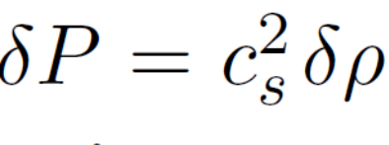
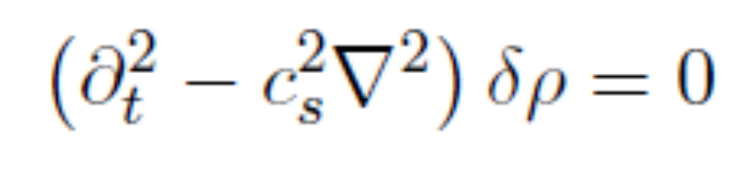
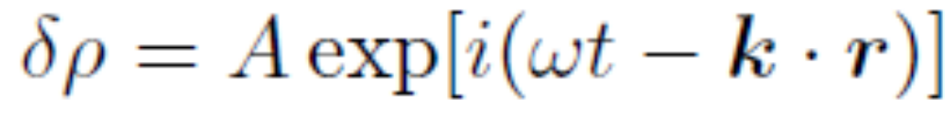
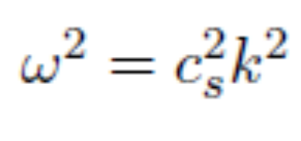
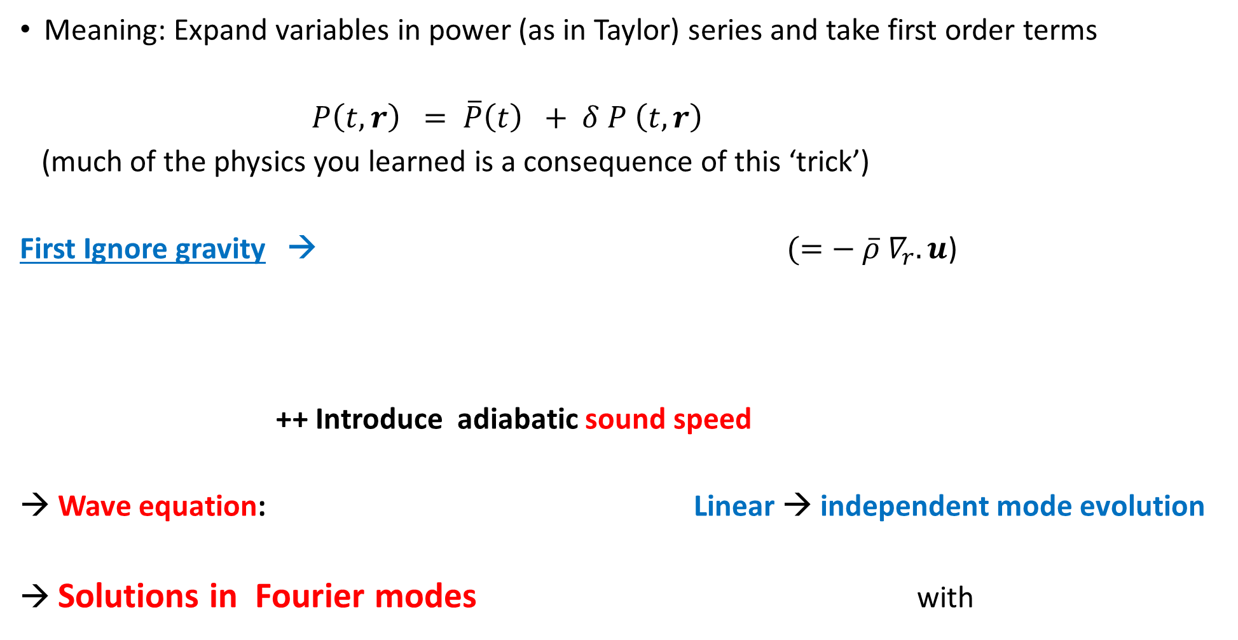
Small Perturbation Propagation → Linearise
Meaning: Expand variables in power (as in Taylor) series and take first order terms
$P\left(t, r\right) = \overline{P}\left(t\right) + δ P \left(t, r\right)$
(much of the physics you learned is a consequence of this ‘trick’)
First Ignore gravity → $(=− {\overline{ρ} ∇}_{r}.u$)
++ Introduce adiabatic sound speed
Wave equation: Linear → independent mode evolution
→ Solutions in Fourier modes with

Slide 6
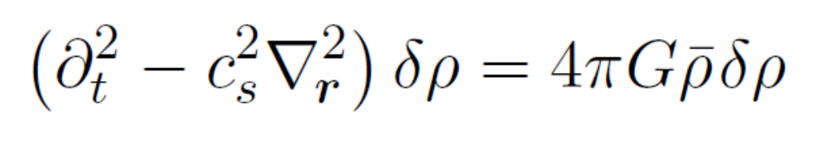
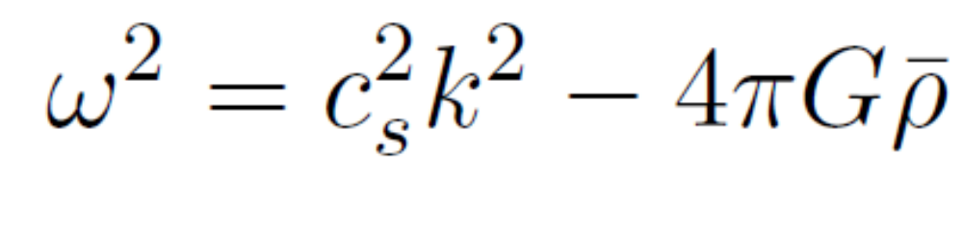
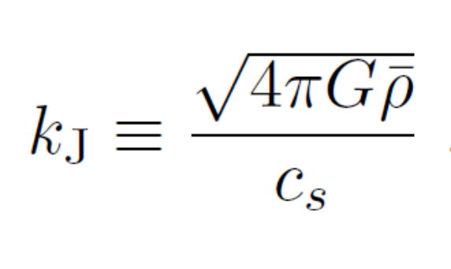
Add Gravity and Start to Cluster
Gravitational source term
“Loading”
→ Jeans (clustering or collapse) scale ~ Dynamical time / sound horizon
If Gravity can start collapse before pressure can act → collapse

Slide 7
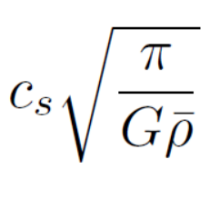
Fundamental Aspect of Gravity : Clustering Instability
I) Small scales
Wavelength <<
Larger Scales
** Slower Propagation
** Larger Amplitude
→ Then collapse
Wavelength >

Slide 8
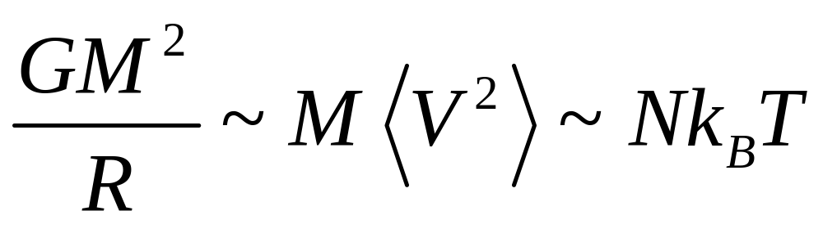
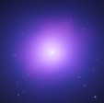

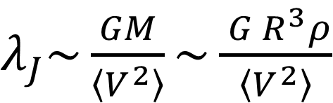

Dynamical Equilibrium and Characteristic Scale
$λ_{J}\sim \frac{GM}{\left\langle V^{2}\right\rangle }\sim \frac{{ G R}^{3}ρ}{\left\langle V^{2}\right\rangle }$
→ $R \sim$
Structures formed via adiabatic cooling and collapse at the Jeans scale then?
$$R\sim λ_{J}\sim \sqrt{\frac{\left\langle V^{2}\right\rangle }{Gρ}}$$

Slide 9
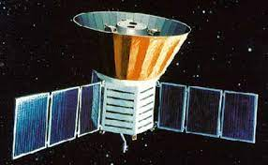
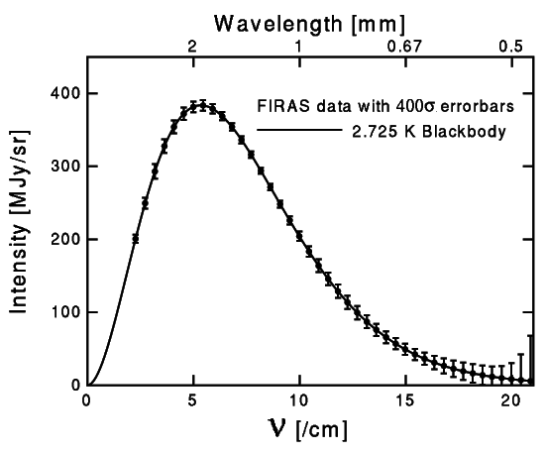

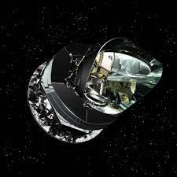
Cosmic Microwave Background and the Hot Big Bang
Nobel Prizes 1978 + ~ 2019, and 2006
The latter prize for discovery of CMB fluctuations using COBE →
Planck Spectrum → Early thermal equilibrium → Parametrized by temperature

Slide 10
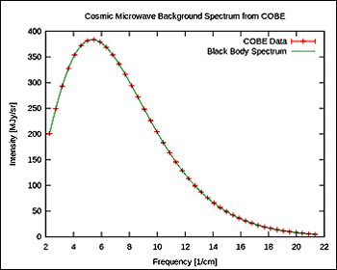
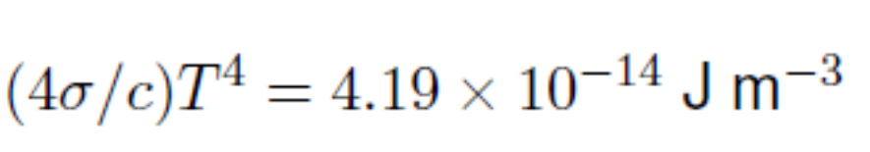
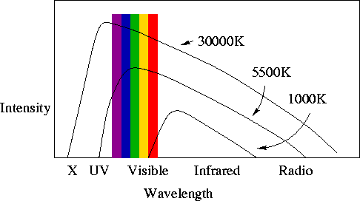
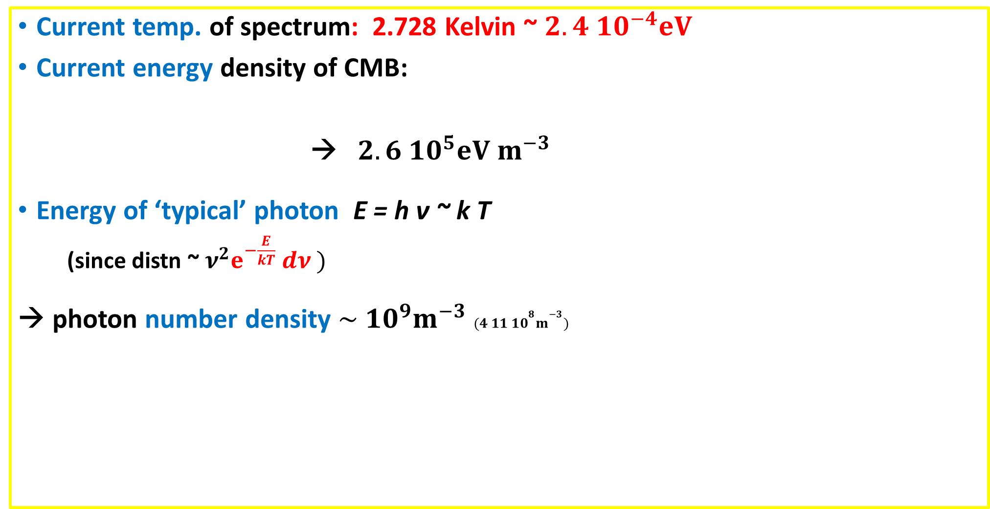
The Cosmic Microwave Background: Tells of Prior Thermal Equilibrium
Current temp. of spectrum: 2.728 Kelvin ~ $2.4 10^{−4}eV$
Current energy density of CMB:
→ $2.6 10^{5}eV m^{−3}$
Energy of ‘typical’ photon E = h ν ~ k T
(since distn ~ ${ν^{2}e}^{−\frac{E}{kT}} dν )$
→ photon number density $\sim 10^{9}m^{−3} (4 11 10^{8}m^{−3})$
Compare with < one proton per cubic meter!
Photon Entropy ~ $n_{γ}a^{3}$ dominates. Small ratio $\frac{n_{b}}{n_{γ}}≡η\sim {10}^{−9}$ Conserved
Ex.: use Stephan-Boltzmann law + current matter mass density, ${3 10}^{−27}\frac{kg}{m^{3}},$ to obtain $T_{eq}$ of matter rad. equality (${\sim 10}^{4}K)$

Slide 11

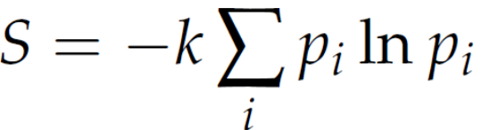
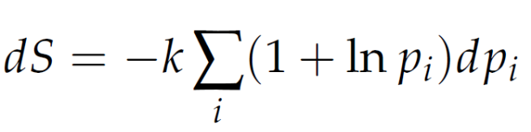

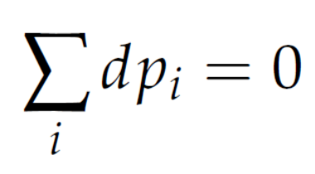

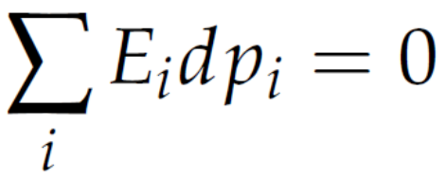
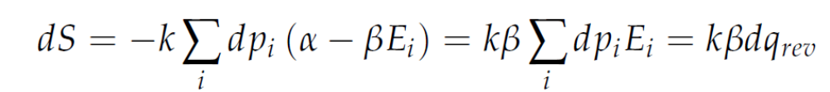
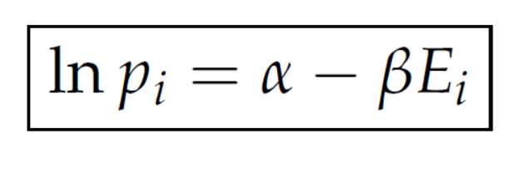
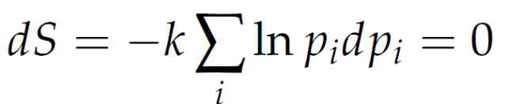
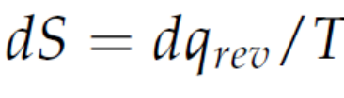
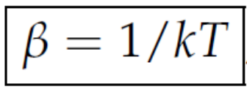
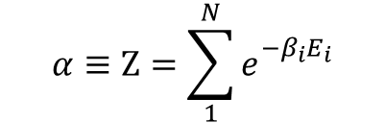
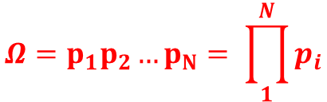

Thermal Equilibrium and the Notion of Temperature
Off Boltzmann’s tombstone
Independent probabilities
$$S=k\ln{Ω}$$
$$Ω=p_{1}p_{2}…p_{N}= \prod_{1}^{N}{p_{i}}$$
Constraints
$$α≡Z=\sum_{1}^{N}{e_{}^{−β_{i}E_{i}}}$$
normalizing partition function
Allow for small change in energies around max:
Condition

Slide 12


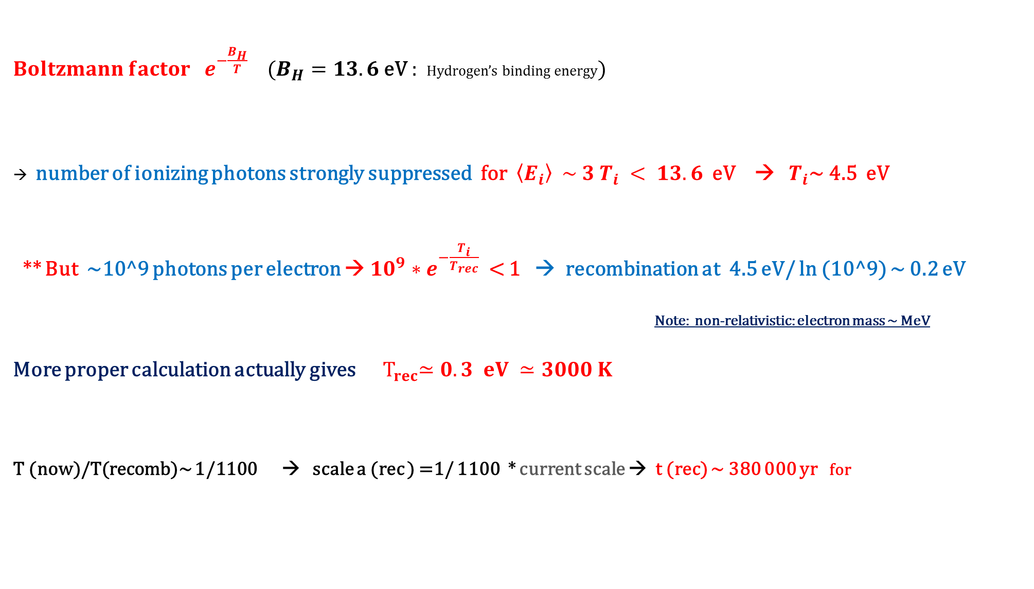
Recombination: Era of Tightly Coupled Plasma Ends
${Boltzmann factor e}^{−\frac{B_{H}}{T}}$ ($B_{H}=13.6$eV : Hydrogen’s binding energy)
number of ionizing photons strongly suppressed for $\left\langle E_{i}\right\rangle \sim 3 T_{i} < 13.6$ eV → $T_{i}$~ 4.5 eV
** But ~10^9 photons per electron → $10^{9}∗e^{−\frac{T_{i}}{T_{rec}}}$ < 1 → recombination at 4.5 eV/ ln (10^9) ~ 0.2 eV
Note: non-relativistic: electron mass ~ MeV
More proper calculation actually gives ${ T}_{rec}≃0.3 eV ≃3000 K$
T (now)/T(recomb)~ 1/1100 → scale a (rec ) =1/ 1100 * current scale → t (rec) ~ 380 000 yr for

Slide 13

Fluctuations in the the CMB
Small amplitude ~ 10^-5→ Can be treated in linear regime
Involves complex kinetics, with coupled photon baryon fluid on a gravitational background… BUT basic physics well understood
Oppose this to complex galaxy formation physics of later lectures

Slide 14
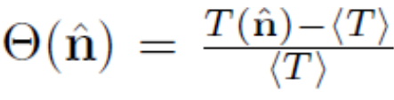

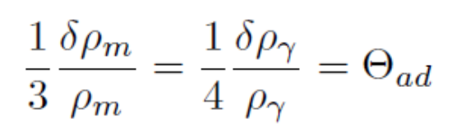
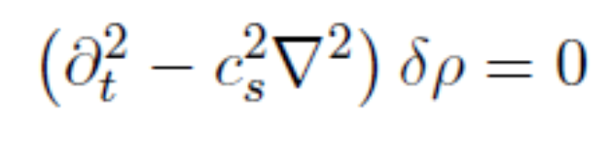
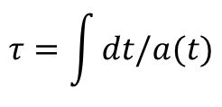
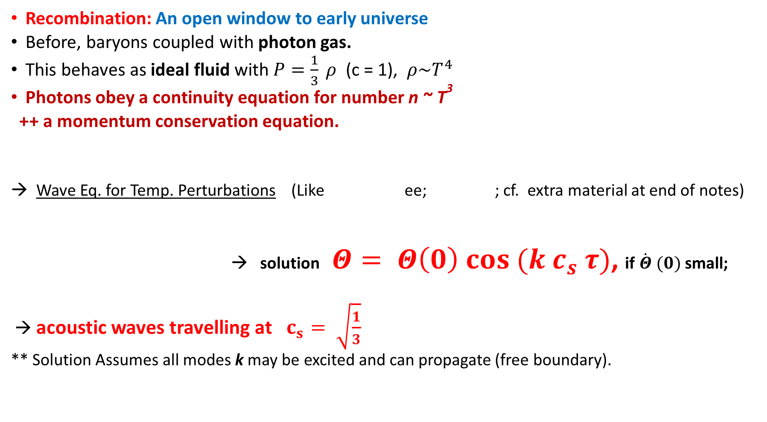
Sound Waves in a Photon Fluid
Recombination: An open window to early universe
Before, baryons coupled with photon gas.
This behaves as ideal fluid with $P=\frac{1}{3} ρ$ (c = 1), $ρ\sim T^{4}$
Photons obey a continuity equation for number n ~ T³
++ a momentum conservation equation.
Wave Eq. for Temp. Perturbations (Like ee; ; cf. extra material at end of notes)
→ solution $Θ= Θ\left(0\right) cos ({k c}_{s} τ)$, if $\dot{Θ} (0)$ small;
→ acoustic waves travelling at $c_{s}= \sqrt{\frac{1}{3}}$
** Solution Assumes all modes k may be excited and can propagate (free boundary).

Slide 15
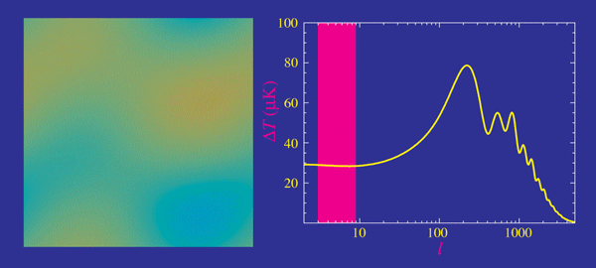
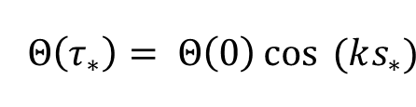


Acoustic Peaks
Photon fluid permeated by superposed sound waves
Interested in those: Frozen at recombination
when sound horizon $s_{∗}=\int{c_{s}}d τ ≈ τ_{∗}/\sqrt{3}$
→ Frozen Soln
→ Peaks indicate $k{ s}_{∗}=n π$
First peak → 1st Compression
Second → 1st Rarefication
Third → 2nd Compression
more oscillations→ damping
From Wayne Hu pages

Slide 16



Location of Peaks (in context of crude approximation)
Object of comoving size D has angular size $θ=\frac{D}{r}$
The peaks are at $n π$ = $\frac{2 π}{λ}{ s}_{∗}$ → $D= λ_{\frac{1}{2}} \left(peak\right)= \frac{s_{∗}}{n}$
$→ θ=\frac{s_{∗}}{n} \frac{1}{r}$ $≃\frac{1}{\sqrt{3} n} \frac{τ_{∗}}{r}$
Try flat universe → r (recombination)$={ D}_{C } ={ τ}_{0}−τ_{∗}≃ τ_{0}$
$θ ≃\frac{1}{\sqrt{3} n} \frac{τ_{∗}}{ τ_{0}}$ ++ $τ \sim a^{\frac{1}{2}}$ (matter domination)
  with $\frac{a_{∗}}{a_{0}}\sim \left(\frac{1}{1100}\right)$ → $θ≃1$ degree for n=1
$→nearly correct++ Note: particle horixon at recombination ≃ \sqrt{3 }θ$

Slide 17






Curvature + Cosmological Constant
$$R χ$$
D
In a closed universe
where and R is radius of curvature
Recall $R=D_{H}/{\left(Ω_{0}−1\right)}^{\frac{1}{2}}$
→ In closed universe objects of same size and
at same comoving distance ‘’appear closer’’
In open universe further away (sin → sinh)
Also in a universe with $Λ$ (but weakly)

Slide 18







Baryon Loading
Sourced by potential fluctuations
Exists also for pure photon fluid
Adding baryons → changes sound speed
(gravitational potential) term in wave Eq. -> ${ m}_{eff}\ddot{Θ}+k^{2}c_{s}^{2}=m_{eff}g$
→ compression larger than rarefaction (but no collapse as Jeans scale is of order of horizon for coupled baryons)
Set $ρ= ρ_{γ}+ρ_{b}; P=P_{γ}=\frac{1}{3}ρ_{γ}$
++ use density evolution with scale factor of components

Slide 19




Radiation Driving and DM fraction
$$Φ_{DM}$$
$$a_{eq}$$
→ a

Slide 20



Summary of CMB Parameter Sensitivity
Gives again flat universe with ~70 % DE ~ 25 % DM (but lower$H_{0})$

Slide 21

Structure Formation beyond the CMB
Common baryon-photon $c_{s}$ → baryons start to collapse when
$T<T_{recomb}$
Silk damping → galaxy scale perturbations heavily damped
Need dark matter that can collapse early
If DM was in thermal equilibrium → large mass, as
$v^{2}\sim k T/m$

Slide 22
Fluids with Gravity
Mass Conservation (continuity eq.):
Momentum Conservation (Euler eq.):
F = m a = dv/dt !
$\frac{dv}{dt}→ \frac{∂u}{∂t}+\frac{∂u}{∂x}\frac{dx}{dt}+\frac{∂u}{∂y}\frac{dy}{dt}+\frac{∂u}{∂z}\frac{dz}{dt}$ →
Poisson Eq. (Gauss law in differential form):
Mass flux from small unit vol
In fixed ‘Eulerian’ coordinates where vely u = u (x)

Slide 23

Add Gravity and Start to Cluster
Gravitational source term
“Loading”
→ Jeans (clustering or collapse) scale ~ Dynamical time / sound horizon
If Gravity can start collapse before pressure can act → collapse

Slide 24
Dynamical Equilibrium and Characteristic Scale
$λ_{J}\sim \frac{GM}{\left\langle V^{2}\right\rangle }\sim \frac{{ G R}^{3}ρ}{\left\langle V^{2}\right\rangle }$
→ $R \sim$
Galaxies formed via adiabatic cooling and collapse of baryons at the Jeans scale then? No.
$$R\sim λ_{J}\sim \sqrt{\frac{\left\langle V^{2}\right\rangle }{Gρ}}$$

Slide 25



Hot Big Bang and Cold Dark Matter Driven Structure Formation
→ Early thermal equilibrium
Baryons coupled to photon bath → cannot collapse early enough
But weakly interacting, massive particles (WIMPs)
Decouple early with small speed → → Drives galaxy formation
→

Slide 26
Need To describe how this dark matter forms these seeds (clustering)
1- In order to do its job the DM needs to be non-relativistic early on.
2- We also assume scale small compared to the Hubble sphere (as in Newtonian derivation of Friedmann equation). Referring to GR when relevant.
3- Take into account expansion and motion relative to local Hubble flow

Slide 27






Comoving coordinates and velocities
→
= H flow + peculiar v = a $\dot{x }$
Physical time derivatives akin to total derivative following expansion

Slide 28



Perturbed Expanding Hydro- Equations
Local equation of motion for proper peculiar velocities
(give heuristic -or precise! - argument for ignoring $\dot{H }$r and $H^{2}r$ terms)
→ $\dot{u} = \dot{v} +H v=F_{phys}$
Note: F = 0 → $\dot{\frac{v}{v}}= \dot{\frac{a}{a}}→v \sim \frac{1}{a}$
$If δ\left(r\right)=\frac{ρ\left(r\right)− ρ_{0}}{ρ_{0}}$ and $ρ= ρ_{0}(1+ δ)$ , $∇_{r}^{2}Φ=4 π G ρ_{0} δ$
Continuity: $\frac{ðρ_{0}}{∂t}+3 H ρ_{0}=0, \dot{δ}=− ∇_{x}. \dot{x}$ (can be related to ‘growth factor’)

Slide 29






Linear Dynamics of Density Perturbations
$δ\left(r\right)=\frac{ρ\left(r\right)− ρ_{0}}{ρ_{0}}$= $\frac{δρ}{\overline{ρ}} , {(ρ}_{0}≡\overline{ρ})$
$$∇^{2} e^{i k . r}=−k^{2}e^{i k.r}$$
$$\ddot{δ}+c_{s}^{2}k^{2} δ=4 π G ρ_{0}δ$$
Note that $δ_{k}$ cannot be further Fourier analysed into $δ_{k}, ω$
$$\ddot{δ_{k}}+{2 H {\dot{δ}}_{k}+a^{−2} c}_{s}^{2}k^{2} δ_{k}=4 π G ρ_{0}δ_{k}$$

Slide 30




Dark Matter Seeds: DM not coupled to photon bath ++ heavy and slow moving!
Pressureless ($c_{s}→0)$→ Jeans scale --> 0 → equations are scale free
Independent of k →
In matter dominated (and flat, Einstein de Sitter Universe)
Recall so$\sim { τ}^{2}$
In radiation dom. growth very slow, since radiation does not cluster and
the matter density small (putting $a\sim t^{\frac{1}{2}}$, $ρ_{0} rhs → 0$above gives $δ →$C ln t + C’ )
${\left(\frac{\dot{a}}{a}\right)}^{2}\sim ρ_{0}\sim \frac{1}{a^{3}}\sim \frac{1}{t^{2}}$

Slide 31

Stunted growth in radiation era
As $ρ_{matter}\sim 1/a^{3}$ versus $ρ_{rad}\sim 1/a^{4}$ → $\frac{ρ_{matter}}{ρ_{rad}}\sim a$
→ Early Universe radiation dominated (as a →0)
From Friedman equation $H^{2}\sim Gρ$ →
Expansion time $H^{−1}\sim 1/\sqrt{Gρ_{rad}}$ < collapse time $t_{D}\sim 1/\sqrt{Gρ_{matter}}$
→ No collapse
Other than initial $δ_{k}$ this defines only scale in the problem → Matter Power Ppectum

Slide 32






Matter Power Spectra
Fourier analyse field
Dimensionless Power spectrum:
Measures variance in fluctuations per logarithmic Interval in k

Slide 33



Potential and Matter Spectra
$If Poisson equation valid 𝒫\left(k\right)=k^{4}𝒫_{Φ}\left(k\right)$
If phases random → complete description
Because fluctuation field is random Gaussian
→ $P\left[δ\left(r\right)\right]=\frac{1}{{\left(2 πσ^{2}\right)}^{\frac{1}{2}} }\exp{ \left(− \frac{δ^{2}}{2σ^{2}}\right)},$
If amplitudes + phases in density known
$${(σ}^{2}= \left\langle δ^{2}\right\rangle )$$
https://www.gaussianwaves.com/2012/07/q-function-and-error-functions

Slide 34


Heuristics of the Matter Power Spectrum
The universe is believed to have undergone early inflation: $a \sim e^{Ht}$
Fluctuation modes $δ_{k}$are ‘outside horizon’ if their ‘ends’ are not causally connected
During this period modes exit the Hubble horizon (large wavelength first): $λ_{phys} \sim a ≳cH^{−1}$
They re-enter when inflation is over (short fluctuation modes first)
Time spent by mode inside horizon during radiation era is the only scale in the problem
Newtonian description used so far valid only (well) inside horizon
In GR, evolution of density perturbation depends on gauge (choice of coordinates)
In frame comoving with DM perturbations, these grow outside horizon in radiation era as in matter domination
In that gauge the Poisson equation is also valid

Slide 35

(usually assumed) Initial Conditions for the Fluctuations
(almost) ‘Scale invariant’ dimensionless power spectrum
$${ Δ}_{Φ}^{2}=\frac{k^{3}}{2 π^{3}}P_{Φ}\left(k\right)≈ const,$$
k are commoving wavenumbers $k=a k_{phys}= \frac{2π}{λ}=\frac{2 π a }{λ_{phys}}$
$Δ_{Φ}^{2} \sim a_{hexit}^{3} \left\langle Φ_{k}^{2}\right\rangle \sim constant \left(at{}_{}^{′}h{exit}^{′}→same flcutuations →Self similar\right)$
$$\left(Inflation→ fluctuations exit horizon , at phys. scale H^{−1} c ≈ constant\right)$$
Adiabatic fluctuations → volume compression → affects all component
Modes with random phases → Gaussian field Defined by Power Spectrum
** Current observations support these expectations

Slide 36




If we initially have potential perturbations on various scales → seed matter density perturbations
Analyse into scales, take modes with wavelength $λ,$ $k=2 π/λ$
→ $Φ=Φ_{k}e^{−i k.r}, ρ=ρ_{k}e^{−i k.r}$
Use Poisson equation (commoving gauge)
Suppose $Δ_{Φ}^{2} \sim k^{3}{ Φ}_{k}^{2} \sim constant$
→ $Δ_{ρ}^{2}\sim k^{3}δ_{k}^{2} \sim k^{4}$
-------------------------------------------------------------------------------------------------------------------------------------------------------------
Time mode $δ_{k}$ spends inside horizon during rad era breaks scale free power law in $Δ_{ρ}^{2}$

Slide 37

Radiation Era Effect on Matter Power Spectrum
Modes inflated beyond horizon → re-enter after inflation; large k first
Density perturbations entering in radiation era ~ can’t grow much until $t_{eq}$
This is the major effect on Transfer Function ${ ∆}_{ρ}^{2} \left(z=0\right)=\frac{δ^{2}\left(0\right)}{δ^{2}\left(z_{i}\right)} T_{k}^{2}$ $∆_{ρ}^{2} \left(z_{i}\right)$
Modes entering horizon at $τ_{E}=c\int_{0}^{τ_{E}}{dt/a}≃\frac{1}{k} in radiation era$
grow little from $z_{E }$to $z_{eq}$ →
stilted growth factor ~ $\frac{δ(z_{E})}{δ\left(z_{eq}\right)}={\left(\frac{τ_{E}}{τ_{eq}}\right)}^{2}=\frac{1}{k^{2}τ_{eq}^{2}}$ → $T^{2}\left(k\right) \sim k^{−4}$
Other effects: finite DM streaming, baryon acoustic oscillations etc.

Slide 38



Dark Matter Streaming Length
Comoving distance travelled until matter-radiation equality
If particle was in thermal equilibrium its v(t) in CMB temperature T ~ 1/a is
Up to corrections to take into account changes in $g_{∗}$ after decoupling
Cold dark matter ~ 100 GeV → earth mass; WDM ~ keV → dwarf galaxy mass; HDM ~ eV >~ cluster scales
$$v^{2}\left(t\right) ≈ \frac{k T\left(t\right)}{m_{DM}}$$

Slide 39





CDM Seeding of Structure
Linear regime scales grow independently
Small scales are favoured →
When linear overdensity reaches ~1.7
Collapse into structures
Largest scales still linear
They probe primordial spectrum
Time
Percival et. al. (2001)

Slide 40


Full Matter Power Spectrum
Projected lensing map, left, and actual image
of galaxies, right.
Massey et. al. (2007) COSMOS
Collaboration
Planck Collaboration 2018.

Slide 41


Baryon Acoustic Oscillations
Compare with…

Slide 42
CDM Seeding of Structure
Linear regime scales grow independently
Small scales are favoured →
When linear overdensity reaches ~1.7
Collapse into structures
Largest scales still linear
They probe primordial spectrum
Time
Percival et. al. (2001)

Slide 43





Tophat collapse of pressureless ball (as closed Freidmann U.!)
Recall heuristic derivation of Friedmann Eq., as energy integral of
$\ddot{r}=−G M(<r)/r^{2}$ →
$M \left(<r\right)=\frac{4π}{3}r^{3}ρ_{0}\left(1+ δ\left(r\right)\right)$ in flat universe E < 0 → collapse
With parametric ‘’cycloid’’ soln. With $A^{3}=GMB^{2}$
1) Scales with largest initial 𝜹(𝒓) collapse first
2)Large scale initial fluctuation field reflected in present

Slide 44

Modelling Cosmic Structure Formation
Mathematical models from known physical law
Input from huge parallel computations
What do we model?
Gas, stars and DARK MATTER
Simple, dominant dynamics → seeds clustering

Slide 45




Modelling Structure Formation with CDM simulation
** Cosmic Microwave Background 400 000 yrs
**Present Galaxy Distribution (~14 Gyr)

Slide 46
Filling in the attractive sketch…
How do we define a halo?
What is its structure; .e.g, density profile?
What is the mass distribution of haloes?
Do all haloes trace mass (as galaxies in previous slide)?
How do galaxies form inside? (Big, tough one this!).
How do we match galaxies and haloes.

Slide 47

To Define Viralised Halo: Back to Tophat
Recall heuristic derivation of Friedmann Eq., as energy integral of
$\ddot{r}=−G M(<r)/r^{2}$ →
$M \left(<R\right)=\frac{4π}{3}r^{3}ρ_{0}\left(1+ δ\left(r\right)\right)$ in flat universe E < 0 → collapse
With parametric ‘’cycloid’’ soln.
with $A^{3}=GMB^{2}$
Important dates!
1) Turnaround $θ=π ;t=π B$ 2) Collapse 𝜽= 2 𝝅 ;𝒕= 2 𝛑 𝑩

Slide 48


Virial Density, Radius and Mass
Nonlinear overdensity of sphere → $Δ= \frac{3}{4}\frac{ t}{B}{\left(1 −cos θ\right)}^{−3}$
Virialisation → 2 KE + PE = 0 → at $\frac{3}{2}π$ and again at $\frac{5}{2}π$
with $Δ=147 and 178$.
Generally one takes $Δ_{vir}≃ 200 ρ_{0 }\left(=200 ρ_{c, } in flat uni \right)$
Virial radius of halo → radius inside which this is true
→ Virial mass is

Slide 49



In standards CDM pic (e.g., White & Rees, Fall & Efstathiou)
Gas first shock heats to virial temp
Then cools and condenses in centers of haloes,..
Forms stars when self gravitating~ dominates mass
Dissipation → disks
Most galaxies form hierarchically →
Lots depends on history
angular momentum evolution
After Franck van den Bosch (lecture slides)

Slide 50


Reionization and Subsequent Cosmic Noon
Simulation of the reionization process.
Emission from neutral hydrogen decreasing as stars and BH driven sources reionize the intergalactic medium
From Zaroubi (2013), astrophysics Sci library
After Thomas, Zaroubi et al (2009)
Evolution of integrated star formation rate,
as derived from UV luminosity. After Madau & Dickinson
Annual Review of Astronomy and Astrophysics (2014)

Slide 51


The Galaxy Population
Determined by mass, rotation, history of star formation → feedback
→ largely determined by the hierarchical DM halo buildup
In turn
→ ~ Determined by the statistics of initial fluctuations
Some predictions appear borne out: → e.g, fraction of large disk galaxies increases with time
→

Slide 52


Hubble Sequence
Simulates sequence. After Eagle Simulation web page
After SDSS, Sky Server web page.

Slide 53




A relatively recent development:
→ Early massive galaxies -- even ‘Milky Way like’!
Credit: Tommaso Treu (UCLA); Image Processing: Zolt G. Levay (STScI)
Finkelstein et. al. U. Texas, Austin

Slide 54






Halo Profiles: NFW $ρ=\frac{ρ_{s}}{\left(\frac{r}{r_{s}}\right){\left(1+\frac{r}{r_{s}}\right)}^{2}}$
$c =r_{vir}/r_{s}$ correlates with M (vir)
→ statistically $ρ_{h}= ρ_{h}\left(r | M\right)$
Prada et. al. (2012)
Franck van den Bosch lectures( 2012)
Coe et. al. (2012). Lensed profile of A2261

Slide 55



Small Scale Failures at low z
Central parts of CDM haloes too dense
Too many small structures? (and wrong mass distribution?)
Simulation of M.Y. size halo →
.vs. Dwarf galaxy population
(being challenged! Nadler et. Al. 2020)
Bullock & Boylan Kolchin (2017)

Slide 56



Some Proposed Solutions
Heat DM → decrease DM density:
** Warm DM → preheat!
** Self interacting DM → Conduction
** Quantum fluctuations (FDM)
e.g., Hu et al. (2000), Peebles (2000), Hui et. al. (2017), El-Zant et. al. (2019, 2020)
** Baryonic ‘gastrophysics’:
Baryons pump energy to DM
Through dynamical friction or feedback driven gas
(e.g., El-Zant et. al 2001;2004; Pontzen & Governato 2014; El-Zant et. al. 2016, Hashim et. al. 2023)
El-Zant et. al. (2001)

Slide 57



Example of complex ‘gastrophysics’: Hydro Simulations of feedback-driven gas in galaxies
Courtesy of Justin Read
Teyssier et. al. 2013

Slide 58




‘Gastrophysics’, simple and complex
Formally need to solve huge N-body problem + +
Simple physical arguments go some way BUT
Cooling → electromagnetic forces
→ disks form at constant L ~ r V with r shrinking -- but needs feedback to avoid cooling and L catastrophes
Cooling → fragmentation and star formation → nuclear forces
Galaxies with mass less ~ solar masses may ‘fail”
Cooling time larger than age of universe for masses >>
But how does old argument work in hierarchical context
How does clumping, thermal instabilities, radiation transfer affect?
Cooling processes Atomic, free, molecular, inverse Compton
Details of thermal state, fragmentation complex
Heating: Stellar, SN, AGN, gravitational
Transfer of input energy --- heat, dynamical, escape?
More like ecology than fundamental physics!

Slide 59


‘Conspiratorial’ Puzzles (e.g., Baryonic Tully Fisher relation)
Baryonic Tully Fischer relation.
Why does the final rotation speed scale
with baryon mass? Despite dominant DM?
Trachternach et. al. (200(

Slide 60
CDM Seeding of Structure
Linear regime scales grow independently
Small scales are favoured →
When linear overdensity reaches ~1.7
Collapse into structures
Largest scales still linear
They probe primordial spectrum
Time
Percival et. al. (2001)

Slide 61
Modelling Structure Formation with CDM simulation
** Cosmic Microwave Background 400 000 yrs
**Present Galaxy Distribution (~14 Gyr)

Slide 62
Full Matter Power Spectrum
Projected lensing map, left, and actual image
of galaxies, right.
Massey et. al. (2007) COSMOS
Collaboration
Planck Collaboration 2018.

Slide 63
The Galaxy Population
Determined by mass, rotation, history of star formation → feedback
→ largely determined by the hierarchical DM halo buildup
In turn
→ ~ Determined by the statistics of initial fluctuations
Some predictions appear borne out: → e.g, fraction of large disk galaxies increases with time
→

Slide 64


‘Subgrid gastrophysics’
May now be ‘calibrated’ in cosmological simulations to produce a realistic galaxy population at low and intermediate redshift.
Impressive but expensive ++ needs periodic recalibration
Semi-analytic models → inexpensive.
→
~ subgrid ‘gastrophysical’ input is effectively averaged over each galaxy
‘Empirical’ models: make few (or no) gastrophysical assumptions
Including star formation recipe (e.g., Kennicut, or Jeans scale); initial mass function and stellar synthesis; stellar + AGN feedback; feedback energy transfer efficiency and route (e.g., dynamical-kinetic vs thermal); thermal and radiative physics, even magfields.
(Freundlich et al. 2019).
Illustris TNG project

Slide 65


Halo Model
Basic ingredients: Halo Mass function n(M) , profile $ρ$, statistics of halo spatial distribution (linear regime + bias b)
Assumes all dark matter in haloes
DM density
$$ρ\left(r\right)=\sum{ ρ_{j}(r−r_{j})=}\sum{M_{i} N_{ik} u\left(r −r_{ik} | M_{i}\right)}$$
Contribution from density of haloes at mass M point t

Slide 66



The Press Schechter Formalism, for n (M)
Gaussian random field → $P\left[δ\left(r\right)\right]=\frac{1}{{\left(2 πσ^{2}\right)}^{\frac{1}{2}} }\exp{ \left(− \frac{δ^{2}}{2σ^{2}}\right)}$
Smoothed field → $δ\left(R\right)=\int{δ\left(r^{′}\right)}W\left(r+r^{′}, R\right){ dr}^{′}$
Also Gaussian, so for $δ_{s}= δ(R)$
$P\left(>δ_{c}\right)$=
Press-Schechter postulated: $F\left(>M (R)\right)=2× P\left(>δ_{c }\right)$
$${(σ}^{2}= \left\langle δ^{2}\right\rangle )$$
aa

Slide 67


CDM Seeding of Hierarchical Formation
F$\left(>M\right)=erfc\left[\frac{δ_{c}}{\sqrt{2}σ\left(M\right)}\right]$
Linear regime scales grow independently
Small scales are favoured →
When linear RMS fluctuation reaches ~1.7
Collapse into structures
Largest scales still linear
They probe primordial spectrum
Time

Slide 68

To Fix $δ_{c}$ Back to Tophat
Recall heuristic derivation of Friedmann Eq., as energy integral of
$\ddot{r}=−G M(<r)/r^{2}$ →
$M \left(<R\right)=\frac{4π}{3}r^{3}ρ_{0}\left(1+ δ\left(r\right)\right)$ in flat universe E < 0 → collapse
With parametric ‘’cycloid’’ soln.
with $A^{3}=GMB^{2}$
Important dates!
1) Turnaround $θ=π ;t=π B$ 2) Collapse 𝜽= 2 𝝅 ;𝒕= 2 𝛑 𝑩

Slide 69



Growth in linear regime
Expand sinusoidal functions: ${\sin{θ= θ −\frac{θ^{3}}{3!}+\frac{θ^{5}}{5!}−…; \cos{θ=1−\frac{θ^{2}}{2!}+\frac{θ^{4}}{4!}−… }}}^{ }$
→
Radius initially grows as in scale factor in E-dS universe $a=\frac{A}{2} {\left(\frac{6 t}{B}\right)}^{\frac{2}{3}}$
→ In such (E-dS) universe (to lowest order)
++ $δ_{lin}\left(coll\right)= δ_{lin}(t=2πB) =\frac{3}{20}{\left(12 π\right)}^{\frac{2}{3}}$
→
Max. expansion at linear $δ≃1.06$→ turnaround → full collapse at linear $δ≃1.7$

Slide 70






The Variance
Top hat filter
$W \left(r, R\right)={\left(\frac{4}{3}πR^{3}\right)}^{−1} for$|r| < R and 0 for |r| > R }
$$W(k, R)$$
Gaussian W =
also used

Slide 71


The Press Schechter Mass Function
The number density of haloes of mass M is their total (mass per unit V) / M :
$n\left(M,t\right)=\frac{ρ_{0} }{M} \frac{ðF\left(>M\right)}{ðM}$
As $\frac{ðF\left(>M\right)}{ðM}=\frac{ðF\left(>M\right)}{ðσ}|\frac{dσ}{dM}|$ → $n\left(M, t\right)={\left(\frac{2}{π}\right)}^{\frac{1}{2}}\frac{ρ_{0}}{M^{2}}\frac{δ_{c}}{σ}\exp\left(−\frac{δ_{c}^{2}}{σ^{2}}\right) |\frac{d\ln{σ}}{d\ln{M}}|$
Define $ν=δ_{c}/σ(M)$ and
→ $n\left(M, t\right)=\frac{ρ_{0}}{M^{2}} { f}_{PS}\left(ν\right)$ |𝑑 ln⁡𝜎/𝑑 ln⁡𝑀|

Slide 72


Extensions and Comparison with Simulation
Springel et. al. Nature (2005) and MPA press release, 2004

Slide 73


Halo Bias: More Massive Haloes Rarer
→ More clustered
On large scales a linear relation holds
such that
After J. Peacock
$$𝓟_{hm} \left(k, M\right)=b^{2}𝓟_{mm} (k)$$
++ Formation redshift dependence → assembly bias
Halo bias from ~ 0.3 to 3 sigma halos
Identified in simulations at various z
Tinker et. al. (2009)

Slide 74





Nonlinear Matter Spectrum
Recall
→ with DM density distribution made of haloes → power spectrum that is a sum of two terms
$$𝒫 \left(k\right)\sim δ_{k}^{2}$$
$$𝒫 \left(k\right)=𝒫^{1h} \left(k\right) +{ 𝒫}^{2h} (k)$$
$$ξ\left(r\right)={\left(\frac{1}{2π}\right)}^{3}\int{𝒫\left(k\right)e^{i k.r} d k}$$
from sum over product of n(M) and
$$u_{k}^{2}$$
Involves n(M) b(M) and the linear matter power spectrum

Slide 75



Galaxy Spectra and Correlation Functions
Raw galaxy power spectrum, matched at linear scales,
shows discrepancy at smaller ones, reflecting
(galaxy type scale-dependent) bias in the galaxy distribution
wrt to the halo distribution.
This may be accounted for by halo occupation distributions (HOD) of centrals and satellites
Zehavi et. al. (2011)

Slide 76



From Halo Mass Function to Stellar Mass function
Lapi, Salucci, Danese (2013)
One to one association of galaxies and haloes (incl. sub haloes) → via abundance matching
Also with Lum. Fun.
Main assumption: LF monotonically increasing in M

Slide 77



Constraints on the Halo-Galaxy Correspondence:
Abundances, correlation fun, Star Formation History…
Specific SFR
Agello et al
FERMILAT)
SFR as function of mass and redshift
Whittaker et. al. (2014)

Slide 78



Empiricism in a Universe Machine
Behroozi et. al. (2019)
The correlation between galaxy growth and dark matter halo assembly from z = 0-10

Slide 79


Galaxy Halo Matching: Stellar to DM Ratio

Slide 80


JWST and the Early Massive Galaxies
Lowell et. al. 2022
Boylan-Kolchin (2022)

Slide 81

Some Possible Effects
Top heavy IMF, Pop III stars etc. (ruining mass estimates from UVLF)
Reddening ruining redshift estimates (few spectroscopically confirmed)
AGN contamination
Small/no dust extinction
Barring such things→
More exotic scenarios
Kannan et. al. (2023). Millennium TNG Hydro Sims VS. data

Slide 82
Toward a Consistent Picture: From galaxies to Fundamental Physics
CDM-based models may explain:
**Spatial distribution of galaxies and many of their properties.
**Mostly in terms of the masses of haloes they are assumed to live in
But significant issues at smaller scales and higher redshift
++ Non-gravitational physics of galaxy formation not precisely modelled yet
++ Most of universe is missing: we know the parameters but not content
→ stringent tests with time maps of galaxy distribution and properties
All salvageable; or completely new physics?
(e.g., serious modifications to gravity theory)

Slide 83








Probing wider, deeper → stringent tests
WFIRST-Roman (2027
LSST -Rubin2023
Euclid, up already
Caltech 30 m Telescope 2027
James Webb Space Telescope 2022
Extremely Large Telescope 2024
Square Kilometer Array
‘In process… completion ~ 2030
Gaia, 2018

Slide 84



Next Generation CMB
(polarizations and spectral distortions)
Polarization – primordial gravity waves
QUBIC, ground based ++BICEP etc

Slide 85
Supplementary material

Slide 86














Fluid and Wave Equations for CMB Photon Temp. Fluctuations
For photon number density $n_{γ}\sim T^{3}. Conservation →n_{γ}a^{3}=const$
→ ${\dot{n}}_{γ}+3n_{γ} \dot{\frac{a}{a}}+ ∇ . \left(n_{γ}v_{γ}\right)=0$
→ Continuity Eq. for T-fluctuations: $Θ=\frac{δT}{T}→$ →
(Spatially) Fourier decompose →
++ Momentum (eff. Mass * fluid v) → →
→ → →
--
-
-i

Slide 87

CMB sources and parameter variation
From Hu, silk, Sugiyama (1997)

Slide 88

Star Form History and the Cosmic No

Slide 89


The Kennicutt Schmidt Law
Comparison between low and intermediate z >~ 1. Similar scaling relation, but higher efficiency for same surface density at earlier times. Because of more gas or more efficient star formation? After Freundlich et. al 2014).
from PHIBSS2 at z=0.5-0.8 (Freundlich et al. 2019).

Slide 90

Star Formation and Stellar Mass
J. A. Hodge and E. da Cunha (2020) using ALMA submilimetre data

Slide 91


Scaling Relations
Faber Jackson relation
A. Nigoche-Netro et. al. (2011) Fundamental plane relation tighter, including effective radius.
Black hole Bulge correlations. Skidmore et. al. (2018)

Slide 92

Conspiratorial Puzzles
Baryonic Tully Fischer relation.
Why does the final rotation speed scale
with baryon mass? Despite dominant DM?
Trachternach et. al. (200(
Why is there a need for DM only when acceleration
due to baryons is small. After Lelli et. al. (2016)

