Slide 1
Physical Cosmology and Galaxies I
Background Evolution
Summer Internship Programme
July 2023
Amr El-Zant (CTP, BUE)
Useful refs:
- Liddle: Introduction to Cosmology (Focus on Newtonian background cosmic evolution)
- Ferreira: Lectures on General Relativity and Cosmology (simple intro with essentials) http://wwwastro.physics.ox.ac.uk/~pgf/B3..pdf
Peacock: Cosmological Physics (Newtonian + GR)
- Peebles: principles of Physical Cosmology (a classic with careful treatment; bit outdated)
- Weinberg: Cosmology (advanced, first chapter, to p 100, quite useful).
- Ryden: Introduction to cosmology (covers a lot at a reasonably simple level)

Slide 2
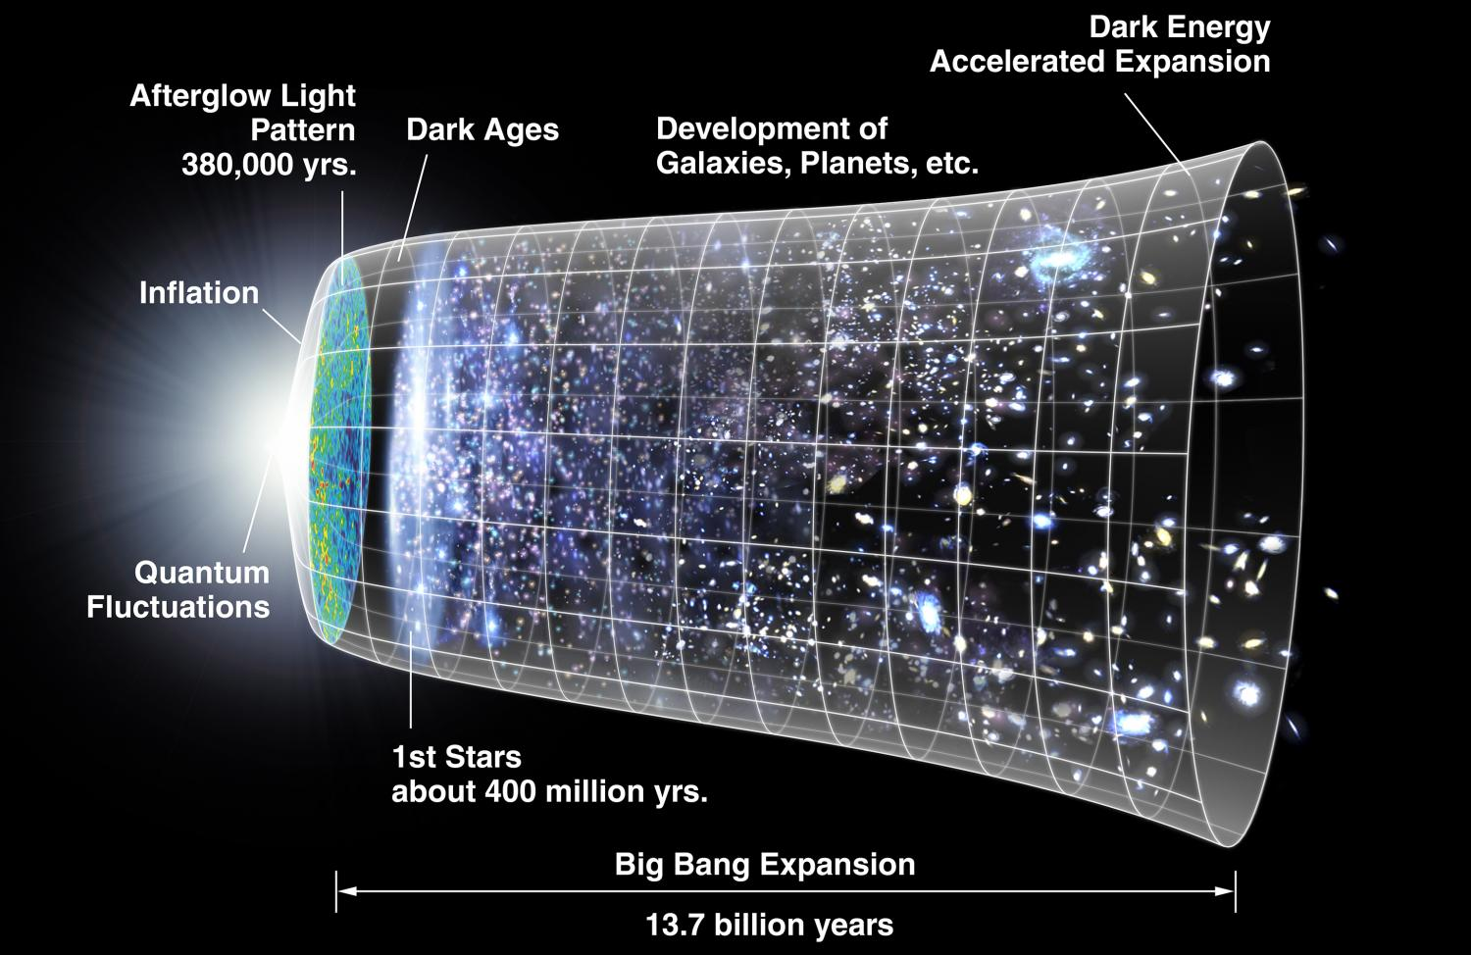
The Subject Matter:
An ambitious and audacious project.
Developed greatly over past decades
Ties galaxies with cosmic evolution. From << second to 14 billion years
Ties almost all branches of physics → theory → model → observations

Slide 3
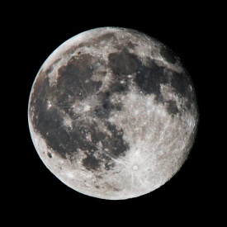
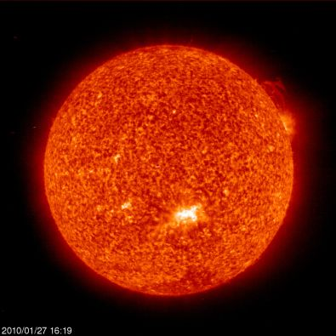
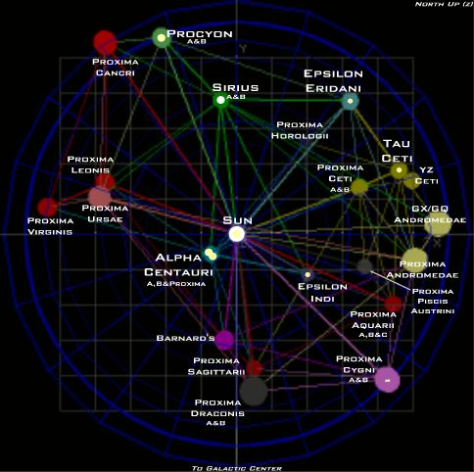
Cosmic Distance Scale
Earth-Moon ~ 1 light second
Earth-Sun ~ 8 light minutes
Nearest stars
>~ few light yrs ~ parsec

Slide 4
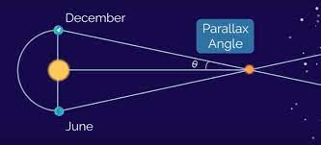
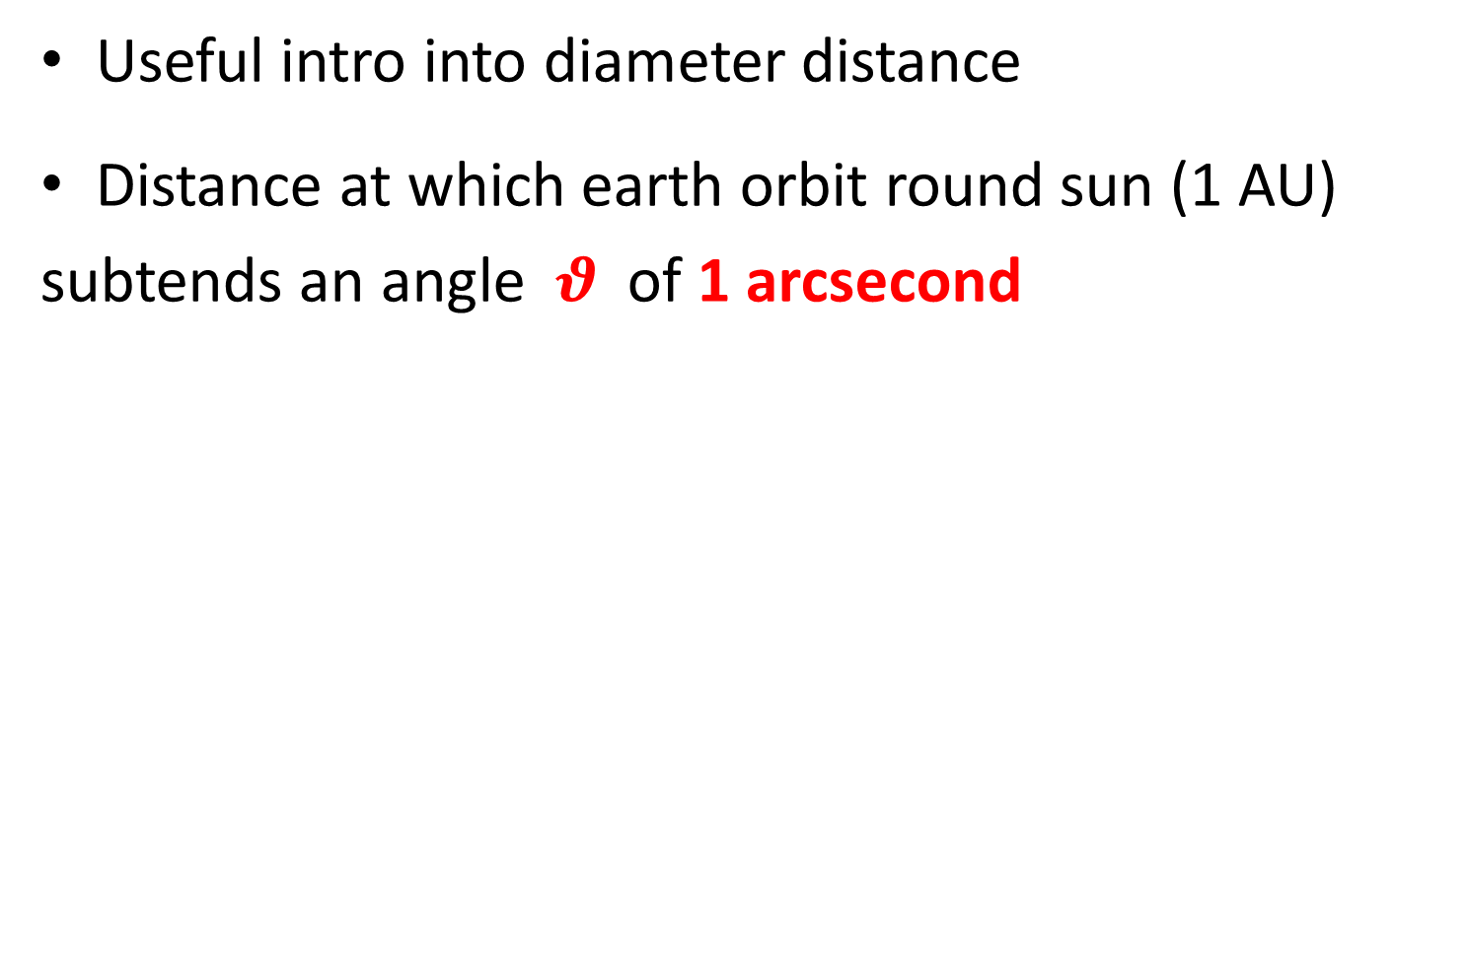
What is a parsec?
Useful intro into diameter distance
Distance at which earth orbit round sun (1 AU)
subtends an angle $θ$ of 1 arcsecond
parsec = pc
kpc = 1000 pc
Mpc = 1000 000 pc
Gpc = 1000 000 000 pc
Exercise: Find that 1 pc = 3.26 light year

Slide 5
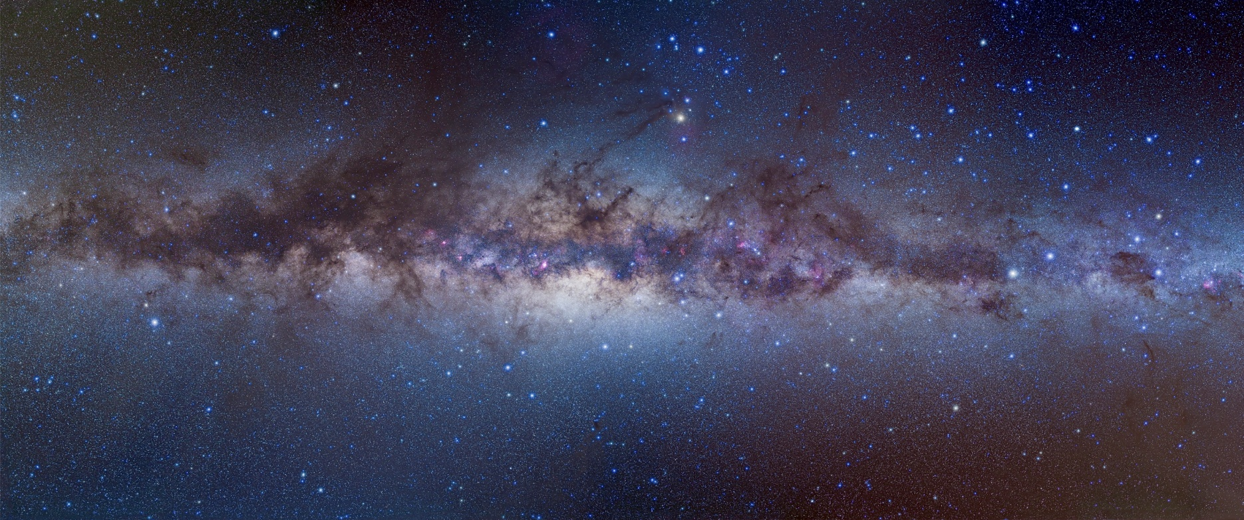
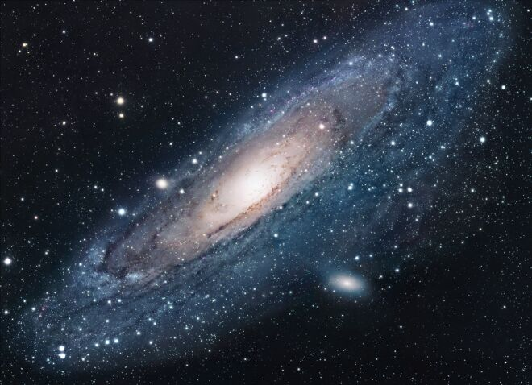
The Milky Way Galaxy
Distance from sun to centre ~ 25 000 light years (8 kpc)
Farthest individual stars seen by naked eye ~ 1000 light years

Slide 6
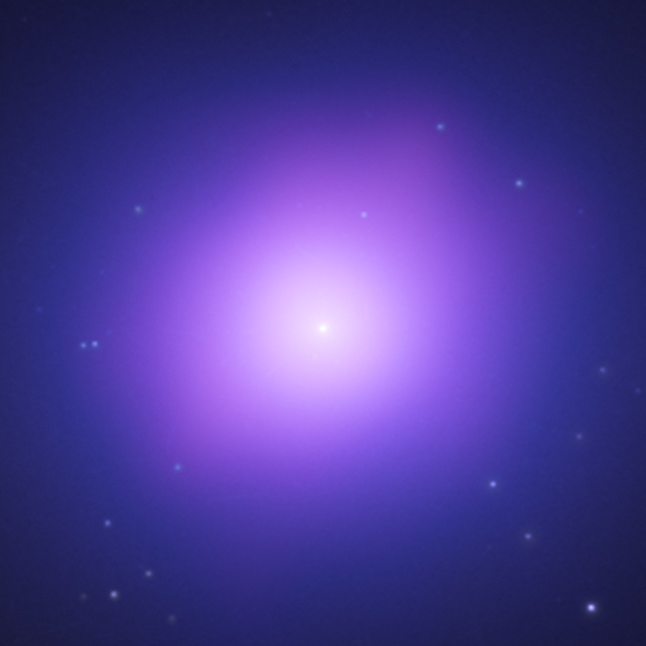
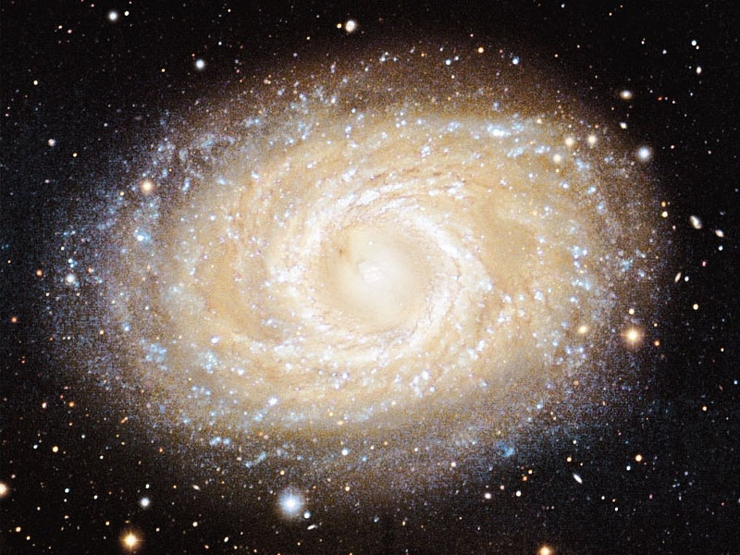
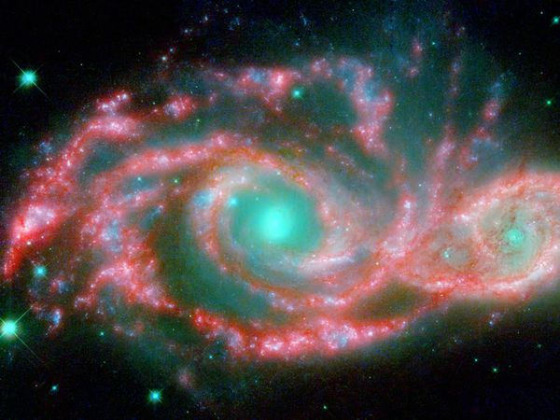
The (Local) Galaxy Population
Stars + Gas + Dust (+ Dark Matter)
May be disk or spheroid,; contain lots of gas or little; have active star formation or not. Some have quasars.
Random , ‘pressure’ support
Rotational support
→
Younger stars with heavy elements
Old and poor stars

Slide 7
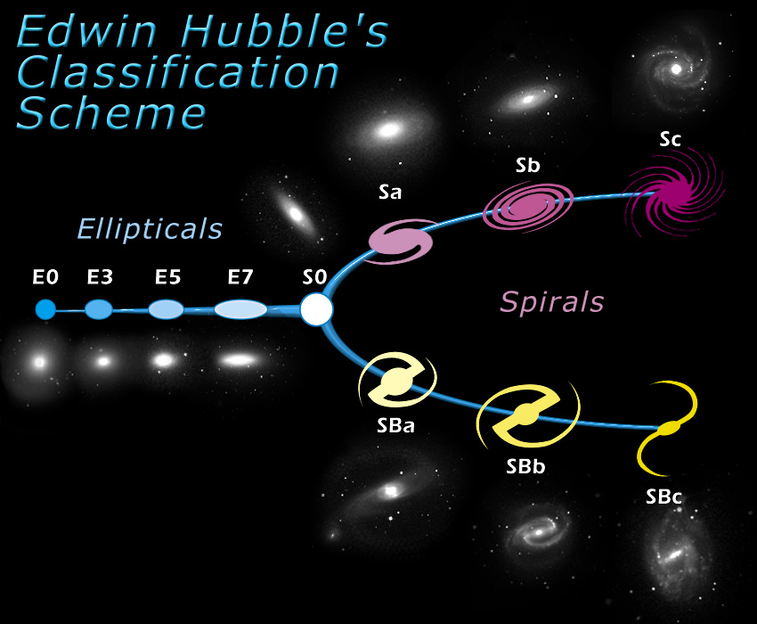
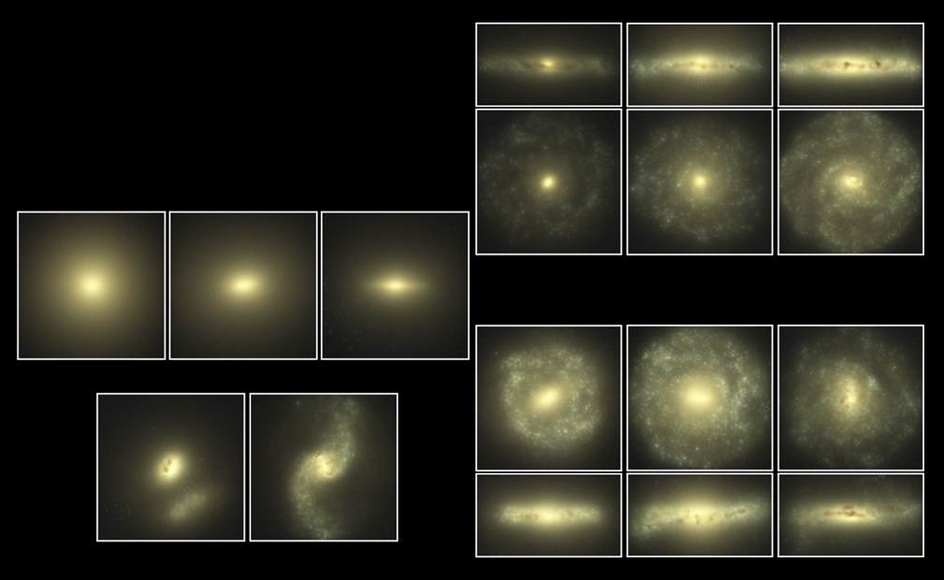
Hubble Sequence
Simulates sequence. After Eagle Simulation web page
After SDSS, Sky Server web page.

Slide 8
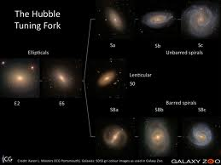
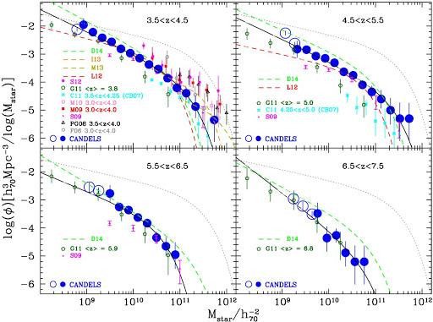
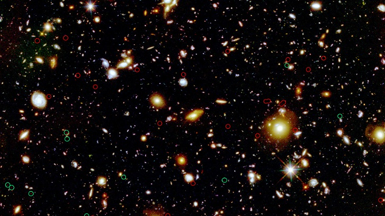
Need to Explain
Shapes, sizes, masses of galaxies
Distribution on sky
Content
evolution of above
→Early evolution of galaxy mass function
(Grazian et. al. 2015)
Within a cosmological model for the evolution of Universe! Using known laws of physics
Primordial Galaxies --- Hubble UDF

Slide 9
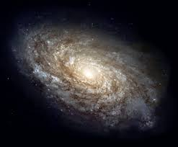
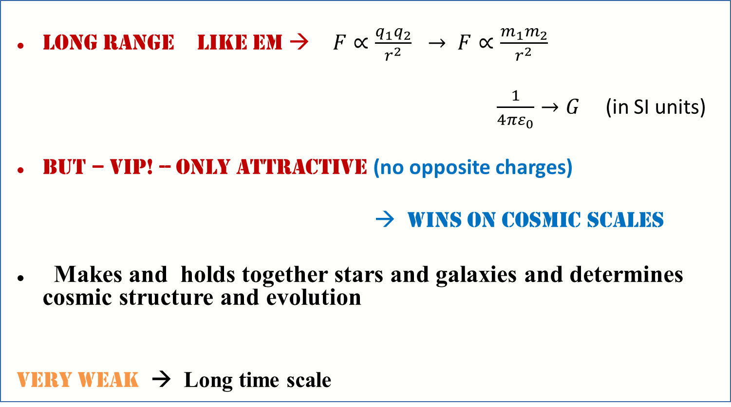
Gravity governs
Long range like EM → $F∝\frac{q_{1}q_{2}}{r^{2}} → F∝\frac{m_{1}m_{2}}{r^{2}}$
$\frac{1}{4πε_{0}}→G$ (in SI units)
But – vip! -- ONLY ATTRACTIVE (no opposite charges)
→ Wins on cosmic scales
Makes and holds together stars and galaxies and determines cosmic structure and evolution
very weak → Long time scale

Slide 10
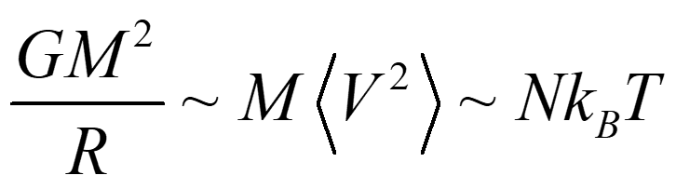
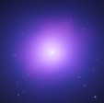
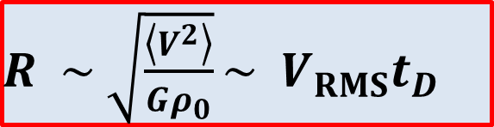

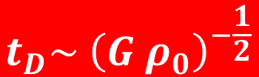
Dynamical Equilibrium and Characteristic Scales Determined by Gravity
With
$$M \sim ρ_{0 }R^{3}$$
$R \sim \sqrt{\frac{\left\langle V^{2}\right\rangle }{Gρ_{0}}}\sim { V}_{RMS}t_{D}$
The dynamical, or crossing, time is scale free →
$$t_{D}\sim {\left(G ρ_{0}\right)}^{−\frac{1}{2}}$$

Slide 11
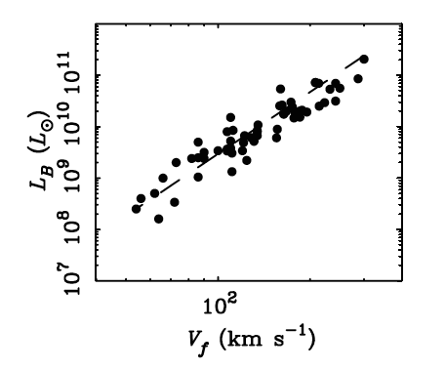
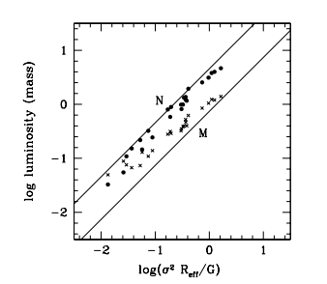
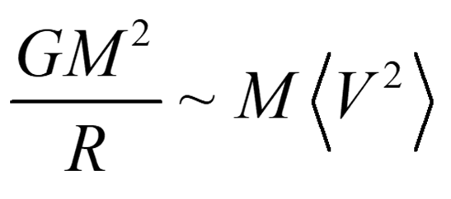
Scaling Relations (Tully Fischer and F and Fundamental Plane)
Rotation speed in spirals vs luminosities
Virial mass
Recall
After McGaugh (2005)
After Sanders 2010

Slide 12
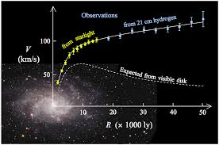
Galactic Characteristics
Average Density ~ 10⁻²⁴ kg/m³ (larger near centre)
Compare with 1 kg/m³ for air
Time scales ~100 million years; speeds ~10-100 km/s
Mass scale ~ 10⁷ to 10¹³ solar masses (thermally governed)
Most mass (particularly in outer regions) dark
Nearest large galaxy > Million light years ~ Mpc

Slide 13
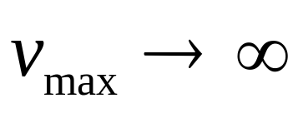
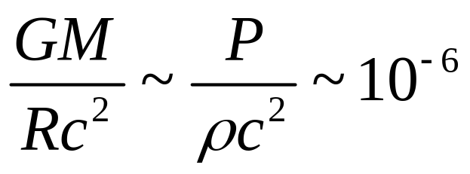
Galaxies are not Relativistic
By shrinking -- or increasing mass – pot. energy can become arbitrarily negative →
In GR → BH forms before ∞!
In practice , in galaxies,
Because: System fragments into stars before
cooling catastrophe complete → collisionless (no cool)
++ Dominant non-dissipative component?

Slide 14
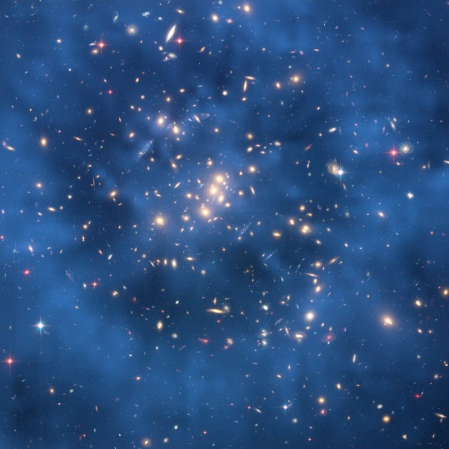
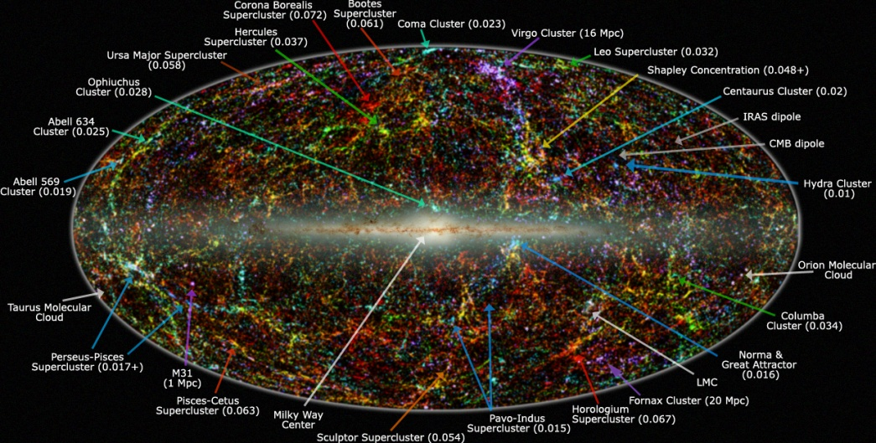
Larger scales
Clusters of galaxies
1-10 Million light years ~ Mpc →
Large scale structure
> few 100 Mil LY >~ 100 Mpc

Slide 15
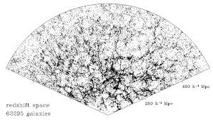
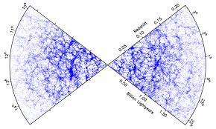
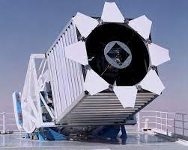
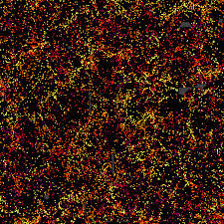
The Convergence to the Cosmological Principle
Large, ground-based surveys
2df, Sloan, 2mass, DES ++
Early deep survey COSMOS
Scoville et. al. (2006)
3Gpc^2 slice
Sloan Dedicated Telescope

Slide 16
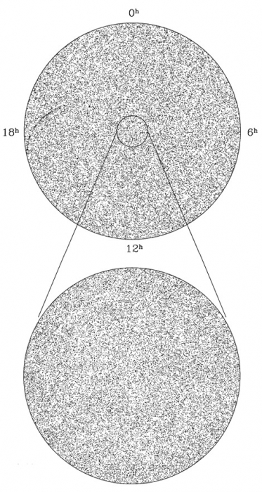
Convergence to the Cosmological Principle
All (northern) sky map of objects detected by radio telescopes.
Credit: Proceedings of the National Academy of Sciences of the United States of America

Slide 17
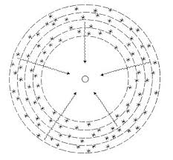
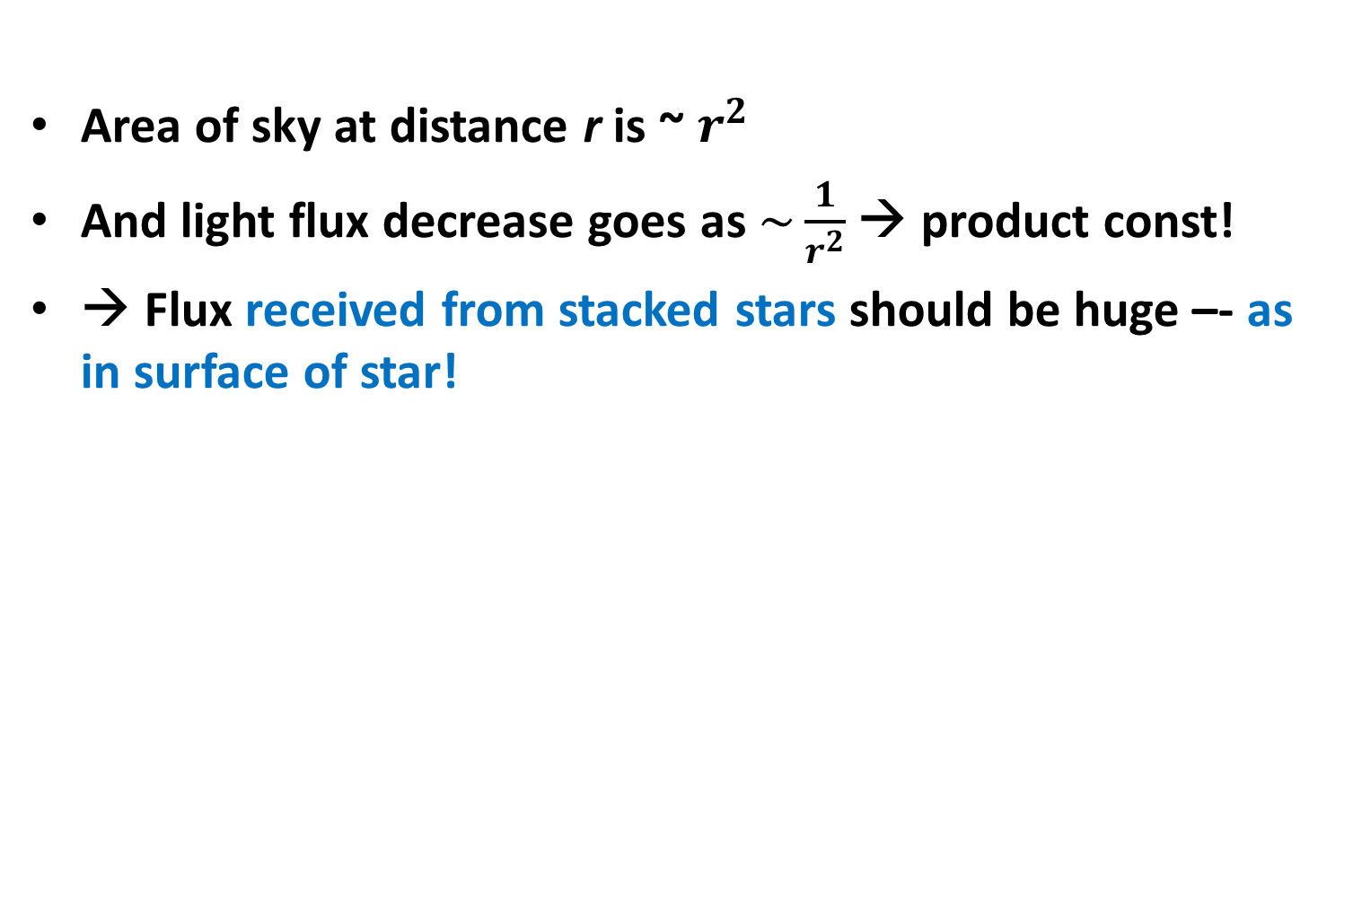
Why’s the Night Sky Dark?
Olber’s Paradox (from Kepler to Edgar Allan Poe!)
Area of sky at distance r is ~ $r^{2}$
And light flux decrease goes as $\sim \frac{1}{r^{2}}$ → product const!
→ Flux received from stacked stars should be huge –- as in surface of star!
But… Finite age and/or fast expansion → horizon

Slide 18
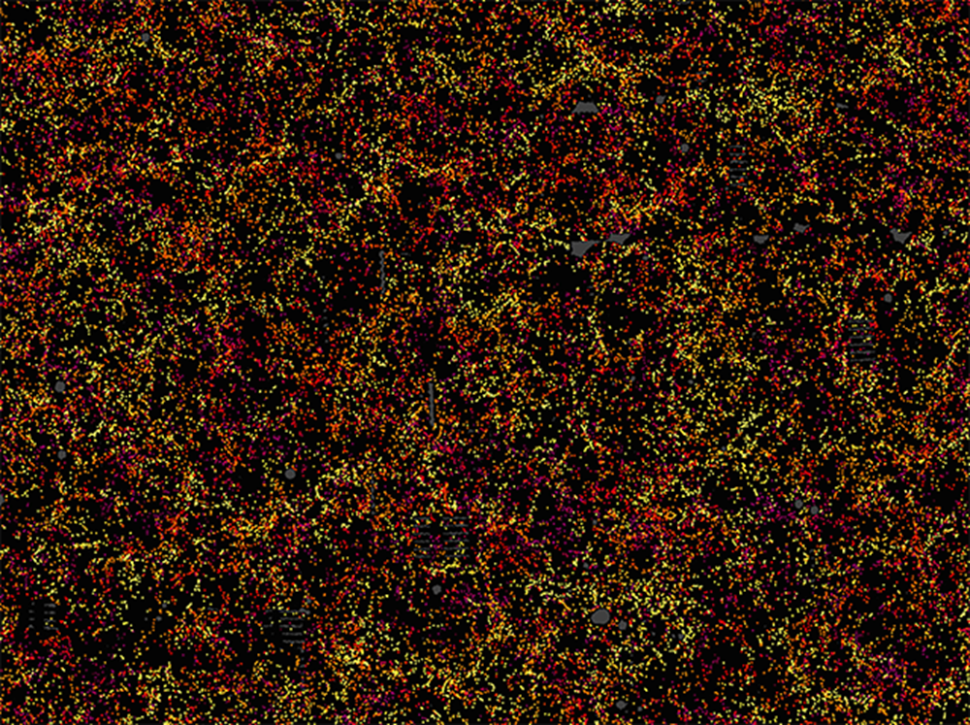
Newtonian Derivation of Cosmological Evolution Equations
Consider universe with uniform energy density
If scale large → need GR – Newtonian → instantaneous interaction (and v<<c)
→ Small patch → fast communication ++ small Vely
Homogeneity → all patches same.
Every point is a centre
→ SDSS

Slide 19
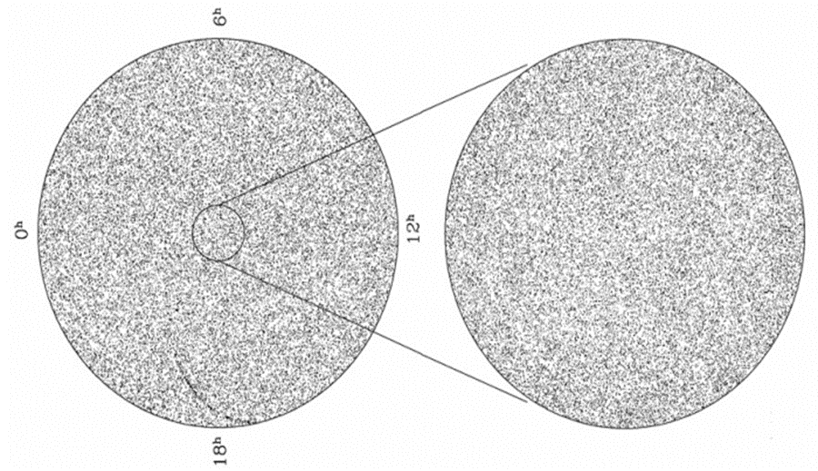

Newtonian Derivation Possible Because
Cosmological Principle: Homogeneity, isotropy
→ any point is a centre
Finite age → finite patch isolated
→ field does not cancel as in infinite universe
→ Patch can be taken as spherical
with radius smaller well inside communication radius
All patches expand (or contract) same way (scale free dynamics)
→ homogeneity, isotropy conserved
$$t_{D}\sim {\left(G ρ_{0}\right)}^{−\frac{1}{2}}$$
Effectively: imagine what we see came about thus→

Slide 20
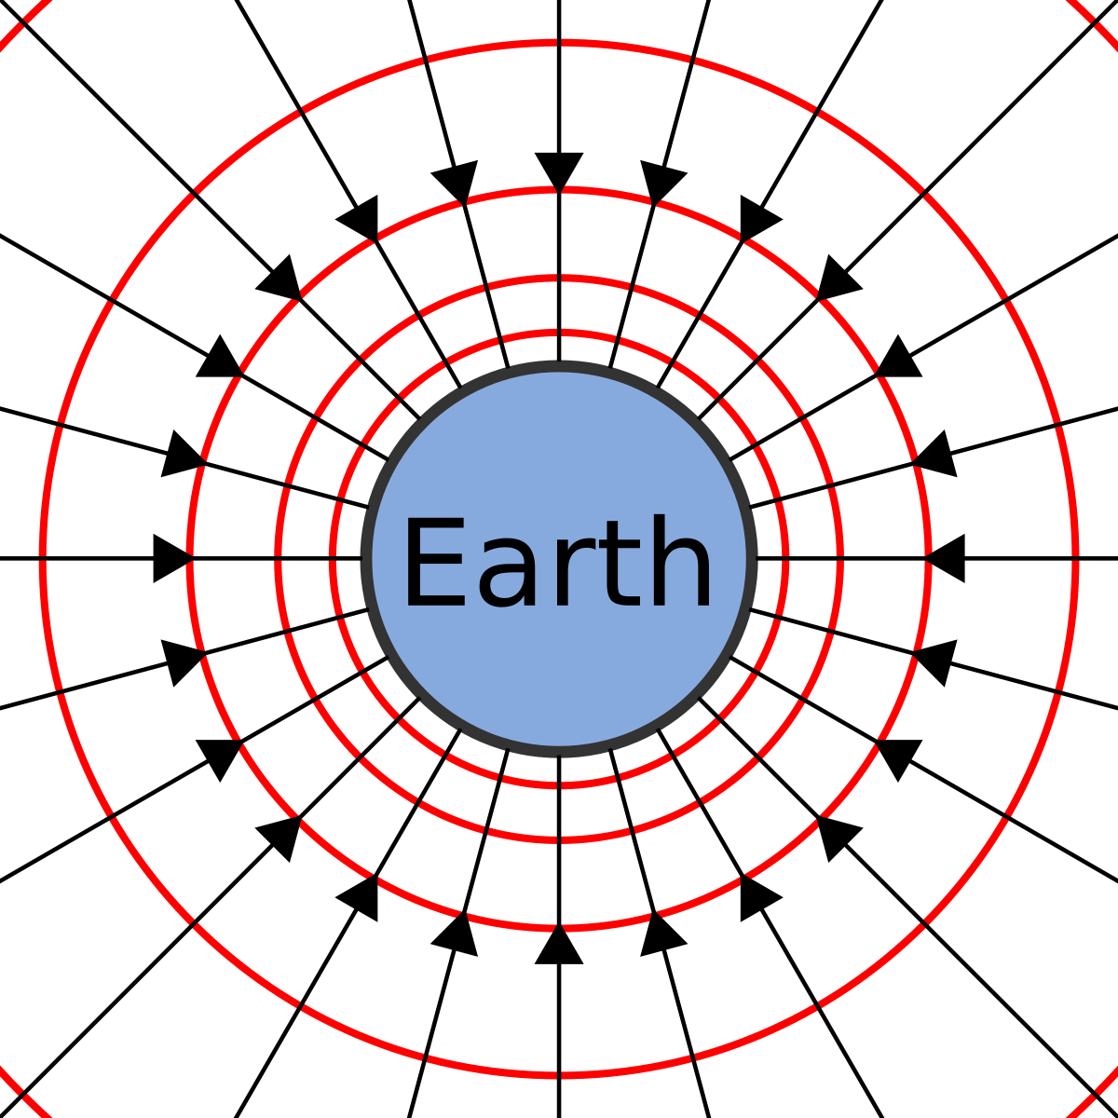
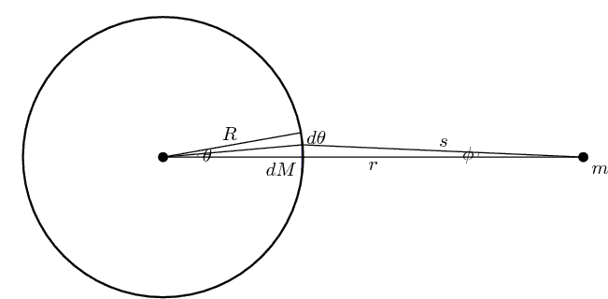
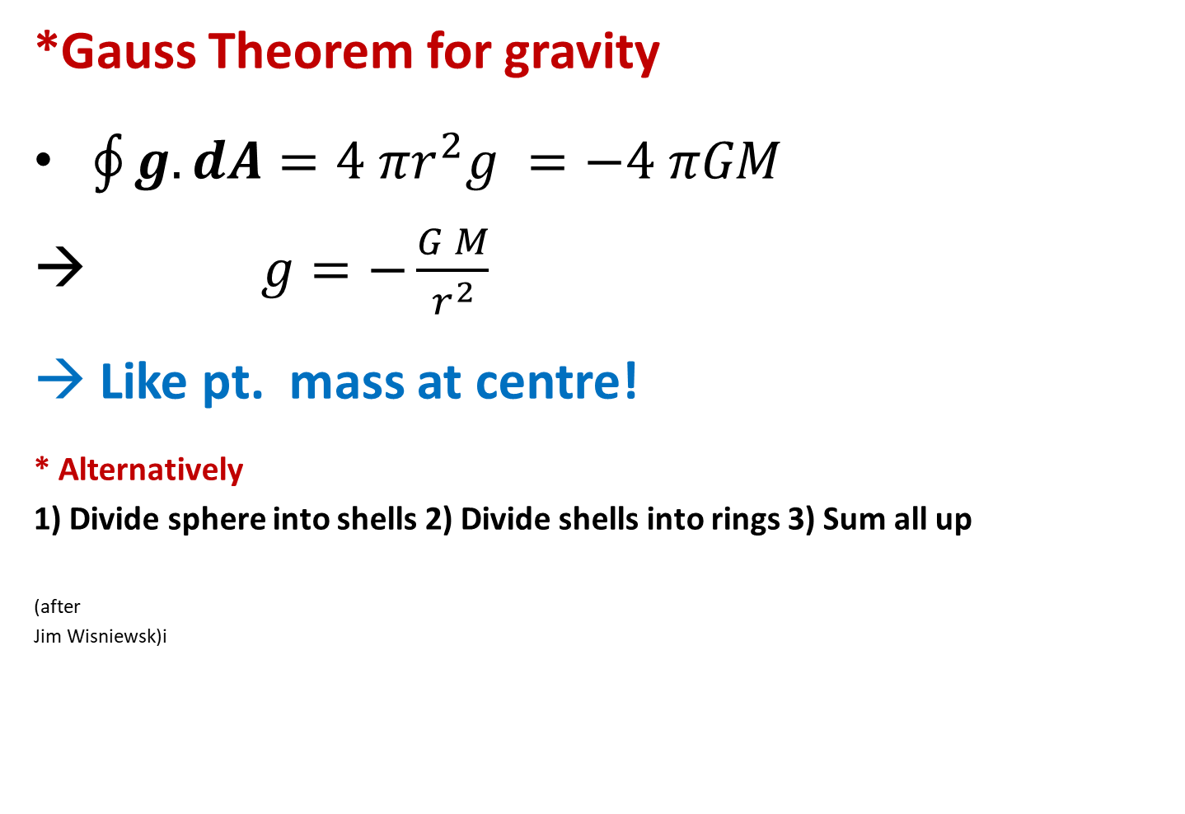
Gravitational Field on a Sphere
*Gauss Theorem for gravity
$\oint{g.dA=4 πr^{2}g =−4 πGM }$
$g=−\frac{G M}{r^{2}}$
Like pt. mass at centre!
* Alternatively
1) Divide sphere into shells 2) Divide shells into rings 3) Sum all up
(after
Jim Wisniewsk)i
Newton’s shell theorem →
each shell contributes like a point mass at its centre

Slide 21
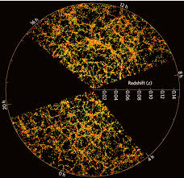
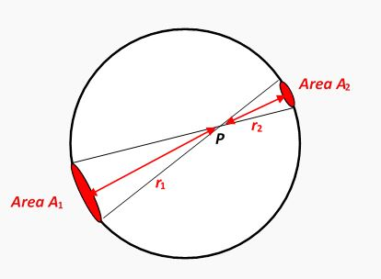
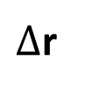
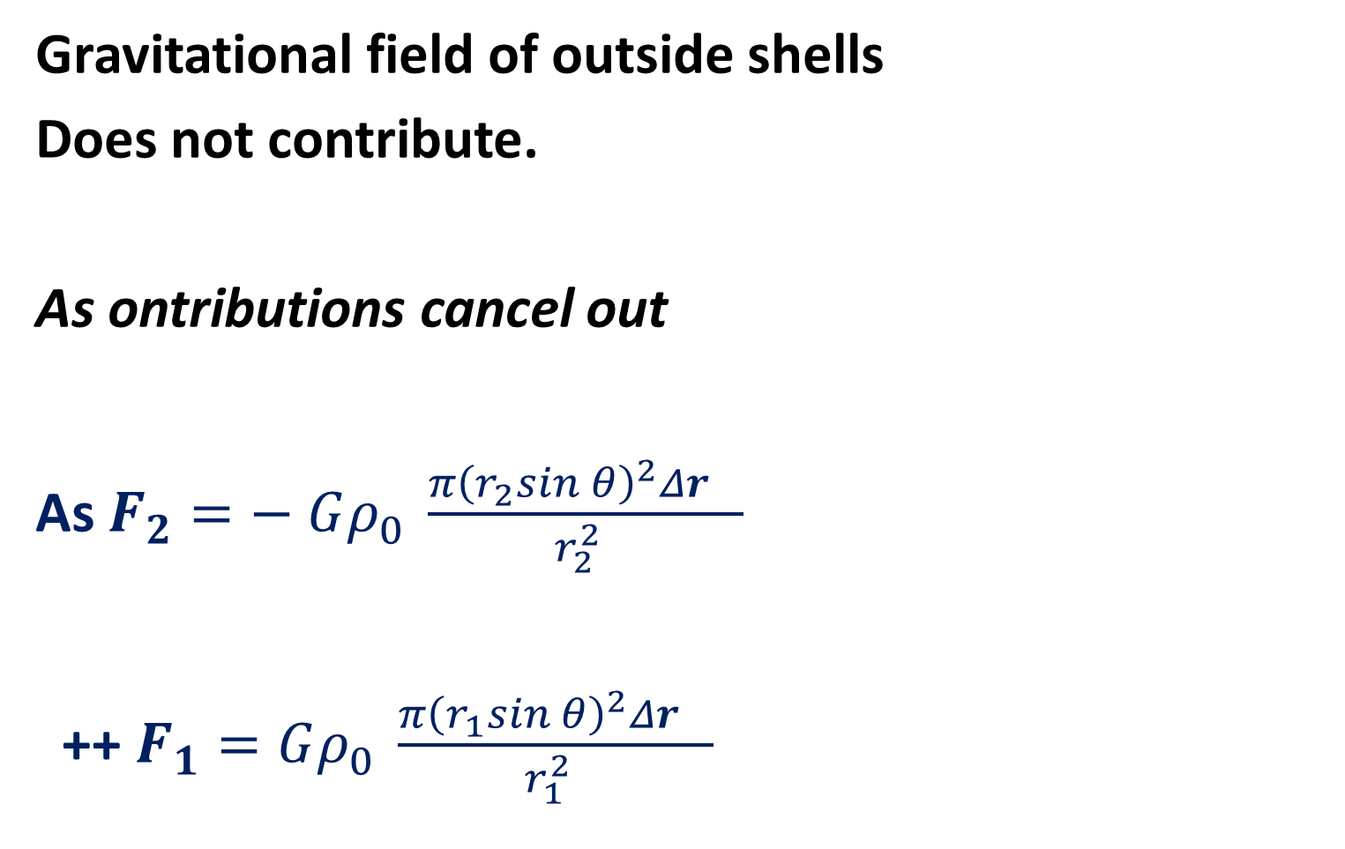




Newton-Birkhoff theorem
Gravitational field of outside shells
Does not contribute.
As ontributions cancel out
As $F_{2}=− Gρ_{0} \frac{π{\left(r_{2}sin θ\right)}^{2}Δr_{}}{r_{2}^{2 }}$
++ $F_{1}=Gρ_{0} \frac{π{\left(r_{1}sin θ\right)}^{2}Δr_{}}{r_{1}^{2 }}$
$$\sim r_{1}^{2}$$
$$θ$$
$$M$$
$Δ$r
$$\sim r_{2}^{2}$$

Slide 22
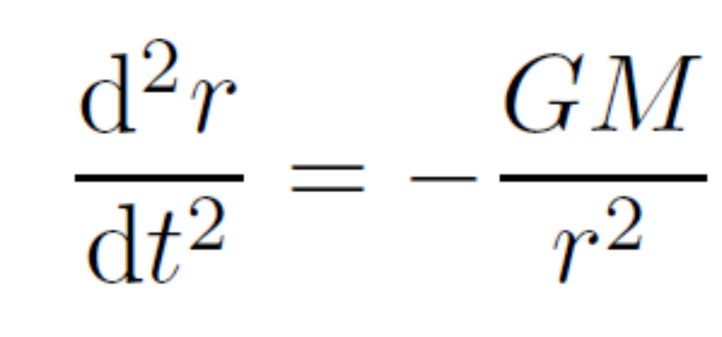


Equation of motion
With M = M (< r) …enclosed!
$$\sim r_{2}^{2}$$
r
$$M$$
$$\sim r_{1}^{2}$$

Slide 23
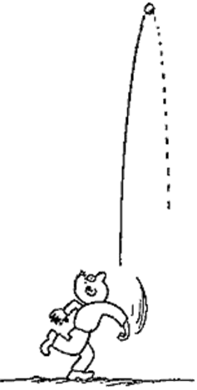
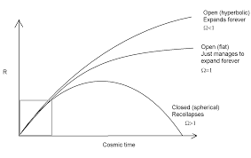
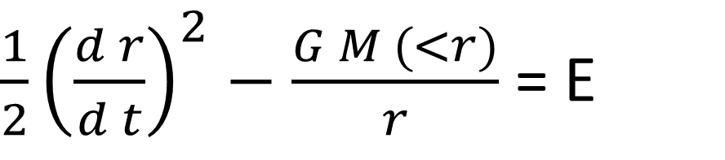
Energy Integral and simple interpretation
Integrate, keeping enclosed mass constant
‘Energy’ E → universe forever expands (E>0 or recontracts (E<0)
No static solutions
→ Like a ball thrown up!
$\frac{1}{2}{\left(\frac{d r}{d t}\right)}^{2}−\frac{G M (<r)}{r}$ = E
Exercise: use above equation, with E =0, to derive ‘typical timescale’ of evolution.
What do you notice? Hint: again depends only on density

Slide 24



All patches expand (or contract) same way (scale free dynamics)
→ homogeneity, isotropy conserved
More prcisiely manifest in following: Let $r={ R}_{s} a\left(t\right)$
$$t_{D}\sim {\left(G ρ\right)}^{−\frac{1}{2}}$$
$$\frac{1}{2}{\left(\frac{d r}{d t}\right)}^{2}−\frac{G M \left(<r\right)}{r}=E$$
Assume normal matter (density ~ 1/V)
$→ {\dot{a}}^{2} −\frac{8π G}{3} ρ a^{2}= \frac{2 E}{R^{2}}$
→ A const for all self similar expanding spheres!
Effectively: imagine what we see came about thus→

Slide 25





Hubble Time
$$\dot{a}t_{H}=a, { t}_{H}=H_{}^{−1}$$
$$H=\frac{d\ln{a}}{d t}$$
Exercise: Check that for Hubble const of 71 km/s/Mpc, the Hubble time is a bit less than 14 Gyr
Hubble sphere radius →
d $≪D_{H}$ → (communication time faster than expansion time)
$${{ D}_{H}=c H}_{}^{−1}$$

Slide 26




Energy, Momentum and Pressure
${ ∇}^{2}φ=4 π G ρ$ (Poisson Eq. for e.g. mass density of galaxies)
Relativistic analogue needs to include momenta
-- as in -- and also $ρ → γ^{2}ρ$
$T^{αβ}= ρ \left\langle U^{α} U^{β}\right\rangle$ may do (U’s, 4-velys -- incl. c=1)
Anisotropic momentum fluxes
Recall that hydro stress $\sim ρ \left\langle v_{i}v_{j}\right\rangle with \left(i, j=1,3\right)$

Slide 27


From Wayward Ball to Cosmological Fluid: Friedmann Equations
- By Symmetry → No cross terms (anisotropic momentum fluxes) ++
No streaming (mass) motions -- $\left\langle v_{i}\right\rangle =0.$
→ left with isotropic pressure terms (trace of space part) + density
→ Only energy and pressure contribute
++ Weak field/small patch (quasi-static)
→ $M= ρ^{′}r^{3}$→
${ → ∇}^{2}φ=4 π G ρ → 4 π G (ρ +3 p/c^{2}$)

Slide 28

Notes regarding pressure
Its effect is unlike hydro pressure force.
The latter comes from gradient, while in Friedmann universes $∇p=0.$
It comes from its mass equivalence
Hence attractive if +ve and repulsive when –ve
As it enters through a term $\frac{P}{c^{2}}\sim \frac{ρv^{2}}{c^{2}}+ρ$
→ important only for particles if relativistic

Slide 29








Energy Integral with Pressure
(when $ρ ≉1/a^{3}$)
$${\dot{a}}^{2} −\frac{8π G}{3} ρ a^{2}=Const \left(=\frac{2 E}{R^{2}} \right)$$
Note: Newtonian E diverges as one considers ‘universes’ of increasing size outside our patch
Note: E here will have dimension of energy if scale factor non-dimensional, and R a distance$]$

Slide 30

The Metric I:
Space time decomposition
Homogeneous Universe →
Observers synchronize clocks
fundamental observers count same proper time
(cf. also Peebles Sec. I.4)
Defined, e.g., in terms of the homogeneous density
$d s^{2}=−c^{2}d t^{2}+a^{2}\left(t\right) d l^{2}$
At proper time t, the proper distance is $a \left(t\right)l$

Slide 31




The Metric II
The Static (closed) Space Metric
Choose four dim. Spherical coordinates:
Line element on surface of sphere
→ Take differentials and square them
R = const defines surface of 3-sphere
$R\sin{χ}$ defines radius of 2-subsphere
Exercise
++ -ve curvature
$$d l^{2}$$

Slide 32










Thus one can write,
or
$$d l^{2}$$
$d l^{2}=$
Or, more compactly
$$R χ$$
$$d l^{2}=R^{2} d χ^{2}+r^{2}d Ω^{2}$$
r $θ$
R
Note:
1- $R χ$ is a geodesic distance
2- $r θ$ is an arclength on sub-sphere (circle on fig.)
3- $r^{2}d Ω^{2}$is an area: arc(theta-circle^2)^2 + arc(phi-circle)^2)
After Mo, van den Bosch & White

Slide 33






Adding Expansion and Time
$$d s^{2}={−c^{2}d t^{2}+a^{2}\left(t\right) [R}^{2} d χ^{2}+r^{2}d Ω^{2}]$$
R a is radius of curvature
→ Ricci scalar ~ ${\left(R a\right)}^{−2}$
Conventions: i) $k=−\frac{1}{R^{2}},0,+ \frac{1}{R^{2}}$→ r has length unit → a is dimensionless (with $a_{0}=1)$
ii) k = -1, 0, + 1 → r is dimensionless → R = 1 → a has length unit
Positive Curvature →
$$r=R\sin{χ}$$
Negative curvature →
$$r=R\sinh{χ}$$
$$r= R χ$$
Flat (zero curvature)

Slide 34








Evolution in GR (maximally symmetric spaces)
FRW Metric
Metric tensor
Field equations
Ricci tensor
$$R_{00}=−\frac{3}{c^{2}}\ddot{\frac{a}{a}}$$
Stress tensor
$$T_{00}=ρc^{2}, { T}_{ij}=p g_{ij}$$
$$R_{ij}\left(static \right)=2\frac{k}{a^{2}} g_{ij}, R\left(space\right)=\frac{6k}{a^{2}}$$
${\dot{a}}^{2} −\frac{8π G ρ}{3} a^{2}= \frac{2 E}{R^{2}}$

Slide 35






Geometry and Density
$$H^{2 }≡$$
If k = 0 flat space
Define
What starts critical, $Ω= 1,$stays so. Same for $Ω$ >1 or < 1

Slide 36





Measuring curvature?
Fixing at ‘now’:
→ $k=\frac{H_{0}^{2} }{c^{2}} \left(Ω_{0} −1\right)$
$$Ω_{0}=\frac{8 π Gρ_{0}}{3H_{0}^{2} }$$
$$v ≃H_{0} d$$
Local Hubble parameter obtainable from observations.
In times (long) past people also looked for
current total density directly

Slide 37


Evolution of Friedmann Universes
To solve equation → need $ρ= ρ \left(a\right)$.
‘Heuristically’, we have (for standard cosmology):
Matter → $ρ_{M}\sim a^{−3}$
Radiation → $ρ_{R}\sim a^{−4}$
Cosmological constant → $ρ_{Λ}=const.$

Slide 38








Using conservation law
Assume eq. of state
Then
$$p=0$$
$$p=\frac{1}{3}ρ c^{2}$$
$p=− ρ{ c}^{2}$

Slide 39




Our understanding → universe went through the following phases
1- Vacuum domination and vast exponential expansion (‘inflation’)
2- Radiation domination
3- Matter radiation
4- ‘Recent’ vacuum domination (again)
Note:
Early universe
→ Necessarily nearly critical!
for ‘normal’ components
As $ρ\sim a^{−3}, a^{−4}≫k a^{−2}$
Evolution in spatially flat, k= 0, universe

Slide 40
Need to Reealat a(t) to Observables
To determine:
Contents, expansion rate, age of the universe

Slide 41





Conformal Time and Comoving Distance
In terms of conformal time
Metric
Comoving distance
between ‘us’ (at $t=t_{0}$) and light (ds = 0) emitted at time t:
→
$$d s^{2}={−c^{2}d t^{2}+a^{2}\left(t\right) [R}^{2} d χ^{2}+r^{2}d Ω^{2}]$$
$$d s^{2}={a^{2}(τ) [− d τ^{2}+R}^{2} d χ^{2}+r^{2}d Ω^{2}]$$
$$D_{C}=R$$
A geodesic distance;
not directly measurable

Slide 42

Horizons
Hubble Sphere ${{ D}_{H}=c H}_{}^{−1}$
Particle horizons: Light emitted at time past and probed at future time $t_{f},$covers commoving distance:
$$D_{C}=c\int_{t_{e}}^{t_{f}}{\frac{dt^{′}}{a\left(t^{′}\right)}}$$
Converges at lower limit → some past events can’t be observed at $t_{f}$ particle horizon→ $t_{e}→0, and t_{f}=t_{0}$
Farthest we can see… ~ 14 Gpc comoving.
Converges at upper limit → current events cannot be seen in future → ‘event horizon’ with ${t_{e }= t}_{0}$and $t_{f }→ ∞$

Slide 43






Distances: with (almost) everything in it
and ${ ρ}_{c0}=\frac{3H_{0}^{2}}{8πG}; Ω_{M0} =\frac{ρ_{M0}}{ρ_{c0}} etc…$
($D_{H}=\frac{c}{H_{0}}, { \frac{da}{dt}=aH, Ω}_{K0}=Ω_{0} −1$)
$$H^{2}=$$
(exercise)

Slide 44

To Compare with Data
Need scale factor a function of an observable
Also need to relate comoving distance $D_{C}$ to observables

Slide 45




Measuring Redshifts
Light from galaxies redshifted
Nobel 2011 → acceleration!

Slide 46









To begin Fixing our Model:
Expansion→ Redshift → Hubble diagram
$$t=t_{1} →→→ t_{0}$$
$\dot{z }$= - $\frac{\dot{a} a_{0}}{a^{2}}$, $\dot{z_{0}}=\text{−} \frac{{\dot{a}}_{0}}{a_{0}^{}}=H_{0}$
$→$
$$H_{0}d ≃c z$$
Hubble Constant usually expressed in km/s/Mpc

Slide 47




Bit more formal route:
Expansion→ Redshift
$$τ \left(t_{0}\right) − τ \left(t_{1}\right)=D_{C} → (invariant)$$
$$t=t_{1} →→→ t_{0}$$
$$→ δ \left[τ \left(t_{0}\right)\right]− δ \left[τ \left(t_{1}\right)\right]=0$$
Frequencies proportional to time intervals →

Slide 48


Distances: Angular and Luminosity
In flat static space: Object of physical size D has angular extension $δθ$if it is at distance $D_{A}$:
$$D=D_{A }δθ$$
In flat static space luminosity of object follows inverse square law. The luminosity distance is defined in terms of the intrinsic luminosity L (energy emitted per second) as,
$D_{L}$ here is just the regular Euclidean distance
F the observed flux (energy reconceived per second)
Assumed transparent medium

Slide 49




Angular dist. in cosmological context
Objects of proper length D
Emitting at a (t)
with angular scale $dθ$
Such that
~ R $χ$ > r
D
R
$$D=a\left(t\right) r dθ=D_{A} dθ$$
$$→D_{A}=r/(1+z)$$
Known object size + angle on sky → D_A ++ compare r from model, given z

Slide 50



Cosmological Luminosity Distance
Recall
Distance squared multiplying angle ${ a\left(t\right) r}^{2}d Ω,$ → area element
Light reaches us at $a_{0}=1, from dist r on a sphere with area$ $4 π r^{2}$
As before
Two further effects:
i) Photons are redshifted (less energetic)
Ii) Rate at which they arrive is smaller
Both by factors 1/ (1+z)
${ D}_{L}= r \left(1+z\right) = D_{A}{\left(1+z\right)}^{2}$
(if convention with dimensional scale factor a is used there’s an extra factor of $a \left(t_{0}\right)=a_{0})$
$$d s^{2}={−c^{2}d t^{2}+a^{2}\left(t\right) [R}^{2} d χ^{2}+r^{2}d Ω]$$

Slide 51





Theoretical Expectation
$$D_{L}= r \left(1+z\right)$$
$χ=\frac{D_{C}}{R}$
Use $a=\frac{1}{1+z}$ and assume late universe (matter domination)
$D_{C}= D_{H} \int_{0}^{z}{\frac{d z }{{\left[\left(Ω_{M}{\left(1+z\right)}^{3}+Ω_{Λ}+(Ω_{0}−1\right){\left(1+z\right)}^{2}\right]}^{\frac{1}{2}}}{ (Ω}_{0}= Ω_{M}+ Ω_{Λ})}$
$k=\frac{H_{0}^{2} }{c^{2}} \left(Ω_{0} −1\right) → R=D_{H}/\sqrt{Ω_{0 }−1}$
Fixes luminosity distance at redshift z:
given Hubble constant, matter and cosmological constant content
$$;{ D}_{H}=cH_{0}^{−1}$$

Slide 52
Brief interlude
A few phenomena actually used in distance measurements… a definition and a couple of steps on the cosmological distance scale.

Slide 53



Calibrating distances: Parallaxes and Cepheids

Slide 54




Magnitudes: from Ptolemy of Alexandria and Distance Modulus (m –M)
Classified stars from (apparent) brightest 1st to least bright 6th
Magnitude gets smaller for brighter objects
Defines a logscale (eye response to light logarithmic)
For historical reasons (see Weinberg and refs there.. Or Wiki!)
$M \left(0bject\right) −M \left(Sun\right)= −2.5\log_{10}{ \frac{L\left(object\right)}{L\left(Sun\right)}}$
Apparent bolometric magnitudes m and absolute M (above; def. at 10 pc) are related by
$$D_{L}$$

Slide 55



Fixing Intrinsic Luminosity at > Gpc: Supernovae 1A
Galaxy Rotation
(Tully-Fisher Relation)
M (visual, Sun) ) ~ 5
After Tom Andersen
Ongoing progress at high z…
After Riess et. al.

Slide 56


A higher z Hubble diagram
Contents → Dynamical History → Which model?
After Andrew Hamilton
Redshift

Slide 57


Late Univ. →
${ D}_{C} = D_{H} \int_{0}^{z}{\frac{d z }{{\left[\left(Ω_{M}{\left(1+z\right)}^{3}+Ω_{Λ}+(Ω_{0}−1\right){\left(1+z\right)}^{2}\right]}^{\frac{1}{2}}} }$
For z < 1 and ~ flat universe
$$D_{C}=D_{H} z \left[1 −\frac{3}{4} Ω_{M} z+… \right]$$
$${ D}_{L}= r \left(1+z\right) ≃ D_{H} z \left(1+z\right) \left[1 −\frac{3}{4} Ω_{M}z\right]$$
$D_{L}\left(z<1\right)=D_{H} z \left[1 + \left(1−\frac{3}{4}Ω_{M}\right)z + O (z^{2})\right]$
$$Ω_{R} small$$

Slide 58



Comparing (flat) FRW universes
(and Milne’s empty universe)
Exponentially inflating $Ω_{Λ}=1, { Ω}_{M}=0$
Old ‘standard’ CDM $Ω_{Λ}=0, { Ω}_{M}=1$
Lambda-CDM ${ Ω}_{Λ}=0.7, Ω_{M}=0.3$
After Andrew Hamilton (CU, Boulder),
From compilation of survey data, as
tabulated by Scolnic et al. 2018.
$$D_{L}\left(z<1\right)=D_{H} z \left[1 + \left(1−\frac{3}{4}Ω_{M}\right)z + O (z^{2})\right]$$

Slide 59

Expansion and its Acceleration:
Dark Energy and Dark Matter
Current acceleration → Dark energy
Past deceleration rate →
Dark matter

Slide 60


Fluctuations → seeding structure → providing verification
Coming talks

Slide 61





Modelling Structure Formation with CDM simulation
** Cosmic Microwave Background 400 000 yrs
**Present Galaxy Distribution (~14 Gyr)

Slide 62







Probing wider, deeper → stringent tests
WFIRST-Roman
LSST -Rubin2023
Euclid 2021
Caltech 30 m Telescope 2027
James Webb Space Telescope NOW
Extremely Large Telescope 2024
Square Kilometer Array
‘1st light’ 2020, completion 2030
Gaia, 2018

Slide 63




Gravitational Wave Astronomy (Nobel 2017)
An exciting nascent field → New window!
GW’s Result from cataclysmic cosmic events
→ ex. black hole or neutron star merger
Supermassive BH’s are also expected in centres
Play important role in structure formation

Slide 64



Next Generation CMB
(polarizations and spectral distortions)
Polarization – primordial gravity waves
QUBIC, ground based ++BICEP etc

Slide 65





Local Form of Coordinate Distance
Expand scale factor around local value:
‘Deceleration’ parameter
Expand r to get (note the flat space approximation emerges; technically should divide both sides of eq. by 1/R then expand, then multiply again. Assume $a_{0}=1$)
\ $c \left(t−t_{0}\right)+c H_{0}^{}\frac{{\left(t_{0}−t\right)}^{2}}{2}+ …=r+ …$
Then (exercise) →
$$r$$

Slide 66


Why’s the Night Sky Dark?
Olber’s Paradox (from Kepler to Edgar Allan Poe!)
Take any solid angle in sky
Area subtended at distance r is ~ $r^{2}$
And flux decrease goes as $\sim \frac{1}{r^{2}}$ → product const!
So flux received from stacked system of stars should be huge – at least as in surface of star!
Poe → Finite age. Good but what about radiation from hot big bang?

